Slide 1

Economies and Dairy markets
Report presented at
Milk SA General Meeting of Members
1December 2021
Prepared by B van Heerden and assisted by the MSA Industry Information Work Group
November 2021

Slide 2
Overview
International economy
International dairy situation
SA economic situation
SA dairy situation

Slide 3
International economy
International dairy situation
SA economic situation
SA dairy situation

Slide 4
Global economic growth and expected growth
2010 – 2022
Source: IMF WEO update October 2021 ** Projection

Slide 5
FAO food price indices
Jan 2012 – Oct 2021
Source: FAO, October 2021

Slide 6
International economy
International dairy situation
SA economic situation
SA dairy situation

Slide 7
International prices of dairy products
Jan 2012 – Oct 2021
US$/ton
Rand/ton
Source: USDA, Reserve Bank

Slide 8
GlobalDairytrade® Auction Sale price index of dairy products,
Jan 2010 – Nov 2021 (Nov 1 reading)
Source: GDT Index

Slide 9
Average European producer price trends of unprocessed milk, Jan 2018 – Oct 2021
Source: European Commissiom (Oct 2021 estimate)

Slide 10
Average EU, Poland and SA producer prices of unprocessed milk, Jan 2018 – Oct 2021
R/L
Source: EU Commission; MPO (Sept and Oct 2021 preliminary)

Slide 11
International economy
International dairy situation
SA economic situation
SA dairy situation

Slide 12
Annual SA economic growth ( non annualized)
2018 – 2021 (Q2)
Source: Stats SA

Slide 13
Retail sales growth (%) at constant 2015 prices
Jan 2011 – September 2021
Source: Stats SA.

Slide 14
Consumer price inflation
Jan 2010 – Sept 2021
Source: Stats SA

Slide 15
International economy
International dairy situation
SA economic situation
SA dairy situation

Slide 16
.
Producer, processor and retail price indices, Jan 2012 – Sept 2021
Source: Stats SA

Slide 17
CHANGES IN THE QUANTITIES OF RETAIL SALES OF SPECIFIC DAIRY PRODUCTS
PRODUCT | Sales in the month of June 2021 versus the sales in the month of June 2020 | Sales in the 3 months from April 2021 to June 2021 versus the sales in the 3 months from April 2020 to June 2020 | Sales in the 6 months from January 2021 to June 2021 versus the sales in the 6 months from January 2020 to June 2020 | Sales in the 9 months from October 2020 to June 2021 versus the sales in the 9 months from October 2019 to June 2020 | Sales in the 12 months from July 2020 to June 2021 versus the sales in the 12 months from July 2019 to June 2020
 | percent |  | percent |  | percent
Fresh Milk | -2.4 | -4.2 | -6.2 | -7.3 | -7.7
UHT milk | -3.6 | -15.0 | -10.8 | -6.2 | -3.5
Flavoured milk | 7.0 | 6.2 | 3.2 | -2.1 | -6.1
Yoghurt | -5.1 | -7.2 | -3.4 | 0.5 | 1.7
Maas | -7.4 | -7.4 | -5.3 | -2.4 | -1.3
Pre-packaged cheese | 4.5 | -6.2 | -3.6 | 0.6 | 2.8
Cream cheese | -9.0 | -13.2 | -7.1 | -4.9 | -3.9
Butter | 0.5 | -16.8 | -5.4 | -3.1 | 0.4
Cream | -7.0 | -13.3 | -2.5 | 1.0 | 4.1
Source: SAMPRO based on Nielsen report

Slide 18
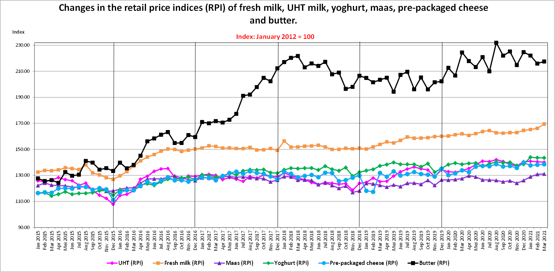
.
THE RETAIL PRICE INDICES (RPI) OF SPECIFIC DAIRY PRODUCTS, FROM JANUARY 2015 TO MARCH 2021
Graph prepared by the Office of SAMPRO based on the results of surveys by “NielsenIQ”.
Non-retail sales such as sales to industrial buyers, are not part of the surveys.

Slide 19
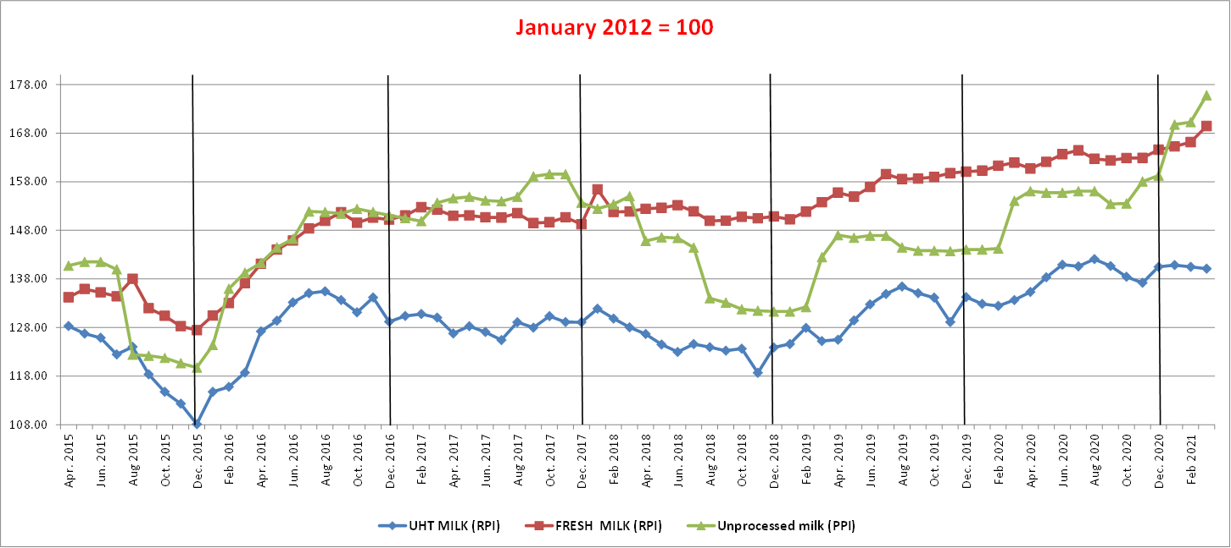
.
THE PRODUCER PRICE INDEX (PPI) OF UNPROCESSED MILK, FROM JANUARY 2015 TO MARCH 2021 AND THE RETAIL PRICE INDICES (RPI) OF FRESH MILK AND UHT MILK, FROM JANUARY 2015 TO MARCH 2021
Graph prepared by the Office of SAMPRO based on information obtained from “NielsenIQ”. Non-retail sales such as sales to industrial buyers, are not part of the surveys.

Slide 20
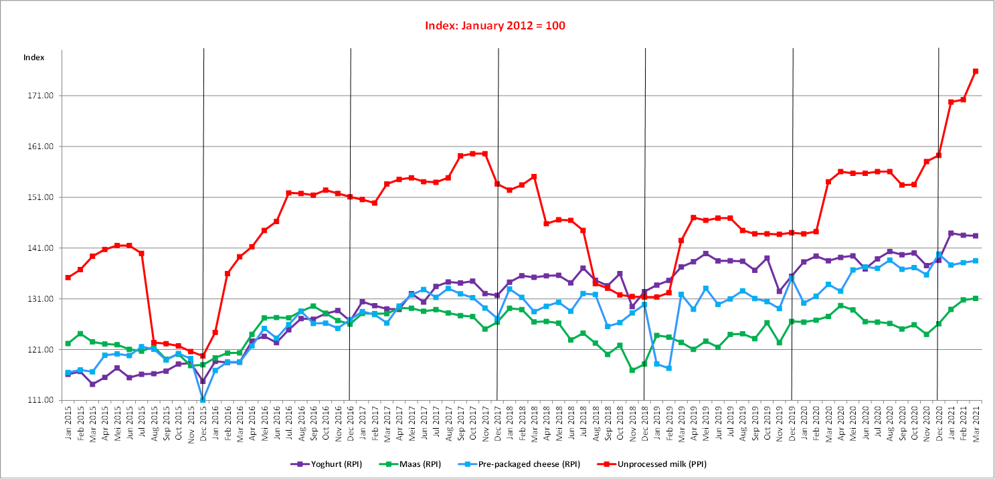
.
THE PRODUCER PRICE INDEX (PPI) OF UNPROCESSED MILK, FROM JANUARY 2015 TO MARCH 2021 AND THE RETAIL PRICE INDICES (RPI) OF YOGHURT, MAAS AND PRE-PACKAGED CHEESE, FROM JANUARY 2015 TO MARCH 2021
Source: Stats SA

Slide 21
Monthly unprocessed milk purchases Jan 2017– Sept 2021
Year | ‘000 Ton
2011 | 2 712
2012 | 2 843
2013 | 2 906
2014 | 2 983
2015 | 3 173
2016 | 3 158
2017 2018 2019 2020 | 3 254 3 411 3 433 3 427
Source: Milk SA; Aug and Sept preliminary

Slide 22
Unprocessed milk purchases per day per month
Jan 2017 – Sept 2021
Source: Milk SA; (Aug and Sept 2021 preliminary)

Slide 23
Calculated milk: maize plus soybean price ratio Jan 2018 – Oct 2021
Source: MPO calculations; “Feed price” = 70% YM1, 30% Soy, Safex nearest month prices, Producer price MPO survey (Sept and Oct preliminary)

Slide 24
Cumulative net imports of dairy products
Jan 2017 – Sept 2021
Source: SARS as supplied by SAMPRO

Slide 25
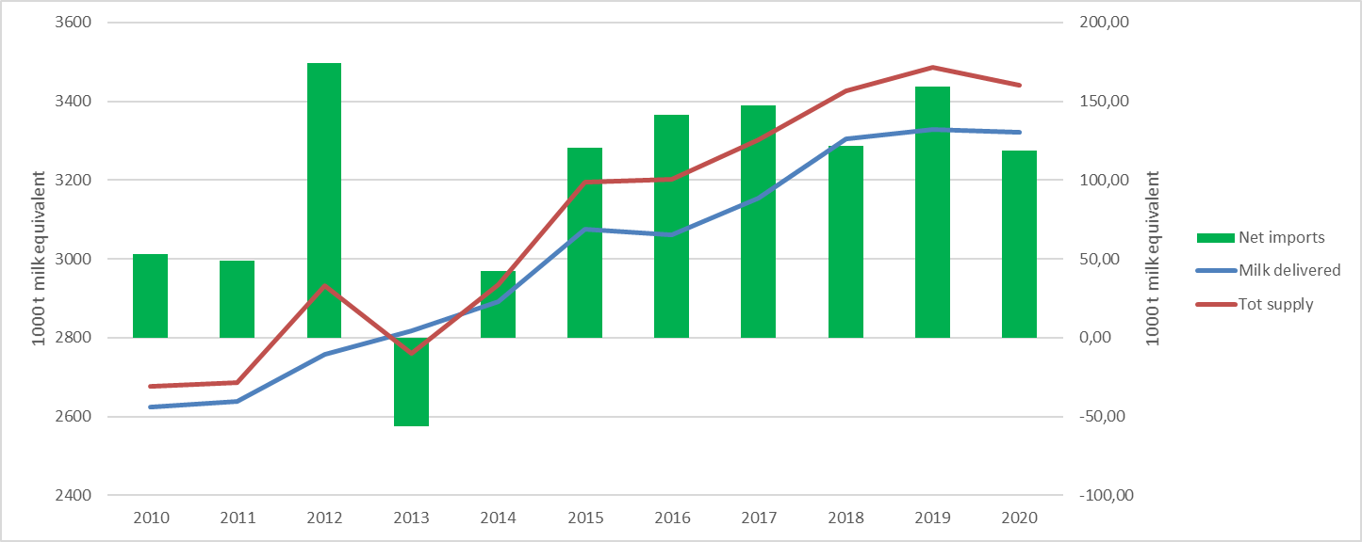
Annual production of unprocessed (raw) milk plus net imports (unprocessed milk equivalent)
2010 - 2020
Source: Milk SA, SAMPRO. Note: Stock changes excluded. BLNS excluded

Slide 26

Thank you

