Slide 1
General Meeting
CEO Presentation – 26 November 2020

Slide 2
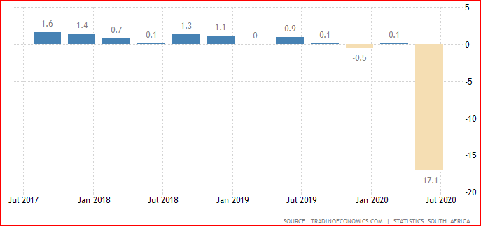
South Africa GDP Annual Growth Rate Source: Trading Economics.com / Statistics SA
The South African GDP contracted 17.1% year-on-year in the second quarter of 2020, following a revised 0.1% growth in the previous period. The strong economic downturn happened amid the impact of one of the strictest coronavirus lockdowns in the world which forced all non-essential activities to shut down operations.

Slide 3
Unemployment and Household debt
SA Unemployment rate:
30,8% in Aug 2020 vs 26,7% in Jan 2018
Expanded definition (including people who stopped looking for work) = 43,1% in Aug 2020.
SA Household debt to net income:
72,8% in 2019 vs 71,9 in 2018

Slide 4
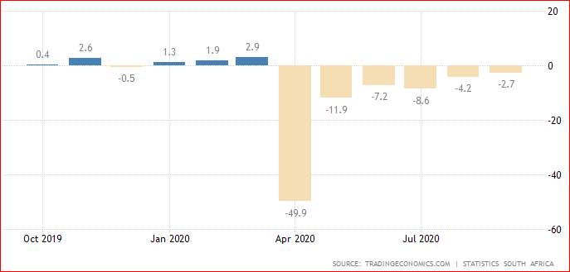
South Africa Retail Sales YoY

Slide 5
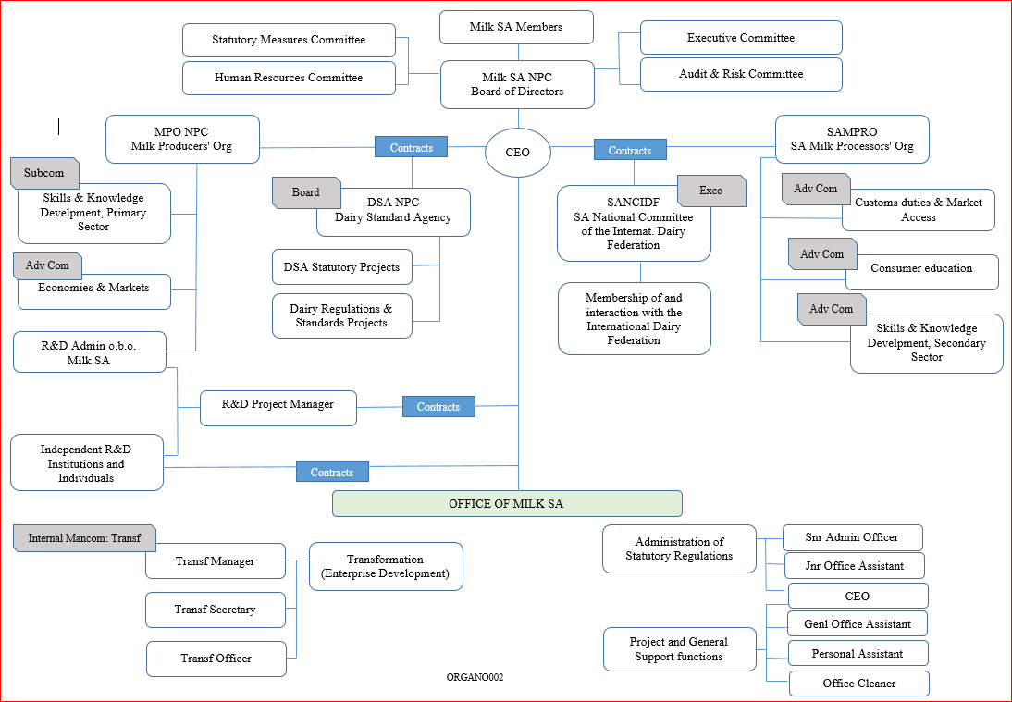
Milk SA structures and contractual relationships

Slide 6
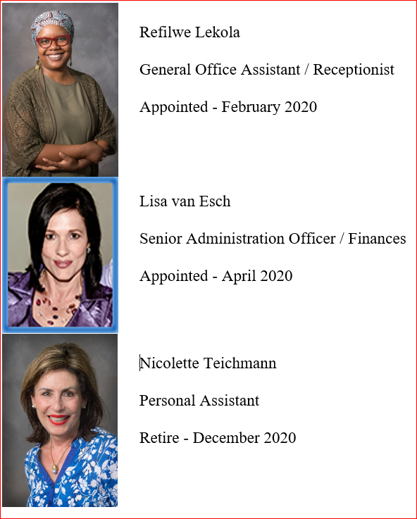
Changes at the Milk SA Office

Slide 7
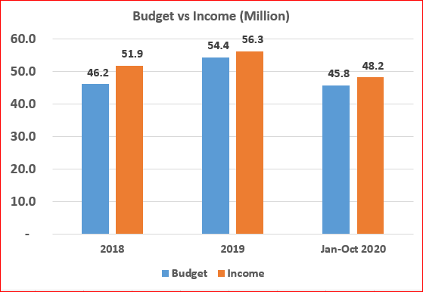
Levy income vs Budgeted income Jan 2018 to Oct 2020
Budget = 146 400 000
Income = 156 400 000

Slide 8
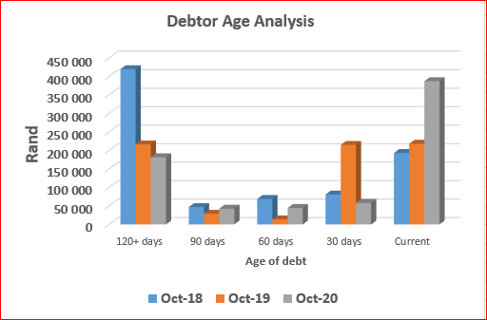
Levy debtors
Debtors days: < 4%
7 Role-players = 80% of debt
67 Role-players = 20% of debt
 | Oct-18 | Oct-19 | Oct-20
Total debt | 810 005 | 692 289 | 714 531

Slide 9
Administration: Other
External audit for 2019 was finalized during the lockdown (April & May) and a clean audit has been achieved again.
Internal audits were conducted for:
Human Resources
Administration of the Statutory Measures
Information Technology
SA National Committee of the IDF
Inspections amongst role-players continued: Verification of statutory returns.
Legal action continued with good results.

Slide 10
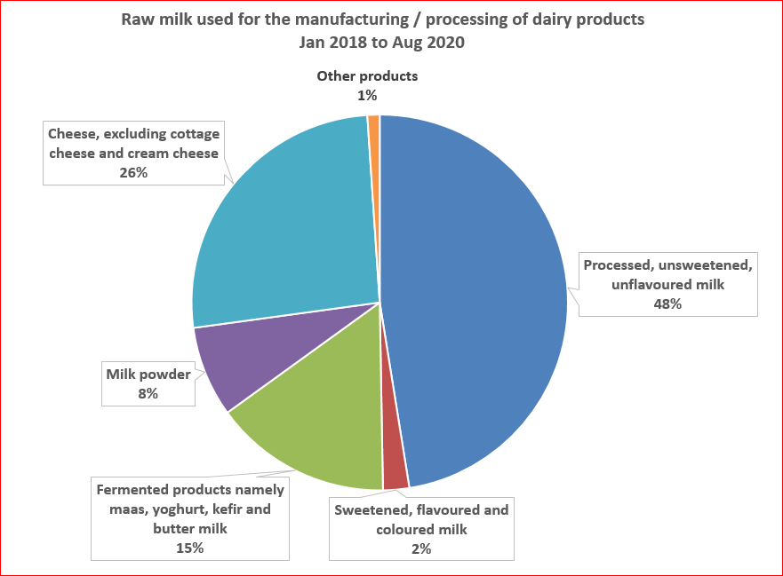
Unprocessed (raw) milk used for manufacturing / processing of dairy products

Slide 11
Agricultural and Agro-processing Master Plan
Since Jan 2020, Milk SA has been involved to create a Master Plan for Agriculture and Agro-Processing. Milk SA’s team was Nico Fouche, Alwyn Kraamwinkel, Dr Van Dijk, Godfrey Rathogwa and Jompie Burger.
The AAMP is part of the President’s investment initiatives, also with the aim to create jobs.
The team provided voluminous input in a number of meetings with BPAP and the NAMC with the main message that the industry expects basic service delivery and public safety from Government.
The NAMC promised to include a Dairy Chapter but nothing has been seen yet.
The CEO was also involved in a Technical task Team and Symposiums held by the President and Minister Didiza.
In October 2020, industries were given 3 days to comment on a DALRRD / NAMC document, sketching the way forward. This was rejected by almost all industries, mainly because of the structures which were loaded with too many irrelevant stakeholders to make the Master Plan “inclusive”.
Stakeholders included ARC, all 9 HOD’s of Prov Agric, 5 labour unions, Oxfam, 4 Civil Society organizations, 5 Emerging Business organizations, AgBiz, Agri SA and TAU.

Slide 12
In conclusion
Government fails to provide an investment friendly environment.
Government initiatives to find solutions for agriculture + agro-processing only deliver plans.
Milk SA is thankful to government and NAMC officials who take hands with Milk SA and other industry bodies.
Milk SA is thankful for the MAP Act and uses it optimally.
The Office of Milk SA has proven itself to improve on its efficiency i.t.o. administration of the measures and otherwise.
The Board of Directors maintains its firm grip on Corporate Governance and is presented with reports from all its committees.
Milk SA pays tribute to the milk producers and processors for their persistent drive and innovation, especially during Covid and the economic climate.

