Slide 1
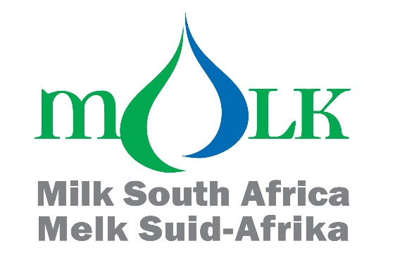
GENERAL MEETING OF MEMBERS
CEO Presentation
1 December 2021

Slide 2
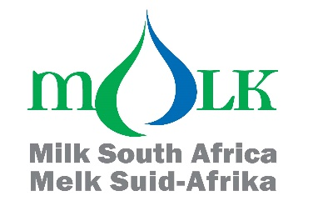
MILK SA
Non-Profit company, “owned” by MPO and SAMPRO. (Est. 2002)
Established to improve competitiveness of the SA dairy industry through actions of collective importance within the limitations of the Competition Act.
For example, Milk SA can in no way be seen to influence or signal prices. However, its projects are designed to expand the market for dairy products and for the industry to be more competitive.
Designated by the Minister as Administrator for statutory measures i.t.o. the MAP Act.

Slide 3
ADMINISTRATION
Levy income for the 10 months almost matched budget of R50,7 mil. For the 10 months.
Two role-players make up 78,5% of the total debt amount of R3,04 mil.
No 1: The unopposed case for R1,1 mil was heard in the High Court on 24 Nov ‘21.
No 2: A statutory inspection revealed an under declaration of R1,3 mil for which a pay-off arrangement was reached (to be paid in full by March 2022).
The remainder of debt was thus only R653 667 by the end of October of which 55% was in the current to 30 days categories.
Levy inspections are crucial in ensuring correct payment and correct information to Milk SA.
Internal audits have been conducted in 2021 for some projects but also for Milk SA’s financial administration.
As the current 4-year levy cycle ends on 31 Dec 2021, the Board of Directors ensured that the maximum levies in excess of budget were optimally employed.

Slide 4
HIGHLIGHTS
The Court Order of 22/2/2021 basically determined that Nejahmogul’s fees were irrational and arbitrary; and that the Executive Officer (of the APS Act) failed to give directions to Nejahmogul how to fulfil its mandate.
Ongoing interaction between Milk SA, Nejahmogul and DALRRD towards achieving agreement in the above regard.
MPO & SAMPRO together with DSA and Milk SA averted attempts by Nejahmogul and the Executive Officer to delay and even undermine the application for continuation of the statutory measures.
Milk SA was interacting with the relevant Cluster Chairpersons under the Agriculture and Agro-Processing Master Plan to ensure that dairy’s requirements are sufficiently covered.
Since the publication of the SABS standards (SANS1694) on animal welfare, the DSA has formulated an audit format with criteria. A work group benchmarked the DSA audit criteria against SANS1694 and the IDF Animal Welfare guideline, which were recently tested on-farm - which could lead to the amendment of SANS1694).

Slide 5
HIGHLIGHTS (Continued)
Milk SA further invested in the DSA Laboratory which was becoming much more relevant i.t.o. national calibration of instruments, monitoring of product quality and research support.
The Consumer Education Project entered a TV commercial in the International Milk Promotion Trophy Awards Competition and won 3rd prize.
Sustainability of dairy depends increasingly on how the industry participants behave i.t.o. issues such as GHG emissions, soil health, waste management, water management, working conditions, product safety and quality and animal care. A document written by Dr Meissner and Dr Ohlhoff, addressing many aspects was recently updated. It is the organized industry’s duty to promote the application of measures in this regard.

Slide 6
OTHER OBSERVATIONS
The importance of dairy animal welfare and the impact of the dairy industry on the environment are increasingly under the spotlight internationally and in South Africa
Extreme plant-based diets and veganism seem to win ground at the cost of animal based diets, mostly on the back of emotion and misinformation. Consumer education becomes increasingly important and the IDF was addressing this actively with messages such as:
Animal and plant-foods should not be thought of as competing entities, but rather as synergistic food sources that provide different nutritional, social, economic, and environmental benefits.
The Agricultural and Agro-Processing Master Plan initiative of the Government is important. However, policies and government measures in respect of agriculture and agro-processing cannot undo the harm caused to the industries concerned by poor service delivery by the public sector on national, provincial and local authority levels.
The dairy industry is increasingly challenged by political instability while there are continuous efforts by governmental institutions to interfere in the free market system.
In 2017, the dairy industry was challenged to the effect that market mechanisms were not supportive of especially smaller milk producers. This was addressed in Nedlac and everyone accepted the outcome. The Competition Commission now also voices its concerns over market concentration, with suggestions that the highly industrialized structures should be transformed into smaller, localized structures.

Slide 7
CLOSING REMARK
Marking 19 years of support to the dairy industry, Milk SA’s successes are mainly attributed to:
The relevancy of our projects and actions;
Our Project Managers’ devotion and drive for success;
The MPO and SAMPRO’s keen participation in the Milk SA structures, particularly from the ranks of the producers and processors.
THANK YOU
_____________________

