Slide 1
CEO report for the General Meeting
15 June 2022

Slide 2
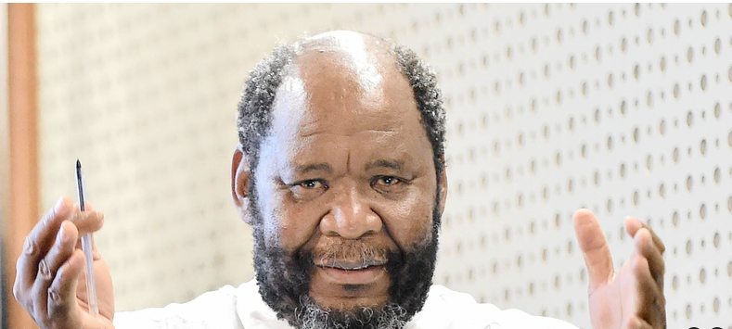
Economic state of South Africa
“State of Gwaragwara for South Africa has come”
“Corruption”
“Divisions within ruling party”
“Institutional capacity”
“Lack of decisive leadership”
“Qualified audits of SEOs and municipalities”
“Unemployment”
“Lack of education”
“Low economic growth”
“Debt to GDP ratio”
“No plans are working”
Dr Pali Lehohla – Former Statistitian-General (Stats SA)
“The era of the Idiot” (Title of his presentation)
(Addressing the plenary session of the ANC Greater Johannesburg 15th regional conference on 5 June 2022)

Slide 3
SA Agriculture on the move

Slide 4
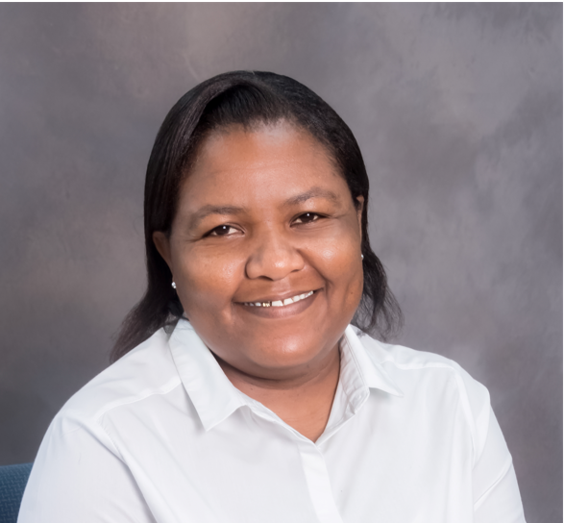
Milk SA Statutory Measures Team
Matilda Wistebaar (Jnr Admin Assistant)
Business Communications Certificate
Office Administration Certificate
Lisa van Esch (Snr Admin Officer)
National Diploma: Internal Auditing
Hansie Ferreira (Ministerial Inspector)
B. Accounting Science

Slide 5
Statutory measures performance 2018-2021
Inspections: 166 from ±310 role-players inspected in 3 years 2019-2021
Over-declared >R2 000 000; Under-declared >R2 000 000.
Significant contribution to levy income and reliable industry information.
Significant impact on role-player relations.
Levy income: The levy income of R62,7 million for 2021 exceeded the budget by ±R400 000.
Debt: Debtor days was at 18 debtors days by 31 Dec 2021 due to two debtors with joint debt of ±R2,3 million. Average for 2021 was 8 debtors days.
Legal (civil) action: Ranged from L.o.Ds to Court Applications and Summons. All 9 judgments were in favour of Milk SA.

Slide 6
No of registered role-players by 31 Dec 2021 Total registered: 316

Slide 7
Unprocessed milk declared by role-players

Slide 8
No of registered role-players per category and contribution to levy income

Slide 9
Industry information derived from the statutory measures (1)

Slide 10
Industry information derived from the statutory measures (2)

Slide 11
Industry information derived from the statutory measures (3)

Slide 12
Distribution of levy income between functions in 2021

Slide 13
Office & Project structures & linkage to Board

Slide 14
A unique organization
Milk SA is unique in the SA agriculture and agro-processing environment, where the primary and secondary sectors work through a jointly established company to address matters of collective interest on a daily basis.
Milk SA is the flagship of the dairy industry for 20 years already, enabling the SA dairy industry with tools required in a free market economy, such as:
Transparent industry information;
Monitoring dairy quality and safety and taking action;
Identification of research requirements and taking action;
Presenting the facts to Government for trade negotiations.

