Slide 1

Economies and Dairy markets
Report presented at
Milk SA General Meeting of Members
15 June 2022
Prepared by B van Heerden and assisted by the MSA Industry Information Work Group
June 2022

Slide 2

Source: IMF WEO update April 2022 ** Projection

Slide 3
Bacground observations
Will the higher-price cure prevail?
The market has the potential for more supply and demand elasticity than ever; (rapid technological advances and demographic shifts)
What is the biggest risk for commodities in 2022/23?
There is hope for a broad base of lower input cost prices but there is an implied unknown time factor we need to deal with and get past. The primary sector face these extraordinary cost since middle 2021;
And there is a danger that the typical cycle movement of markets would be disturbed/lagged more than usual by the war in Ukraine (weaponized food supply)

Slide 4
International economy
International dairy situation
SA economic situation
SA dairy situation

Slide 5
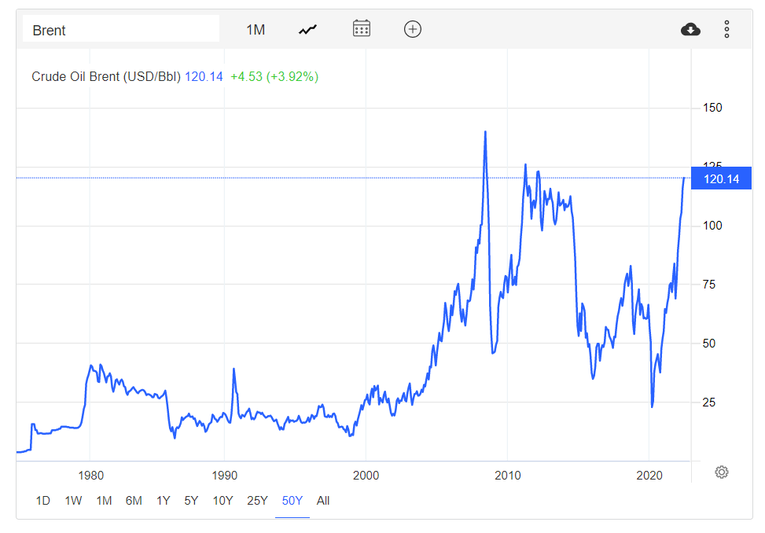
Source: Bloomberg markets

Slide 6
Global economic growth and expected growth
2010 – 2023
Source: IMF WEO and World Bank press release 7 June 2022 ** Projection

Slide 7
FAO food price indices Jan 2012 – May 2022
Source: FAO, June 2022

Slide 8
International economy
International dairy situation
SA economic situation
SA dairy situation

Slide 9
International prices of dairy products
Jan 2012 – May 2022
US$/ton
Rand/ton
Source: USDA, South African Reserve Bank

Slide 10
GlobalDairytrade® Auction Sale price index of dairy products,
Jan 2011 – May 2022
Source: GDT Index

Slide 11
Average European producer price trends of unprocessed milk, Jan 2018 – May 2022
Source: European Commission (May 2022 estimate)

Slide 12
Average EU, Poland and SA producer prices of unprocessed milk, May 2018 – May 2022
R/L
Source: EU Commission; MPO (May 2022 preliminary)

Slide 13
International economy
International dairy situation
SA economic situation
SA dairy situation

Slide 14
Annual SA economic growth ( non-annualized)
2018 – 2022 (base year 2015)
Source: Stats SA

Slide 15
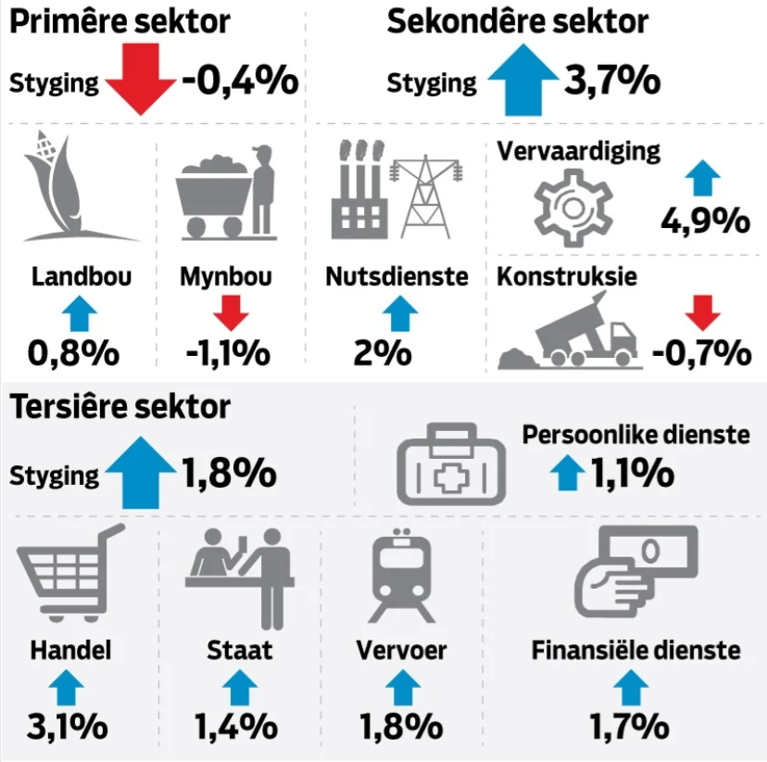
ed)
2018 – 2022 (base year 2015)
Source: Netwerk24

Slide 16
Consumer price inflation
Jan 2010 – April 2022
Source: Stats SA

Slide 17
Prime interest rates in South Africa
Jan 2010 – May 2022
Source: SARB

Slide 18
SA households: real disposable income and debt as %
1982 – 2021
%
Rand
Source: SARB

Slide 19
International economy
International dairy situation
SA economic situation
SA dairy situation

Slide 20
Monthly unprocessed milk purchases Jan 2018– April 2022 (percentage growth per year)
Year | ‘000 Ton
2011 | 2 712
2012 | 2 843
2013 | 2 906
2014 | 2 983 (2.65%)
2015 | 3 173 (6.37%)
2016 | 3 158 (-0.45%)
2017 2018 2019 2020 2021 | 3 254 (3.02%) 3 411 (4.82%) 3 433 (0.65%) 3 427 (-0.16%) 3 403 (-0.71%)
Source: Milk SA; March and April preliminary

Slide 21
Calculated milk: maize plus soybean price ratio Jan 2019 – May 2022
Source: MPO calculations; “Feed price” = 70% YM1, 30% Soy, Safex nearest month prices, Producer price MPO survey (May preliminary)

Slide 22
Liquid dairy products: The volume (kg of unprocessed milk) used in the manufacturing of liquid dairy products in respect of 2021
Source: Industry estimate supplied by Milk SA

Slide 23
Concentrated dairy products: The mass of each product in relation to the total mass of concentrated dairy products in respect of 2021
Source: Industry estimate supplied by Milk SA

Slide 24
CHANGES IN THE QUANTITIES OF RETAIL SALES OF SPECIFIC DAIRY PRODUCTS
PRODUCT | Sales in the month of March 2022 versus the sales in the month of March 2021 | Sales in the 3 months from January 2022 to March 2022 versus the sales in the 3 months from January 2021 to March 2021 | Sales in the 6 months from October 2021 to March 2022 versus the sales in the 6 months from October 2020 to March 2021 | Sales in the 9 months from July 2021 to March 2022 versus the sales in the 9 months from July 2020 to March 2021 | Sales in the 12 months from April 2021 to March 2022 versus the sales in the 12 months from April 2020 to March 2021
 | percent |  | percent |  | percent
Fresh Milk | -6.8 | -9.1 | -7.6 | -7.6 | -6.7
UHT milk | 8.6 | 3.2 | 2.3 | 1.7 | -2.9
Flavoured milk | -1.9 | -4.0 | -1.8 | -0.8 | 0.8
Yoghurt | -4.7 | -7.1 | -7.8 | -9.0 | -8.7
Maas | 2.9 | 1.3 | 0.4 | -2.3 | -3.5
Pre-packaged cheese | 5.4 | 3.0 | 2.9 | 1.5 | -0.5
Cream cheese | -2.3 | -3.1 | -2.5 | -3.4 | -5.8
Butter | -0.6 | -1.0 | 0.4 | -0.4 | -4.9
Cream | -8.7 | -7.8 | -5.0 | -5.3 | -7.4
Source: SAMPRO based on NielsenIQ March 2022 report

Slide 25
Changes in average retail prices of specific dairy products
PRODUCT | March 2022 versus February 2022 (1 month ago) | March 2022 versus December 2021 (3 months ago) | March 2022 versus September 2021 (6 months ago) | March 2022 versus June 2021 (9 months ago) | March 2022 versus March 2021 (12 months ago) | March 2022 versus September 2020 (18 months ago) | March 2022 versus March 2020 (24 months ago)
 | Percent | Percent | Percent | Percent | Percent | Percent | Percent
FRESH MILK | 1.5 | 1.5 | 0.2 | 1.3 | 3.8 | 8.3 | 8.6
UHT MILK | 0.5 | -1.5 | -2.8 | -3.3 | 1.0 | 0.9 | 5.7
FLAVOURED MILK | -0.1 | 1.2 | -2.7 | -1.7 | 7.6 | 7.1 | 9.5
YOGHURT | 0.2 | 3.1 | 1.4 | 2.0 | 5.4 | 8.9 | 9.8
MAAS | 0.1 | 0.0 | 0.9 | -0.1 | 1.4 | 6.4 | 4.3
PRE-PACKAGED CHEESE | -1.3 | -3.0 | -1.6 | -0.5 | 2.2 | 3.5 | 5.8
CREAM CHEESE | 1.6 | -0.7 | 1.4 | 0.9 | 2.5 | 10.4 | 15.4
BUTTER | 4.5 | -0.1 | 0.03 | -1.9 | 0.8 | -1.2 | -2.3
CREAM | 0.1 | -0.5 | 2.3 | 2.9 | 5.7 | 6.9 | 7.2
Source: SAMPRO based on NielsenIQ March 2022 report

Slide 26
.
Producer, processor and retail price indices, Jan 2012 – April 2022
Source: Stats SA

Slide 27
THE RETAIL PRICE INDICES (RPI) OF SPECIFIC DAIRY PRODUCTS, FROM JANUARY 2015 TO MARCH 2022
Source: NielsenIQ and Statistics SA as supplied by SAMPRO

Slide 28
THE PRODUCER PRICE INDEX (PPI) OF UNPROCESSED MILK, FROM JANUARY 2015 TO APRIL 2022 AND THE RETAIL PRICE INDICES (RPI) OF FRESH MILK AND UHT MILK, FROM JANUARY 2015 TO MARCH 2022
Source: NielsenIQ and Statistics SA as supplied by SAMPRO

Slide 29
THE PRODUCER PRICE INDEX (PPI) OF UNPROCESSED MILK, FROM JANUARY 2015 TO APRIL 2022 AND THE RETAIL PRICE INDICES (RPI) OF YOGHURT, MAAS AND PRE-PACKAGED CHEESE, FROM JANUARY 2015 TO MARCH 2022
Source: NielsenIQ and Statistics SA as supplied by SAMPRO

Slide 30
Closing remark
In times of this level of uncertainty regarding world events and markets, clear and real-time up and down communication in the dairy value chain is paramount.

Slide 31

Thank you

