Slide 1
MilkSA Project: Economies and Markets
Presentation for the
Milk SA General Meeting of Members
30 November 2022
Prepared by B van Heerden and assisted by the MSA Industry Information Work Group
November 2022

Slide 2
International economy
International dairy situation
SA economic situation
SA dairy situation

Slide 3
Background observations
World economy has been shaken by four once-in-a-century external shocks in the space of two years:
Worst pandemic in 100 years,
First major war in Europe in 75 years,
Massive monetary stimulus, (Countering the Cost-of-living crisis)
The complexity of supply chains within globalization.
Major increase in uncertainty over a broad base of variables
.

Slide 4
Global economic growth and expected growth 2010 – 2023
Source: IMF WEO October 2022 ** Projection

Slide 5
Source: World bank (* projections)

Slide 6
Source: Bloomberg markets

Slide 7
Source: Bloomberg markets

Slide 8
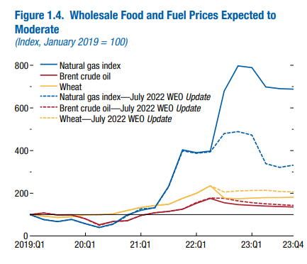
Source: IMF: WEO October 2022

Slide 9
FAO food price indices Jan 2012 – Oct 2022
Source: FAO, November 2022

Slide 10
International economy
International dairy situation
SA economic situation
SA dairy situation

Slide 11
International prices of dairy products Jan 2012 – October 2022
US$/ton
Rand/ton
Source: USDA, South African Reserve Bank

Slide 12
GlobalDairytrade Auction Sale price index of dairy products, Jan 2011 – November 2022
Source: GDT Index

Slide 13
Average European, Poland and SA producer prices, of unprocessed milk, Jan 2019 – Oct 2022
Source: European Commission (Oct 2022 estimate)

Slide 14
International economy
International dairy situation
SA economic situation
SA dairy situation

Slide 15
Annual SA economic growth ( non-annualized) 2018 – 2022 (base year 2015)
Source: Stats SA

Slide 16
Consumer price inflation Jan 2010 – Oct 2022
Source: Stats SA

Slide 17
Consumer price inflation Jan 2021 – April 2022
Differential 225 basis points
Source: Us Federal Reserve and the SA Reserve Bank

Slide 18
Prime interest rate, real interest rate and inflation rate in South Africa Jan 2010 – Oct 2022
Source: SARB

Slide 19
SA households: real disposable income and debt as % 1982 – 2021
%
Rand
Source: SARB

Slide 20
International economy
International dairy situation
SA economic situation
SA dairy situation

Slide 21
Monthly unprocessed milk purchases Jan 2019– Oct 2022 (table percentage change per year)
Year | ‘000 Ton
2011 | 2 712
2012 | 2 843
2013 | 2 906
2014 | 2 983 (2.65%)
2015 | 3 173 (6.37%)
2016 | 3 158 (-0.45%)
2017 2018 2019 2020 2021 | 3 254 (3.02%) 3 411 (4.82%) 3 433 (0.65%) 3 427 (-0.16%) 3 403 (-0.71%)
Source: Milk SA; Sep and Oct preliminary

Slide 22
Calculated milk: maize plus soybean price ratio Jan 2019 – Oct 2022
Source: MPO calculations; “Feed price” = 70% YM1, 30% Soy, Safex nearest month prices, Producer price MPO survey (Oct preliminary)

Slide 23
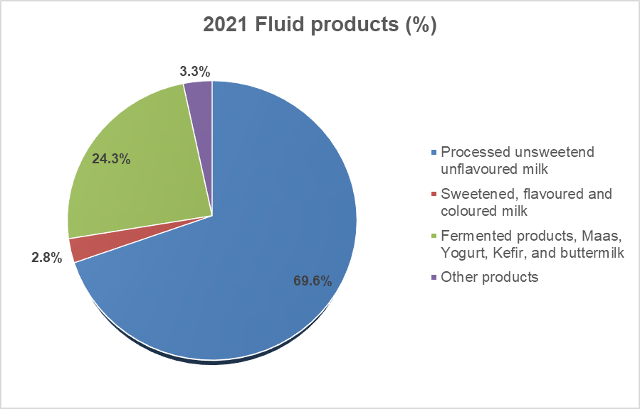
Milk utilization in liquid products: 2021
Source: Milk SA

Slide 24
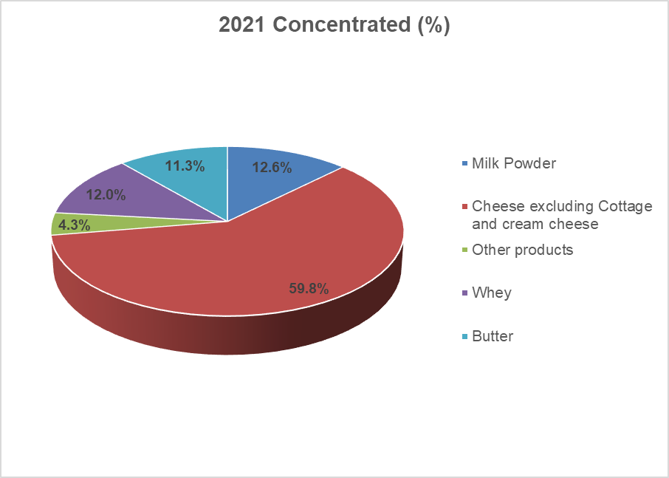
Milk utilization in concentrated products: 2021
Source: Milk SA

Slide 25
CHANGES IN THE QUANTITIES OF RETAIL SALES OF SPECIFIC DAIRY PRODUCTS
PRODUCT | Sales in the month of September 2022 versus the sales in the month of September 2021 | Sales in the 3 months from July 2022 to September 2022 versus the sales in the 3 months from July 2021 to September 2021 | Sales in the 6 months from April 2022 to September 2022 versus the sales in the 6 months from April 2021 to September 2021 | Sales in the 9 months from January 2022 to September 2022 versus the sales in the 9 months from January 2021 to September 2021 | Sales in the 12 months from October 2021 to September 2022 versus the sales in the 12 months from October 2020 to September 2021
 | percent |  | percent |  | percent
Fresh Milk | -3.9 | -5.7 | -7.6 | -8.4 | -8.0
UHT milk | 0.1 | -5.2 | -1.1 | -0.5 | 0.2
Flavoured milk | -1.2 | -0.6 | -2.7 | -3.8 | -3.7
Yoghurt | -6.1 | -3.6 | -2.9 | -3.1 | -4.2
Maas | -1.8 | 3.4 | 1.3 | 1.3 | 0.6
Pre-packaged cheese | 2.1 | 1.6 | 0.6 | 1.2 | 1.5
Cream cheese | -9.0 | -5.8 | -3.2 | -3.1 | -2.8
Butter | -4.9 | -10.1 | -3.7 | -2.9 | -1.7
Cream | -6.9 | -7.0 | -6.2 | -7.0 | -5.9
Source: SAMPRO based on NielsenIQ September 2022 report

Slide 26
Changes in average retail prices of specific dairy products
PRODUCT | September 2022 versus August 2022 (1 month ago) | September 2022 versus June 2022 (3 months ago) | September 2022 versus March 2022 (6 months ago) | September 2022 versus December 2021 (9 months ago) | September 2022 versus September 2021 (12 months ago) | September 2022 versus March 2021 (18 months ago) | September 2022 versus September 2020 (24 months ago)
 | Percent | Percent | Percent | Percent | Percent | Percent | Percent
FRESH MILK | -0.014 | 2.6 | 5.1 | 6.5 | 5.1 | 9.0 | 13.5
UHT MILK | 1.0 | 2.7 | 11.3 | 9.8 | 9.3 | 13.6 | 13.2
FLAVOURED MILK | 1.7 | 4.4 | 10.7 | 13.0 | 8.9 | 19.5 | 20.4
YOGHURT | 1.0 | 8.3 | 7.5 | 9.6 | 8.6 | 12.9 | 16.0
MAAS | 1.7 | 6.8 | 8.9 | 8.8 | 10.0 | 10.6 | 15.6
PRE-PACKAGED CHEESE | -2.0 | 2.4 | 7.5 | 4.2 | 5.7 | 9.9 | 11.3
CREAM CHEESE | 0.7 | 2.6 | 6.6 | 5.8 | 8.4 | 9.7 | 18.2
BUTTER | -2.6 | 4.6 | 7.6 | 7.3 | 7.4 | 8.4 | 5.9
CREAM | 0.6 | 3.8 | 6.6 | 5.9 | 8.9 | 12.6 | 14.0
Source: SAMPRO based on NielsenIQ September 2022 report

Slide 27
.
Producer, processor and retail price indices, Jan 2012 – October 2022
Source: Stats SA

Slide 28
Closing remarks
The dairy market is struggling to find the right balance between supply and demand due to the:
Very high levels of uncertainty in South Africa and internationally, due to initially Covid and now the disruption created by the Russian invasion and the reaction of other countries to it;
Consumer and industrial demand is undermined in the current high inflationary environment and the weak economy, and
Role players in the value chain need to approach the dynamic between supply and demand with caution, as the present situation is very different from the past and further developments should be closely monitored and reacted to.

Slide 29
Thank you

