Slide 1
CEO Presentation
To the Members
at the
General Meeting of
14 June 2023

Slide 2
THE DAIRY MARKET
Dairy product sales, except for fresh milk and flavoured milk, held reasonably strong up until 2020, after which sales declined significantly up to now.
Dairy product prices shot up since 2021 to levels beyond inflation.
Unprocessed milk production followed suit with volumes increasingly down since 2020 and steeper prices.

Slide 3
THE ONLY WAY OUT OF THE ECONOMIC DEBACLE
The only way out of the current debacle is sufficient economic growth, which seems increasingly difficult due to:
Unemployment of 33% and still counting
Deepening electricity crisis
Very low GDP expectations for 2023
Railway strikes and port logistics
High interest rates
Etc

Slide 4
FURTHERMORE, CLOSER TO THE DAIRY INDUSTRY …
Over the past 16 months, food inflation registered a record level of 14.3% in April 2023.
Sales of dairy products are in a downward spiral.
The macro-economic performance of the SA economy negatively affects consumer spending and preferences.
El Niño is expected from May-July (62% chance), which might impact negatively on the production of unprocessed milk and thus on the production of dairy products.
Poor service delivery by Government overall.
Unrealistic laws, e.g. race based water use licences and tighter BEE codes.

Slide 5
PROJECTS
Congratulations to all project leaders, as they have done excellently in their portfolios. Just a few highlights:
Expert input on draft Front of Pack Labelling regulations
Expert input on Regulation R1510 (classification, packing and marking of dairy products and imitation dairy products)
Expert input on the APS amendment bill, which i.a. defines requirements for assignees to enforce R1510
“Pathways to Dairy Net Zero” of the GDP was supported with factual information
Model developed for dairy production systems to estimate environmental footprint, linked to financial indicators. Expansion is underway to include animal health & welfare
New Brucellosis project waiting: Immune profiling & manipulation of the immune system to design vaccine formulations. (Safer for humans / less abortions, etc)
First-hand information published re Fresh & UHT milk and FMP & SMP
Pressure on Government to act on false product claims (e.g. Flora Plant Butter)

Slide 6
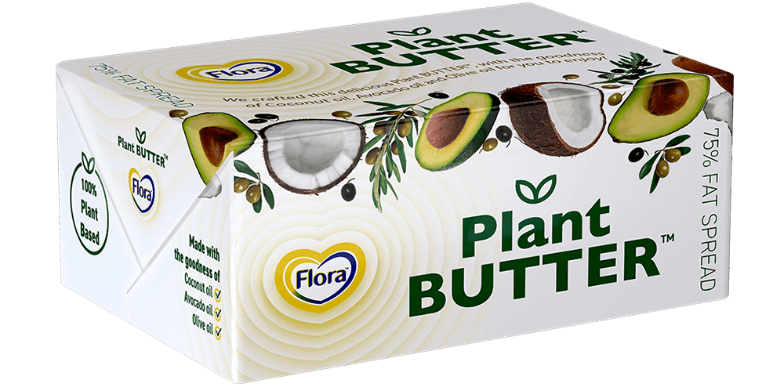
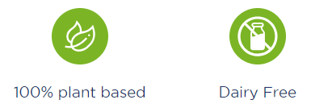

Slide 7
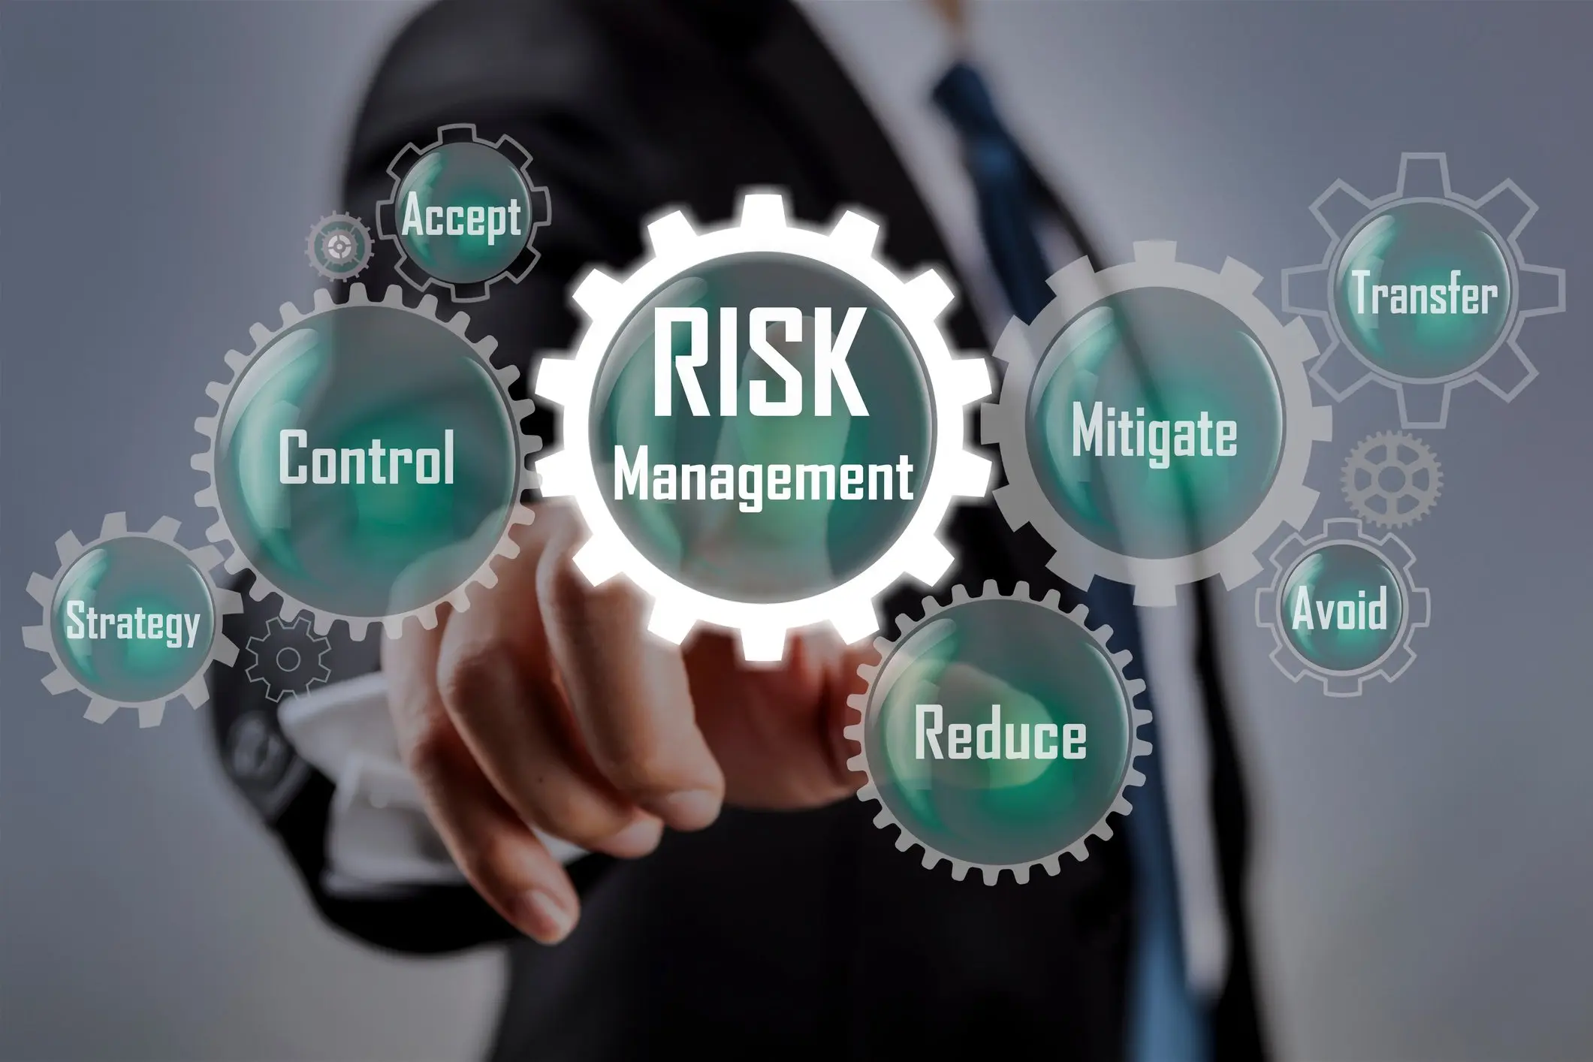
RISK MANAGEMENT
105 industry Risks were listed of which most are dealt with by the projects
Company related risks are assessed continuously
Risk based project and admin audits are conducted continuously

Slide 8
MILK SA ADMINISTRATION
The engine room of Milk SA (Administration) fires on all cylinders:
Substantial amounts have been collected from statutory inspection services
All legal cases have been ruled in favour of Milk SA and substantial legal fees were recovered
By the end of April 2023, debt in the 60+ days category was only R580 000
Levy income in 2022 was 2,3% lower than budget due to less unprocessed milk and less imports
Overwhelmingly positive cooperation from role-players
Reliable information published monthly on-time
More detailed information was published as the following were added to the portfolio:
Fresh milk / UHT & Sterilized milk
FMP / SMP
Blessed with aptly qualified staff members who are up to their task

Slide 9
Registered persons / institutions: 2006-2022 (Dec)

Slide 10
REGISTERED ROLE-PLAYERS PER CATEGORY AND CONTRIBUTION TO LEVY INCOME

Slide 11
DETAILED EXPENDITURE (%) OF NET LEVY INCOME AND SURPLUS: 2022 – R63,6 million
Shares are based on guideline percentages, as per business plan submitted by the applicants (MPO and SAMPRO) and approved by the Minister

Slide 12
Thanks for your attention

