Slide 1

Milk SA Project: Economies and Markets
Presentation for the
Milk SA Annual General Meeting
14 June 2023
Prepared by B van Heerden, assisted by the MSA Industry Information Work Group and presented by Nico Fouché
June 2023

Slide 2
International economy
International dairy situation
SA economic situation
SA dairy situation

Slide 3
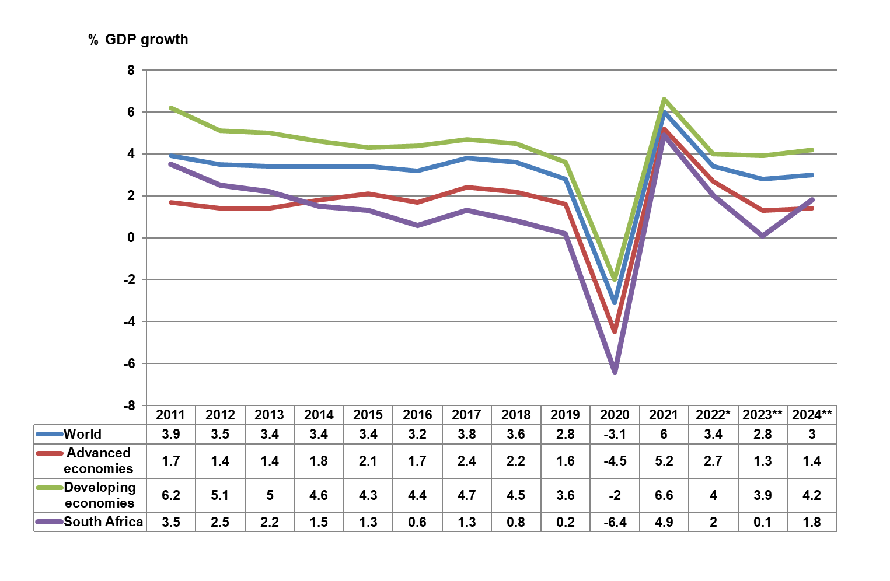
Global economic growth and expected growth
2011 – 2024
Source: IMF WEO April 2023 * Projection ** Forecast
Notes:
Red line around 2% till 2017. Since 2018: High energy prices + inflation, industrial action, disruption in car production, China imported less.
Stimuli by countries after Covid eroded by Russia.

Slide 4
Source: World bank (* forecast)
Notes:
2008 Global fin crisis due to –
USA tariff introduction;
Trade war USA+China;
Scrutiny of Tech Companies;
USA tax cuts, saw companies moving investments back to USA.
Lower inflations expected for 2023/24, but still much higher than even before 2000.

Slide 5
Source: Bloomberg markets
Notes:
FedRate definition
Control available funds and inflation
Zero interest: stimulate activity
Impact of Fed rate increase : inflation down & demand for USD
Weaker Rand

Slide 6
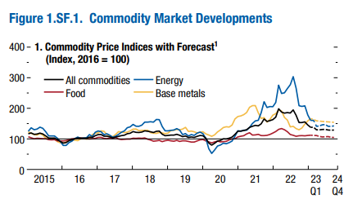
Source: IMF: WEO April 2023
Notes:
Energy: Oil producers (2 weeks ago) decided to extend production cuts throughout 2024.
Food: Still higher than before Covid but on a downward trajectory. / Factors which might overturn the trajectory = El Nino, Lack of fertilizers, If countries restrict exports.

Slide 7
FAO food price indices Jan 2013 – April 2023
Source: FAO, May 2023
Notes:
Indices higher than 7 years ago.
Cereals: Prices down: higher production in Brazil and USA (major exporters) / Cancelled purchases by China.
Dairy: April to May = 3,9 points down. / May 2022 to May 2023 = Index is 17,7% lower.
Meat and Sugar: 4th consecutive increase, esp due to demand in Asia.

Slide 8
International economy
International dairy situation
SA economic situation
SA dairy situation

Slide 9
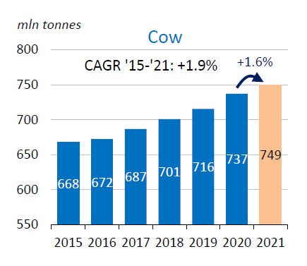
Global unprocessed cows’ milk production,
2015 - 2021
Source: IDF Bulletin 518/2022
Notes:
COMPOUND Annual Growth Rate
80% of global unprocessed milk supplies is from cow’s milk and 16% from buffalo cows.

Slide 10
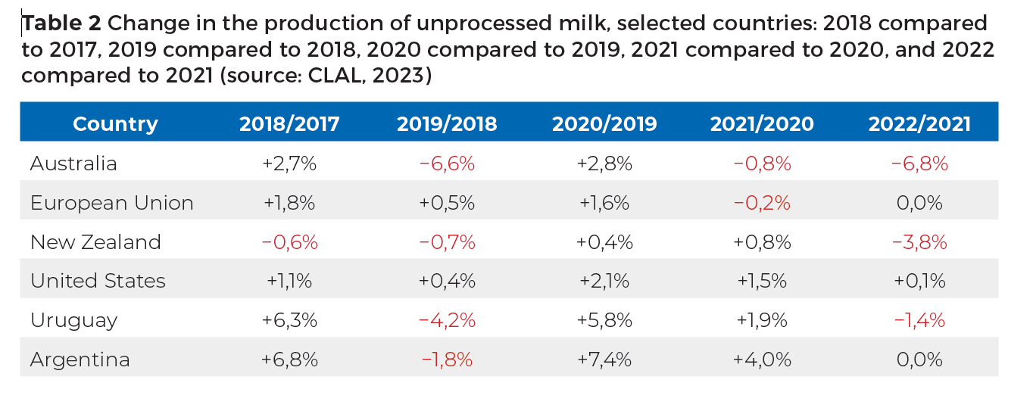
Change in production of unprocessed milk: Selected countries
Source: CLAL, May 2023

Slide 11
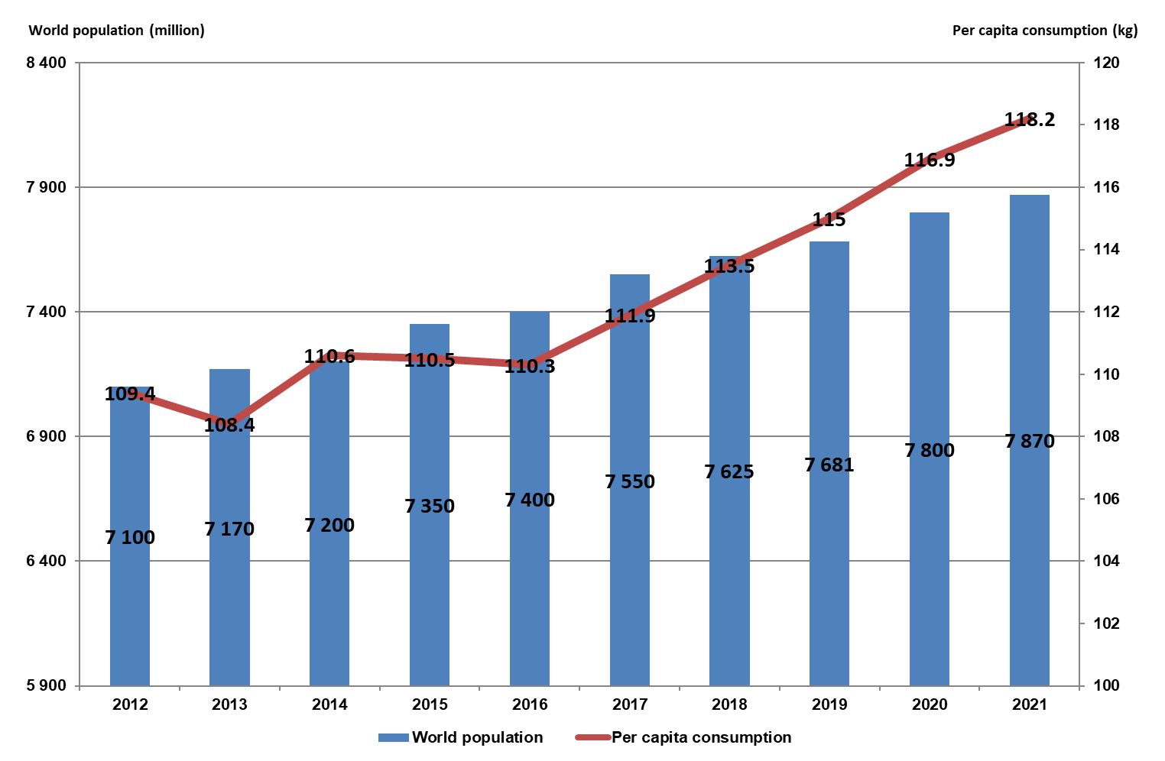
World population and per capita dairy consumption, 2012 - 2021
Source: IDF Bulletin 518/2022

Slide 12
GlobalDairytrade Auction Sale price index of dairy products,
Jan 2012 – May 2023
Source: GDT Index
Notes:
GDT Ltd, a subsidiary of Fonterra ...
Auctions every two weeks
Index is based on winning prices
20 Dec 2022 to 6 June 2023 is on the next slide

Slide 13
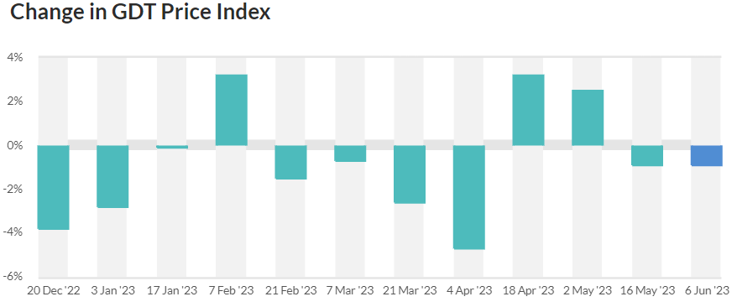

% Change in GDT Price index: 20 Dec ’22 – 6 Jun 2023
Notes:
The last 4 auctions show that prices were doing better than the prior 8 auctions.

Slide 14
International prices of dairy products
Jan 2013 – May 2023
US$/ton
Rand/ton
Source: USDA, South African Reserve Bank
Notes:
Prices of all products down since mid 2022.
Uptick in prices recently
Second graph accentuate the international prices, as it is expressed in Rand terms which weakens all the time.

Slide 15
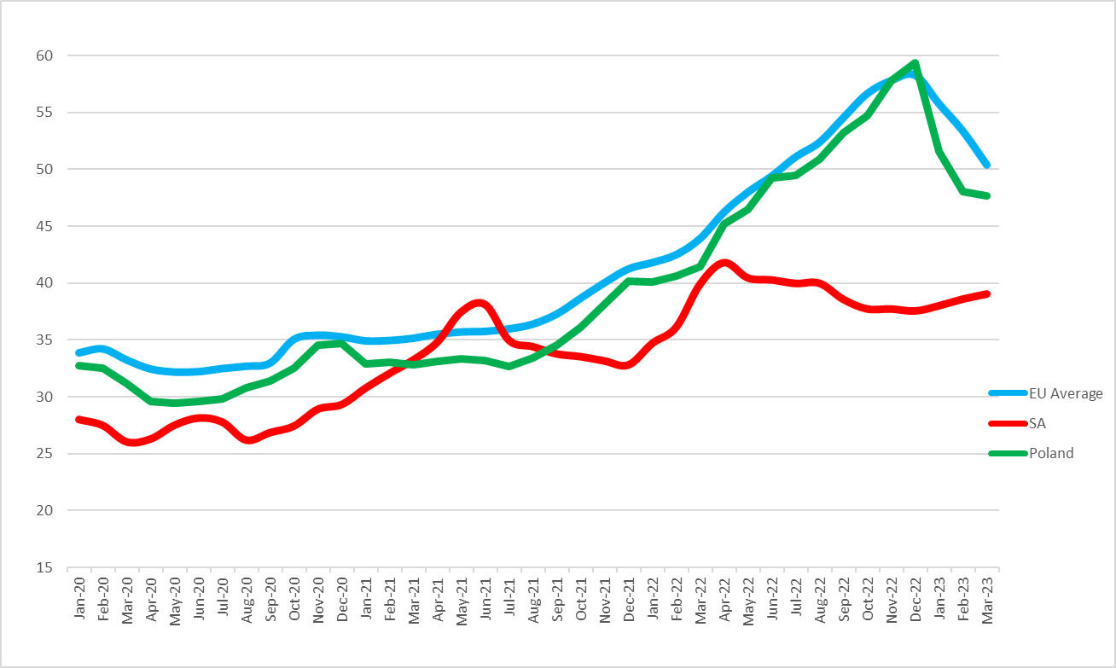
Average European, Poland and SA producer prices, of unprocessed milk, Euro/100kg, Jan 2020 – March 2023
Source: European Commission, MPO and SARB
Notes:
Producer prices were mainly driven by energy and fertilizer prices.
Drop in prices lately: Rabo Bank ... “A little bit less demand and a little more supply”.
In Rand terms, producer prices increased by ±17,7% (Mar 22 – Mar 23) but the Rand devaluated with also ±17,7% during that period. Hence the flat line since Mar 22

Slide 16
International economy
International dairy situation
SA economic situation
SA dairy situation

Slide 17
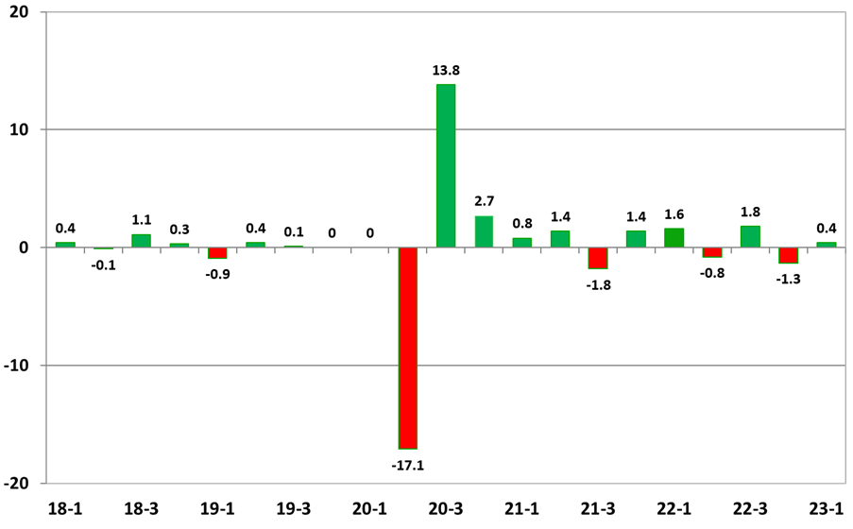
Annual SA economic growth ( non-annualized)
2018 – 2022 (base year 2015)
Source: Stats SA
Notes:
Quarter on Quarter percentage changes.
First quarter of 2023 saw a 0,4% increase despite electricity crisis.
Main contributors to the 0,4% was the financial and manufacturing sectors.
Within the manufacturing sector, food and beverages was the main driver.
In the household consumption category, spending on restaurants and hotels were the biggest contributors.

Slide 18
Annual SA GDP at market value (seasonally adjusted) 2016 – 2022 (base year 2015) (R billion)
Source: Stats SA
Notes:
GDP in 2022 was 2% higher than in 2021 and only 0,26% higher than in 2019.
2022 GDP value is R4,6 trillion.

Slide 19
Consumer price inflation
Jan 2010 – April 2023
Source: Stats SA
Notes:
Steep increase in CPI since Covid
CPI eased to a 11 month low in April 2023.
CPI in March was 7,1% and 6,8% in April.

Slide 20
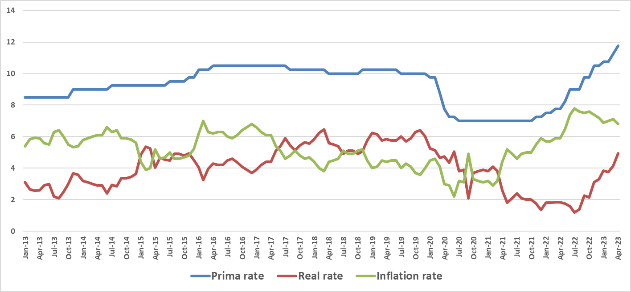
Prime interest rate, real interest rate and inflation rate in South Africa: Jan 2013 – April 2023
Source: SARB
Notes:
Prime lending rate was accommodating in the Covid period to stimulate the economy.
Trend is towards a real positive interest rate, where interest moves closer to inflation.

Slide 21
SA households: real disposable income and debt as %
1982 – 2021
%
Rand
Source: SARB

Slide 22
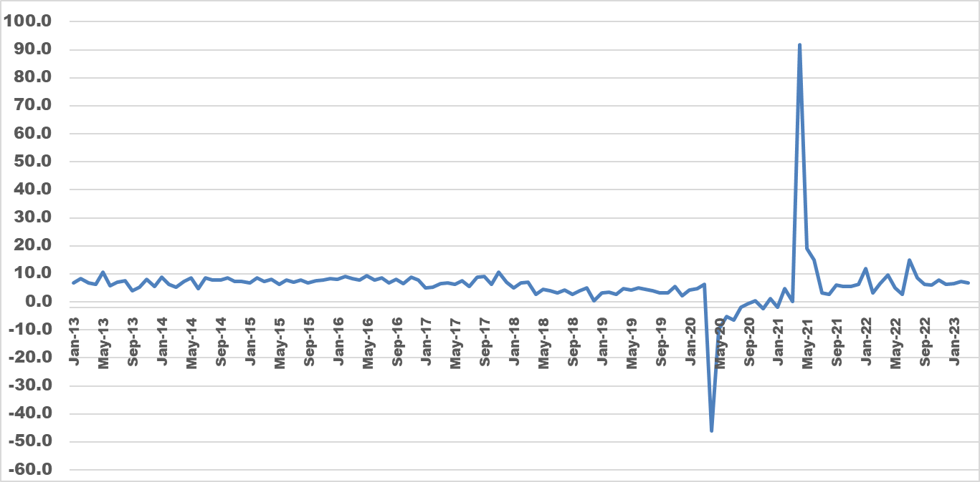
Retail sales growth at nominal prices
Jan 2013 – March 2023
Source: Stats SA

Slide 23
International economy
International dairy situation
SA economic situation
SA dairy situation

Slide 24
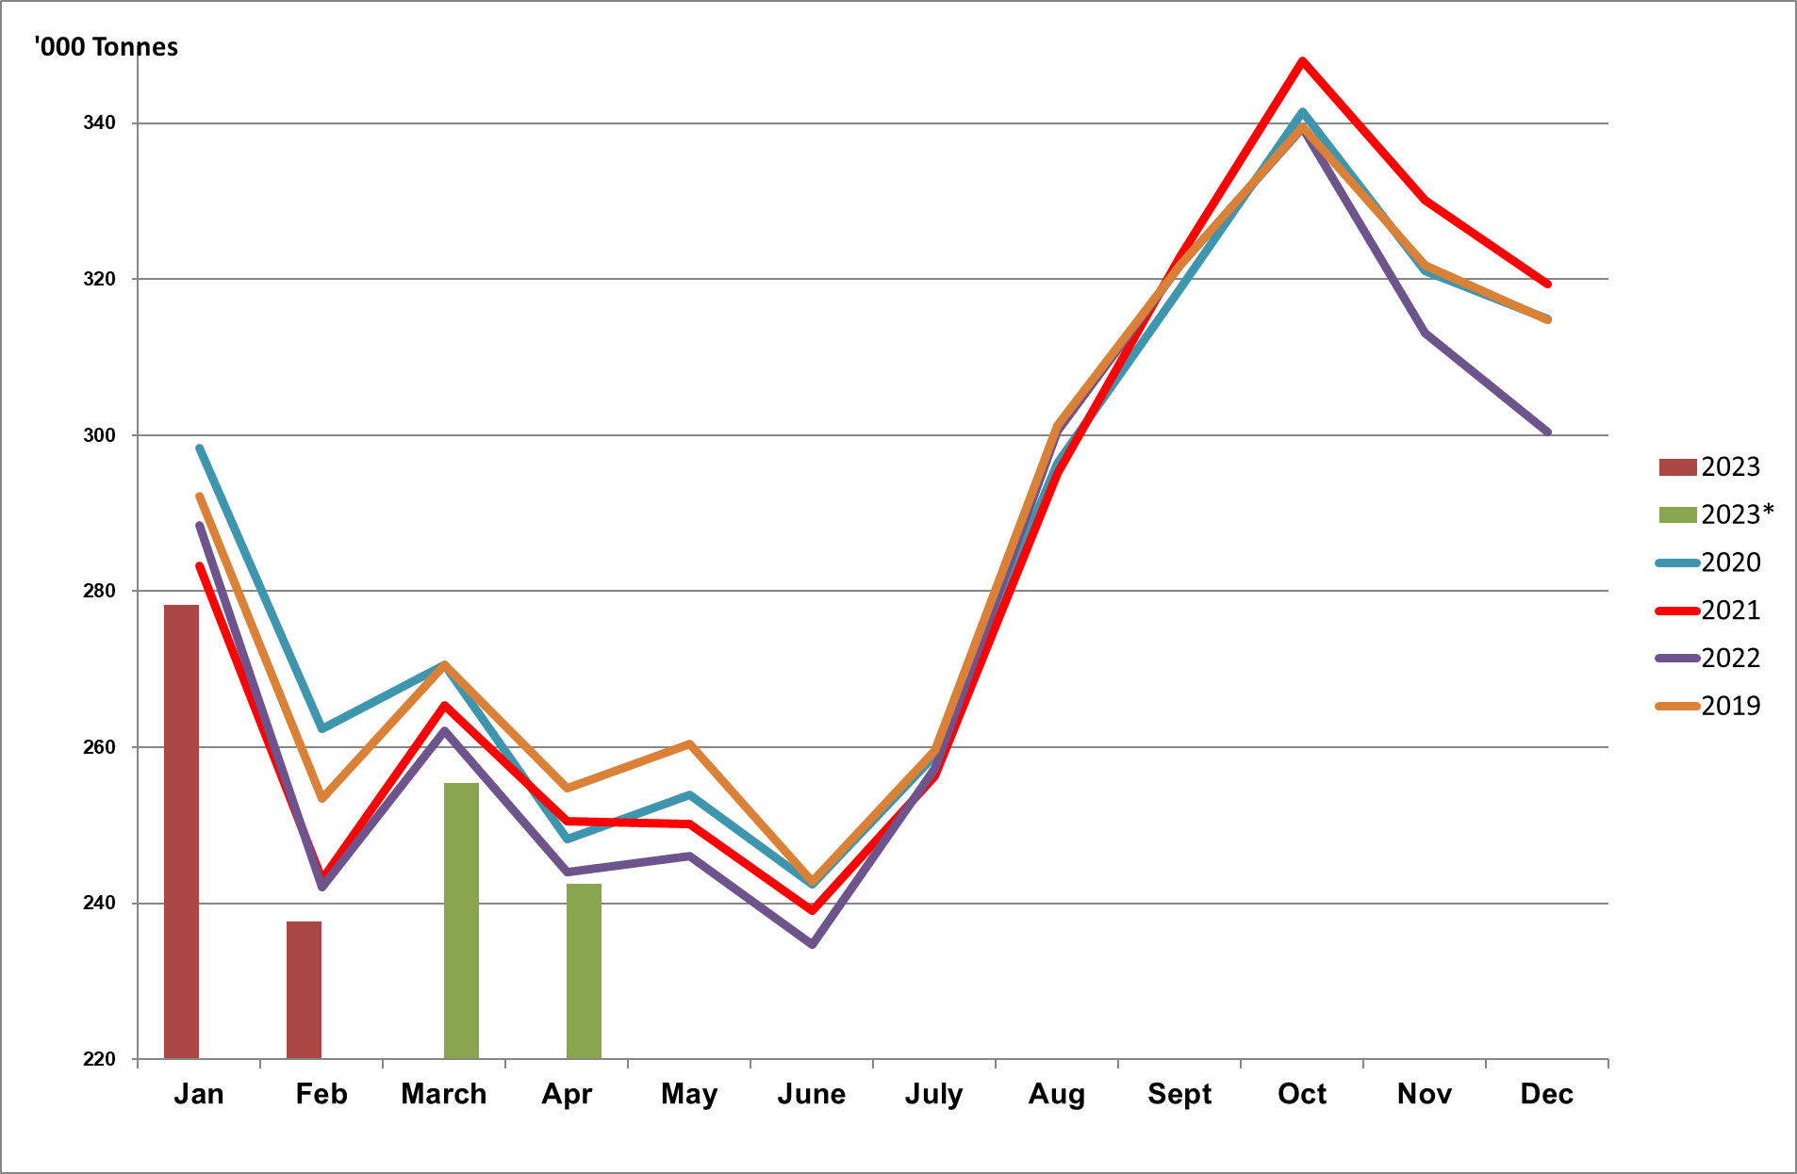
Monthly unprocessed milk purchases :Jan 2019 – April 2023 (table percentage change per year)
Year | ‘000 Ton
2011 | 2 712
2012 | 2 843 (4.83%)
2013 | 2 906 (2,22%)
2014 | 2 983 (2.65%)
2015 | 3 173 (6.37%)
2016 | 3 158 (-0.45%)
2017 2018 2019 2020 2021 2022 | 3 254 (3.02%) 3 411 (4.82%) 3 433 (0.65%) 3 427 (-0.16%) 3 403 (-0.71%) 3 350 (-1.56%)
Source: Milk SA; March and April preliminary

Slide 25
CHANGES IN THE QUANTITIES OF RETAIL SALES FROM THE YEAR JANUARY 2021 TO DECEMBER 2021, TO THE YEAR JANUARY 2022 TO DECEMBER 2022, AND CHANGES IN THE RETAIL PRICES FROM DECEMBER 2021 TO DECEMBER 2022 OF SPECIFIC DAIRY PRODUCTS
Source: SAMPRO based on NielsenIQ December 2022 report

Slide 26
CHANGES IN THE QUANTITIES OF RETAIL SALES OF SPECIFIC DAIRY PRODUCTS
Source: SAMPRO based on NielsenIQ December 2022 report

Slide 27
Changes in average retail prices of specific dairy products
Source: SAMPRO based on NielsenIQ December 2022 report

Slide 28
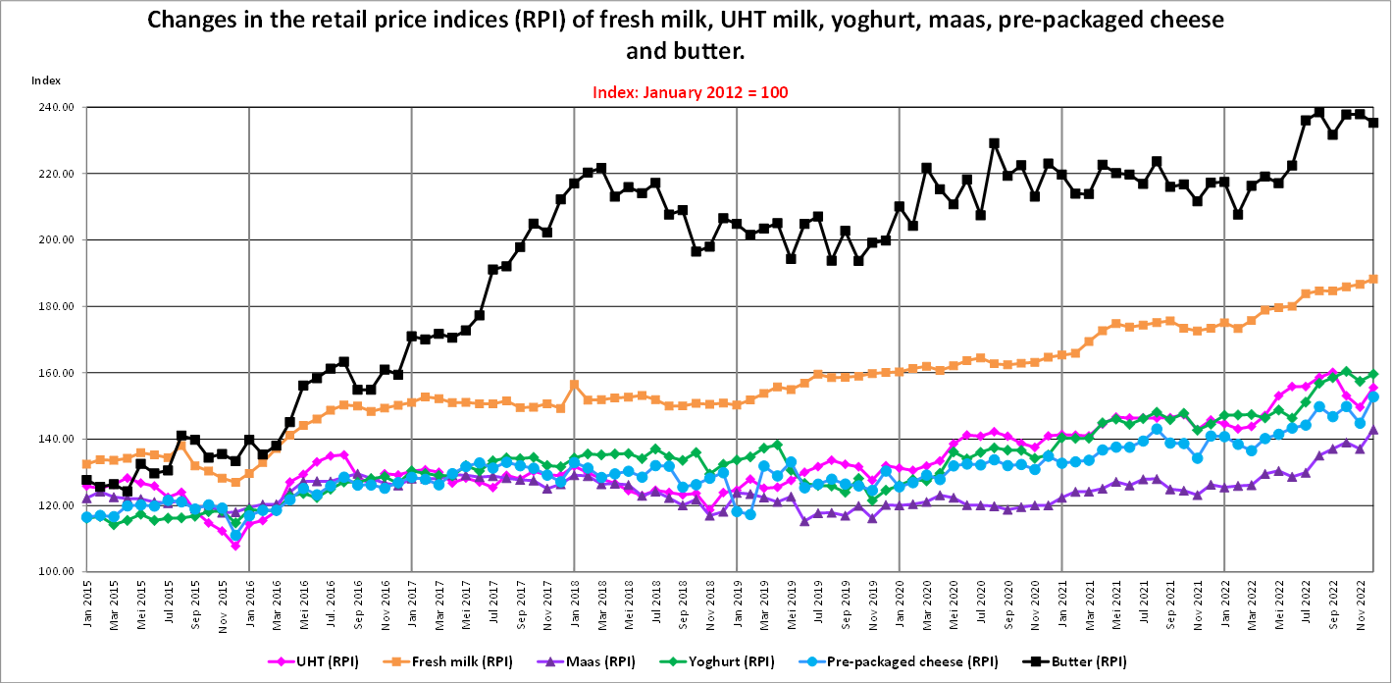
to March 2023
Source: Stats SA as supplied by SAMPRO
Notes:
Since 2014, butter became popular again after scientific evidence convinced consumers that saturated fats are essential to good health.
TIME magazine of June 2014: “Eat butter”.
All retail prices took off quite substantially since the start of Covid in March 2020.

Slide 29
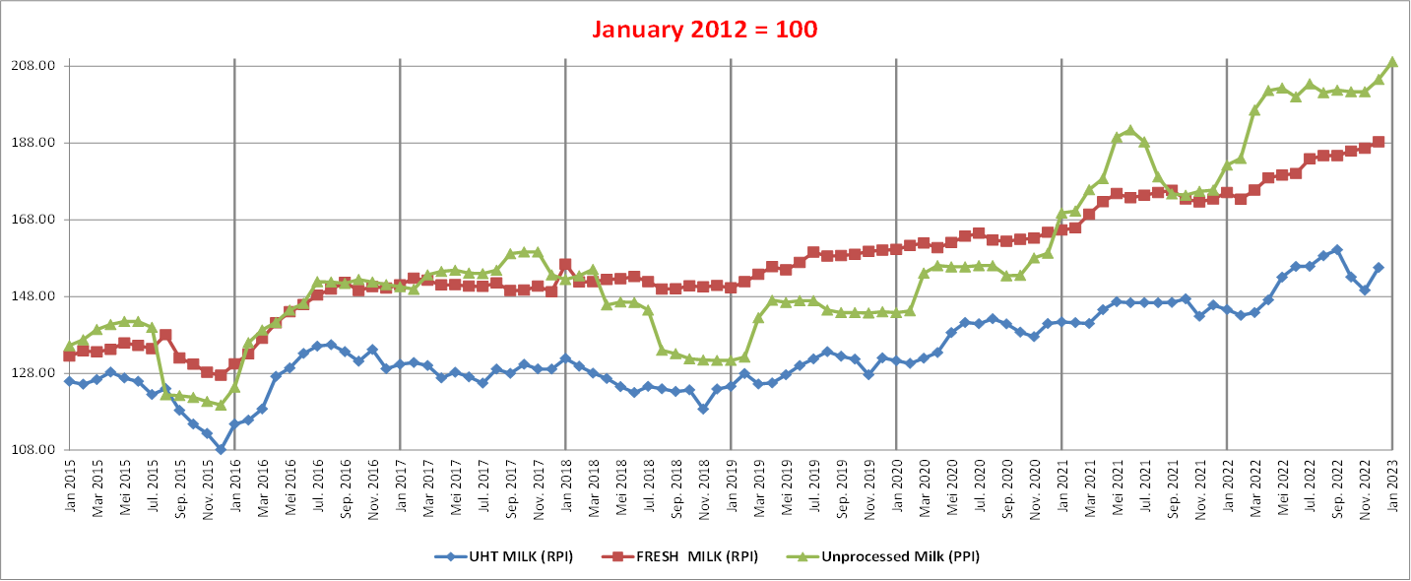
THE PRODUCER PRICE INDEX (PPI) OF UNPROCESSED MILK, FROM JANUARY 2015 TO JANUARY 2023 AND THE RETAIL PRICE INDICES (RPI) OF FRESH MILK AND UHT MILK, FROM JANUARY 2015 TO DECEMBER 2022
Source: Stats SA as supplied by SAMPRO
Notes:
Fresh milk had a smoother index than UHT milk and Unprocessed milk.
After a long period of sideways movement for UHT milk’s index, it picked up in March 2020.
Unprocessed milk shows a steeper index since Oct 2020.

Slide 30
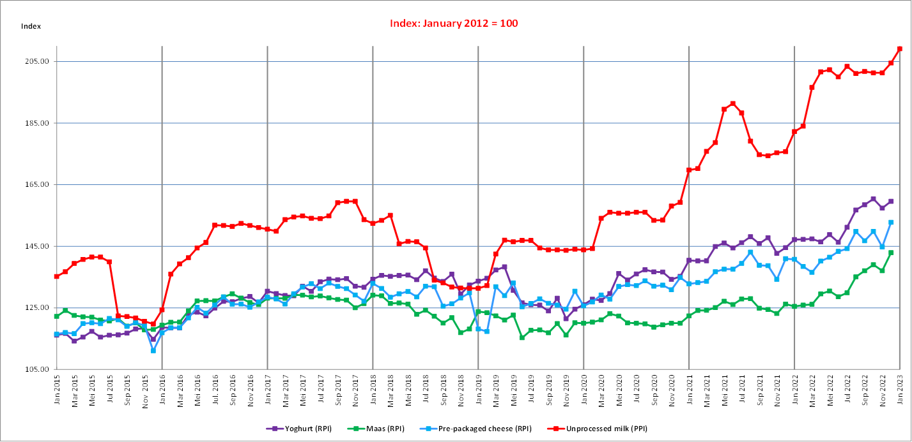
THE PRODUCER PRICE INDEX (PPI) OF UNPROCESSED MILK, FROM JANUARY 2015 TO JANUARY 2023 AND THE RETAIL PRICE INDICES (RPI) OF YOGHURT, MAAS AND PRE-PACKAGED CHEESE, FROM JANUARY 2015 TO DECEMBER 2022
Source: Stats SA as supplied by SAMPRO
Notes:
Once again, a marked movement in the indices since March 2020.

Slide 31
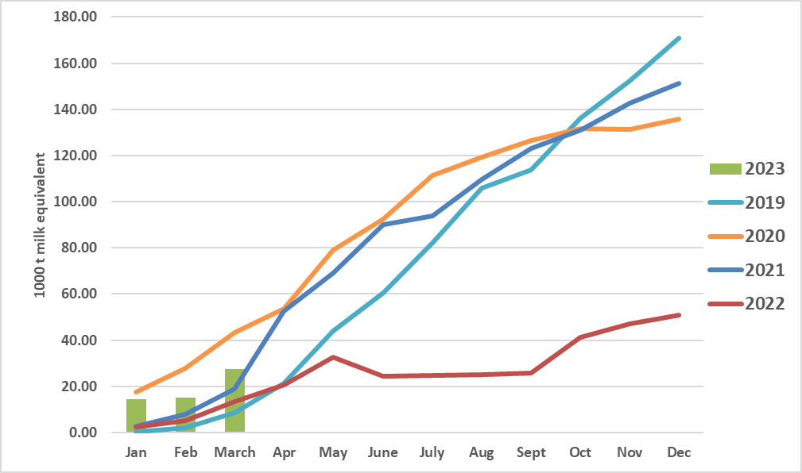
Monthly cumulative net imports, milk equivalent: Jan 2019 to March 2023
Source: SARS as supplied by SAMPRO
Notes:
Important to note that it is NET imports and also MILK EQUIVALENT.
The first quarter saw higher figures than 2019, 2021 and 2022.

Slide 32
Annual purchases of unprocessed milk plus milk equivalent of net imports = Tot supply: 2013 to 2023
Source: SAMPRO, MPO, MILK SA
Notes:
Gap between blue and red lines is NET imports.

Slide 33
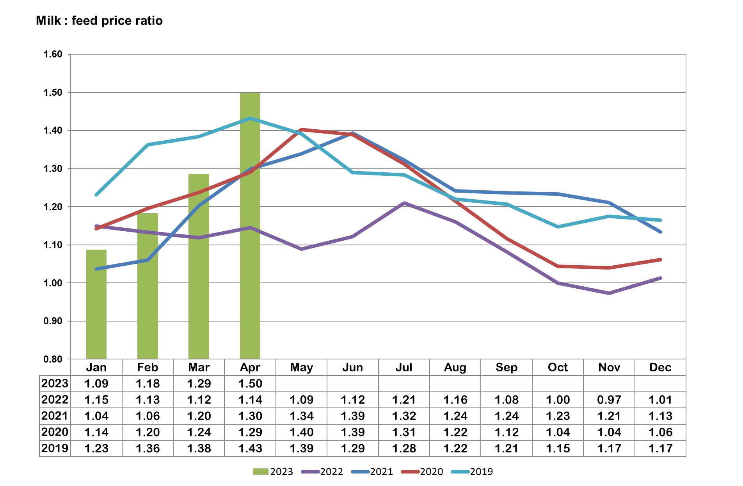
Calculated milk: maize plus soybean price ratio Jan 2019 – April 2023
Source: MPO calculations; “Feed price” = 70% YM1, 30% Soy, Safex nearest month prices, Producer price MPO survey
Notes:
1,5 ration = economically viable for producers, as also recognized by the IFCN.

Slide 34
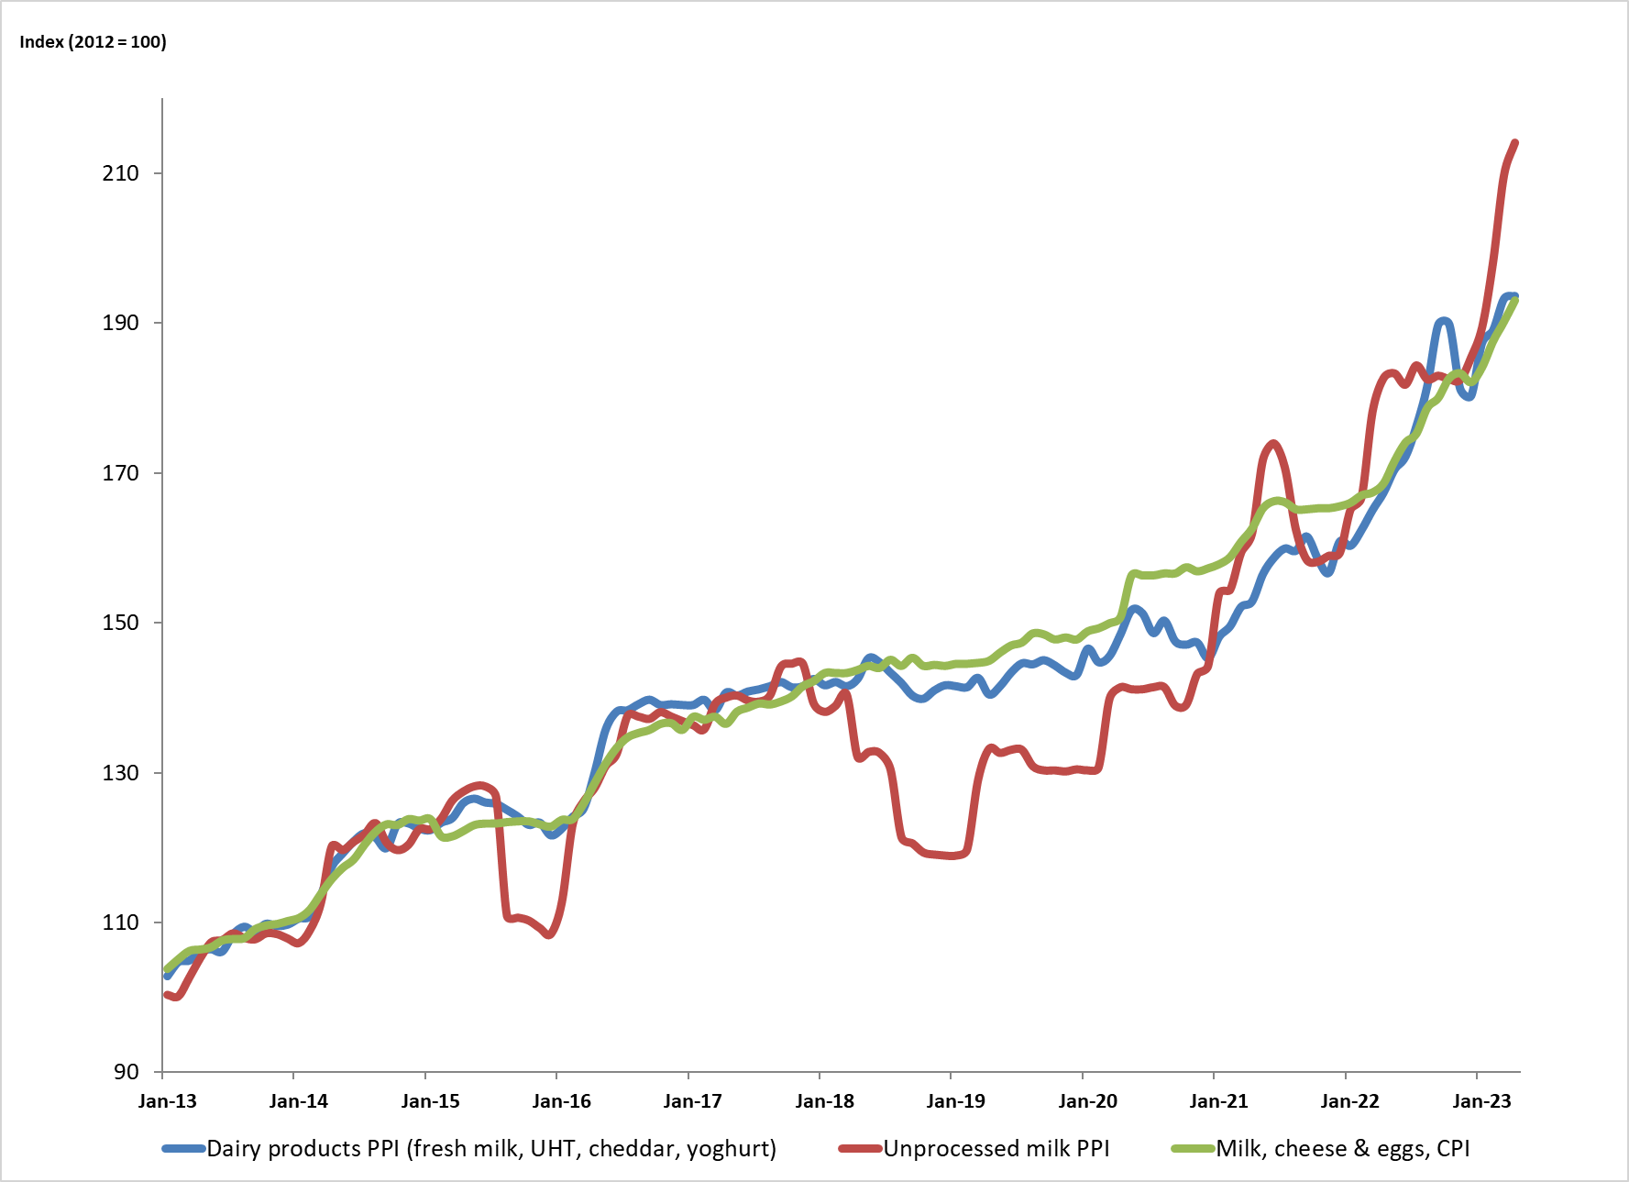
PPI Indices of unprocessed milk and dairy products and the CPI of milk, cheese and eggs: 2013 to April 2023
Source: Stats SA
Notes:
Lately, we saw that the index of dairy products slowed down a bit, with Unprocessed milk PPI soaring for the past few months.

Slide 35

Thank you

