Slide 1
MilkSA Project: Economies and Markets
Presentation for the
Milk SA Annual General Meeting
30 November 2023
Prepared by B van Heerden, assisted by the MSA Industry Information Work Group
November 2023

Slide 2
The New Environment: “When the truth is dependent on what is trending”
Source: Bloomberg Chatroom – The Balance Of Power

Slide 3
International economy
International dairy situation
SA economic situation
SA dairy situation

Slide 4
FAO food price indices Jan 2013 – October 2023
Source: FAO, Nov 2023

Slide 5
.
Source: World bank (* forecast)

Slide 6
World Dynamic: “Moving from a complex world to a more complex world”
Source: Bloomberg Chatroom – The Balance Of Power

Slide 7
International economy
International dairy situation
SA economic situation
SA dairy situation

Slide 8
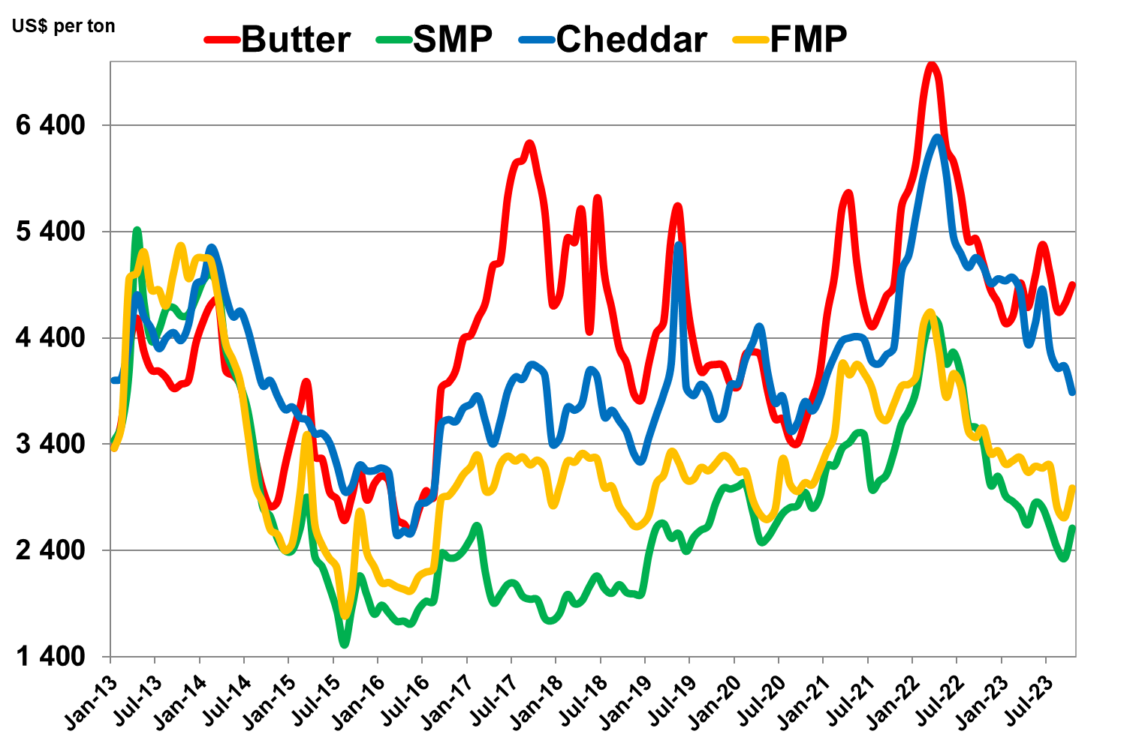
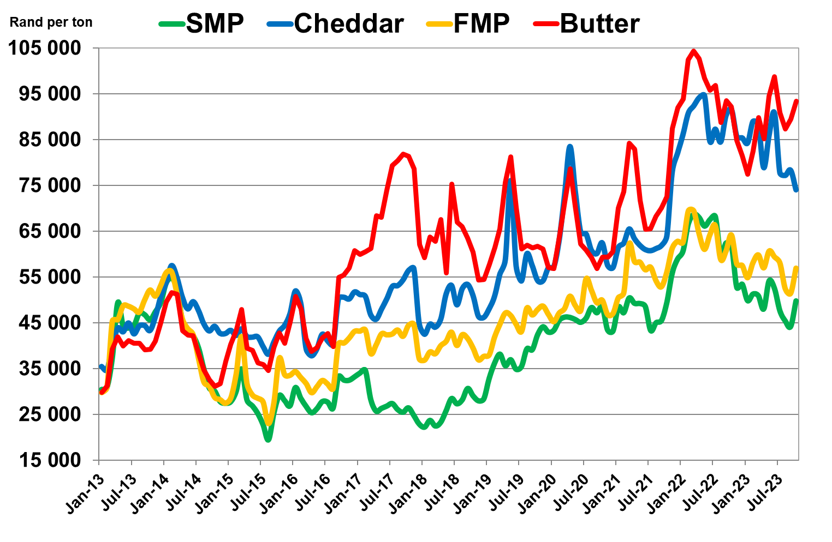
International prices of dairy products Jan 2013 – October 2023
US$/ton
Rand/ton
Source: USDA, South African Reserve Bank (exchange rate)

Slide 9
International economy
International dairy situation
SA economic situation
SA dairy situation

Slide 10
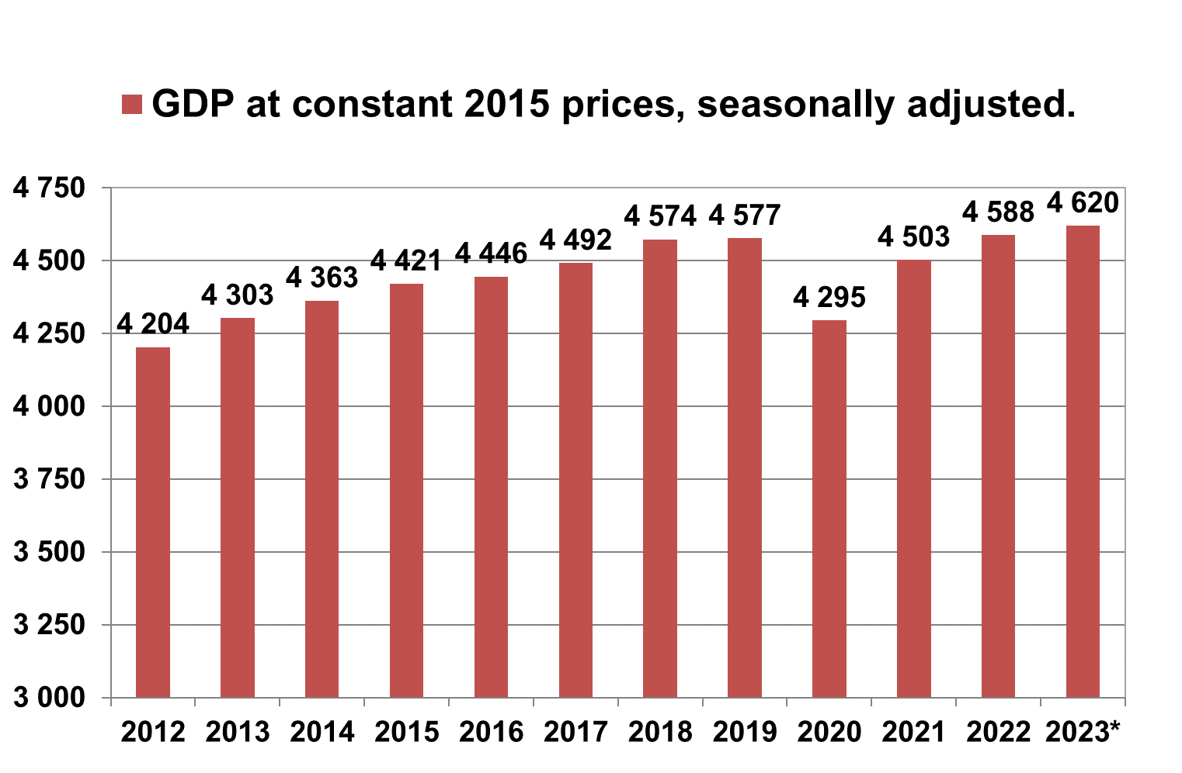
Annual SA GDP at 2015 constant prices 2012 – 2023 (R billion)
Source: Stats SA, * projected.

Slide 11
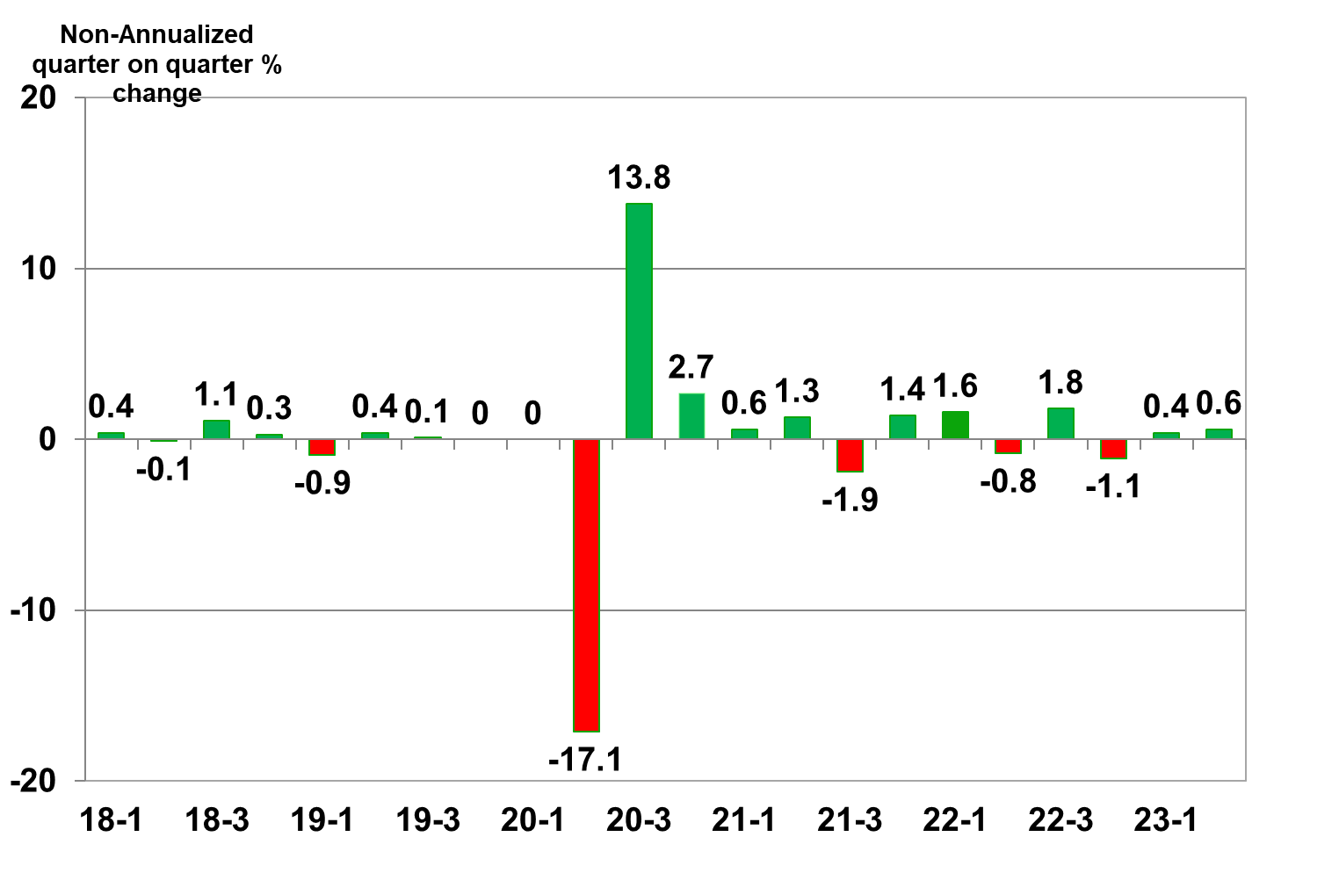
Annual SA economic growth ( non-annualized) 2018 – 2023(1,2) (base year 2015)
Source: Stats SA

Slide 12
.
Year | GDP Growth Rate | GDP (R Billion) | GDP Index | Pop. (millions) | GDP per Capita (R000) | Househ. Expend. (R Billion) | Expend. per Househ. | Monthly Househ. Expend.
2011 | 3.2% | R4 120 | 93 | 52 | R79 | R2 610 | R201 203 | R16 767
2012 | 2.4% | R4 204 | 95 | 53 | R79 | R2 694 | R204 501 | R17 042
2013 | 2.5% | R4 303 | 97 | 54 | R80 | R2 736 | R204 471 | R17 039
2014 | 1.4% | R4 363 | 99 | 54 | R81 | R2 756 | R202 743 | R16 895
2015 | 1.3% | R4 421 | 100 | 55 | R80 | R2 815 | R203 987 | R16 999
2016 | 0.6% | R4 446 | 101 | 56 | R79 | R2 834 | R202 386 | R16 866
2017 | 1.0% | R4 492 | 102 | 57 | R79 | R2 883 | R202 886 | R16 907
2018 | 1.8% | R4 574 | 103 | 58 | R79 | R2 974 | R206 279 | R17 190
2019 | 0.1% | R4 577 | 104 | 59 | R78 | R3 012 | R205 855 | R17 155
2020 | -6.2% | R4 295 | 97 | 59 | R73 | R2 826 | R190 560 | R15 880
2021 | 4.8% | R4 503 | 102 | 60 | R75 | R2 993 | R199 622 | R16 635
2022 | 1.9% | R4 588 | 104 | 61 | R75 | R3 067 | R202 398 | R16 867
Forec | 0.7% | R4 620 | 105 | 62 | R75 | R3 063 | R198 279 | R16 525
Source: Stats SA, All prices at 2015 constant prices

Slide 13
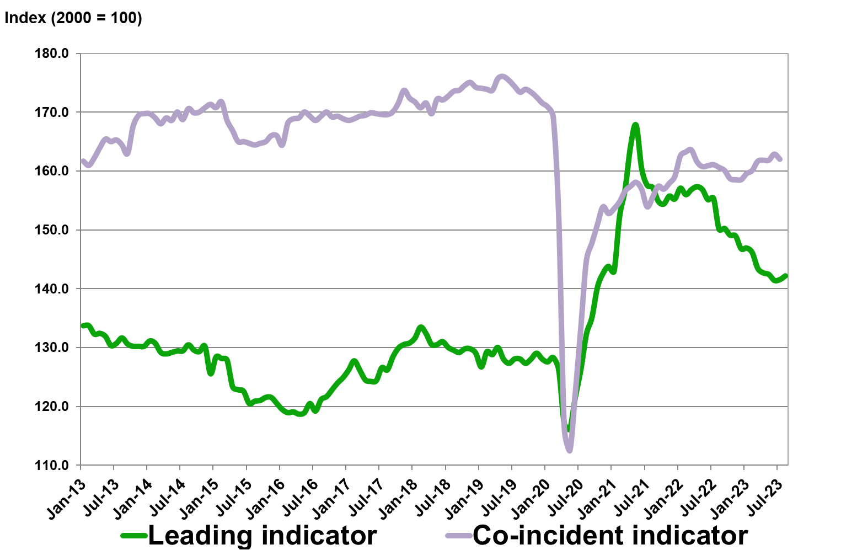
Business cycle indicators: Leading and the Co-incident Indicator Jan 2013 – Augustus 2023
Source: SA Reserve Bank

Slide 14
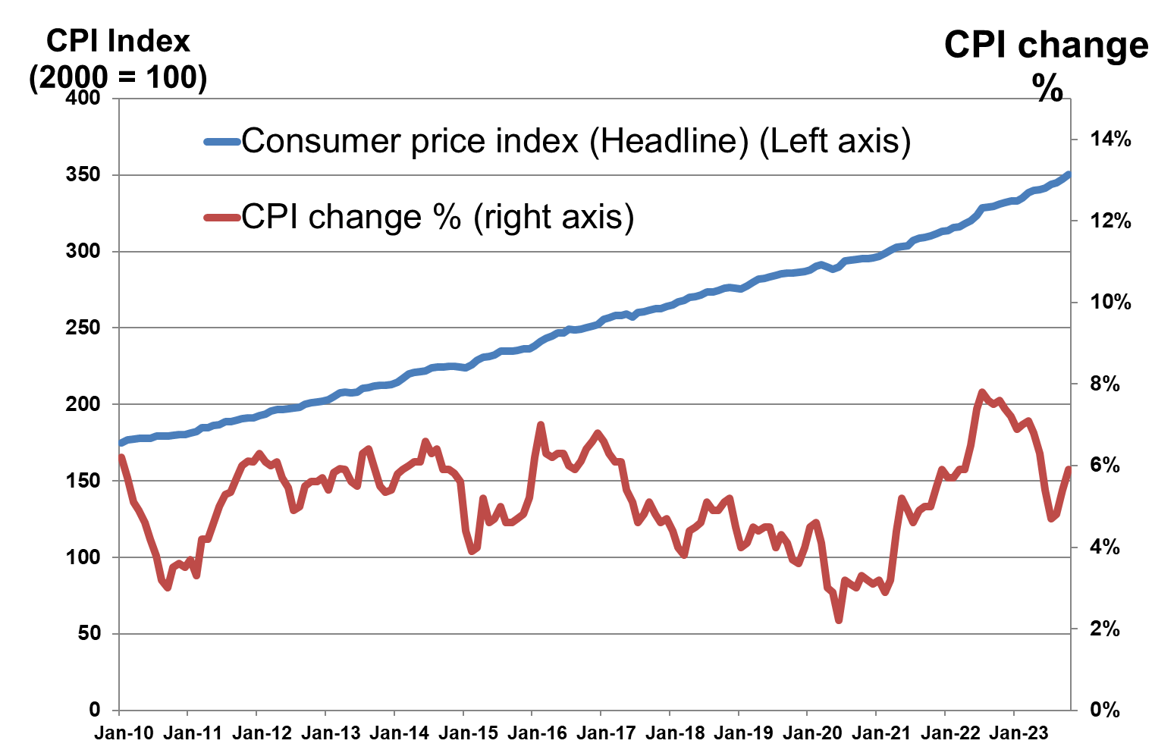
Consumer price inflation Jan 2010 – Oct 2023
Source: Stats SA

Slide 15
International economy
International dairy situation
SA economic situation
SA dairy situation

Slide 16
CHANGES IN THE RETAIL SALES QUANTITIES FROM THE YEAR OCTOBER 2021 TO SEPTEMBER 2022, TO THE YEAR OCTOBER 2022 TO SEPTEMBER 2023 AND CHANGES IN THE RETAIL PRICES FROM SEPTEMBER 2022 TO SEPTEMBER 2023 OF SPECIFIC DAIRY PRODUCTS
PRODUCT | CHANGE IN RETAIL SALES QUANTITY PERCENT | CHANGE IN RETAIL PRICES PERCENT
FRESH MILK | -5.8 | 12.8
LONG LIFE MILK (UHT MILK) | -4.2 | 14.9
FLAVOURED MILK | -10.7 | 9.4
YOGHURT | -7.6 | 9.6
MAAS | -5.9 | 16.8
PRE-PACKAGED CHEESE | -1.1 | 13.2
CREAM CHEESE | 5.6 | 8.6
BUTTER | -5.8 | 12.3
CREAM | -3.1 | 8.6
Source: SAMPRO based on NielsenIQ September 2023 report

Slide 17
CHANGES IN THE QUANTITIES OF RETAIL SALES OF SPECIFIC DAIRY PRODUCTS
PRODUCT | Sales in the month of Sept. 2023 versus the sales in the month of Sept. 2022 | Sales in the 3 months from July to Sept. 2023 versus the sales in the 3 months from July to Sept. 2022 | Sales in the 6 months from Apr. 2023 to Sept. 2023 versus the sales in the 6 months from Apr. 2022 to Sept. 2022 | Sales in the 9 months from Jan. 2023 to Sept. 2023 versus the sales in the 9 months from Jan. 2022 to Sept. 2022 | Sales in the 12 months from Oct. 2022 to Sept. 2023 versus the sales in the 12 months from Oct. 2021 to Sept. 2022
 | percent | percent | percent | percent | percent
FRESH MILK | -6.5 | -6.4 | -6.2 | -6.1 | -5.8
UHT MILK | -2.8 | -0.13 | -2.6 | -4.9 | -4.2
FLAVOURED MILK | -8.8 | -10.9 | -11.5 | -11.5 | -10.7
YOGHURT | -1.8 | -7.1 | -8.5 | -8.5 | -7.6
MAAS | -2.4 | -6.6 | -7.9 | -7.2 | -5.9
Pre-packaged cheese | -3.4 | -1.5 | -1.0 | -1.6 | -1.1
Cream cheese | 19.0 | 15.9 | 11.3 | 8.4 | 5.6
BUTTER | -15.4 | -3.5 | -4.0 | -6.6 | -5.8
CREAM | 2.1 | -1.3 | -2.3 | -2.7 | -3.1
Source: SAMPRO based on NielsenIQ September 2023 report

Slide 18
THE AVERAGE RETAIL PRICES OF SPECIFIC DAIRY PRODUCTS IN SEPTEMBER 2023, COMPARED TO THE AVERAGE RETAIL PRICES OF THE PRODUCTS CONCERNED IN SPECIFIC PREVIOUS MONTHS OF 2022 AND 2021
PRODUCT | Sept. 2023 versus Aug. 2023 (1 m.ago) | Sept. 2023 versus June 2023 (3 m. ago) | Sept. 2023 versus March 2023 (6 m. ago) | Sept. 2023 versus Dec. 2022 (9 m. ago) | Sept. 2023 versus Sept. 2022 (12 m. ago) | Sept. 2023 versus March 2022 (18 m. ago) | Sept. 2023 versus Sept. 2021 (24 m. ago)
 | Percent | Percent | Percent | Percent | Percent | Percent | Percent
FRESH MILK | -0.1 | -1.0 | 0.5 | 10.2 | 12.8 | 18.1 | 19.0
UHT MILK | 0.3 | -0.4 | 5.2 | 11.0 | 14.9 | 27.0 | 23.9
FLAVOURED MILK | 1.5 | 1.4 | 2.2 | 10.5 | 9.4 | 23.8 | 22.4
YOGHURT | -2.9 | -0.03 | 1.8 | 8.4 | 9.6 | 18.0 | 19.3
MAAS | -0.3 | 0.5 | 2.2 | 12.1 | 16.8 | 26.6 | 28.4
PRE-PACKAGED CHEESE | -0.07 | 2.9 | 5.0 | 7.4 | 13.2 | 21.1 | 18.9
CREAM CHEESE | 0.6 | -0.2 | 4.0 | 5.4 | 8.6 | 15.6 | 17.4
BUTTER | 1.9 | 0.5 | 6.7 | 2.7 | 12.3 | 22.4 | 18.2
CREAM | -0.8 | -0.9 | 1.9 | 6.2 | 8.6 | 15.5 | 18.5
Source: SAMPRO based on NielsenIQ September 2023 report

Slide 19
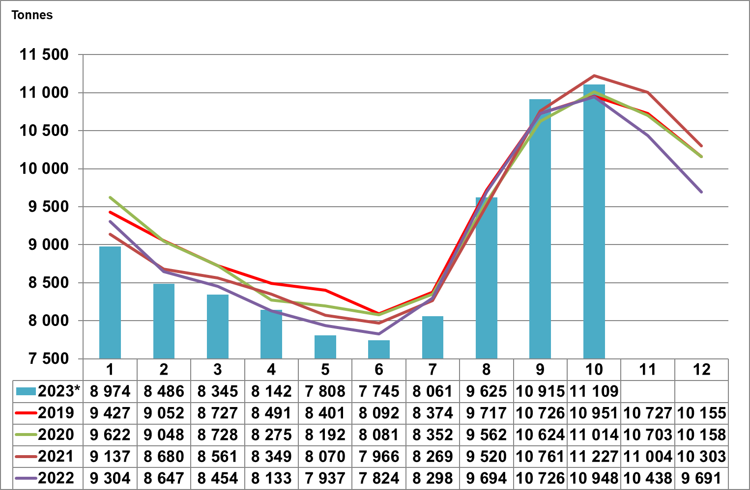
Monthly daily ave. unprocessed milk pur.: Jan 2019 – Oct 2023
Source: Milk SA; September and October preliminary

Slide 20
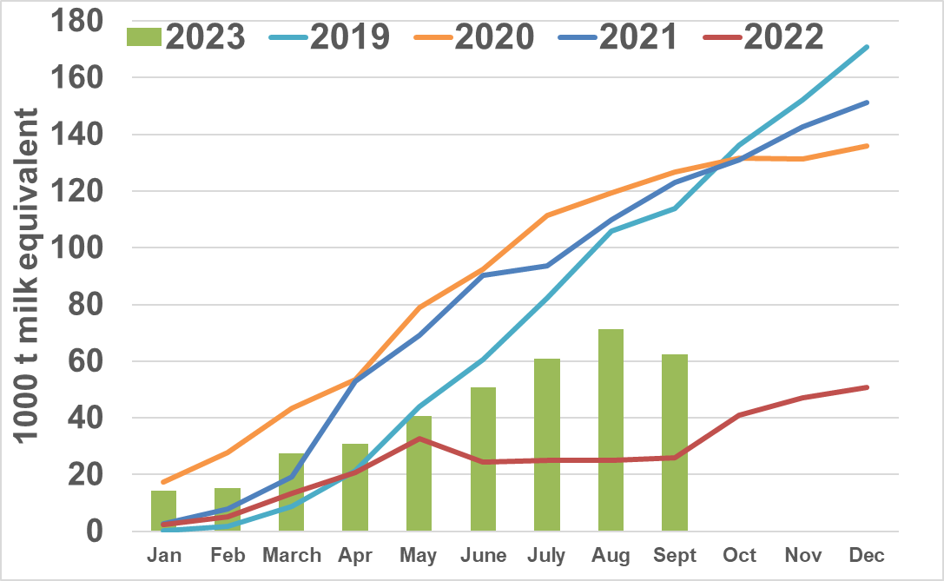
Monthly cumulative net imports, milk equivalent: Jan 2019 to Sept 2023
Source: SARS as supplied by SAMPRO

Slide 21
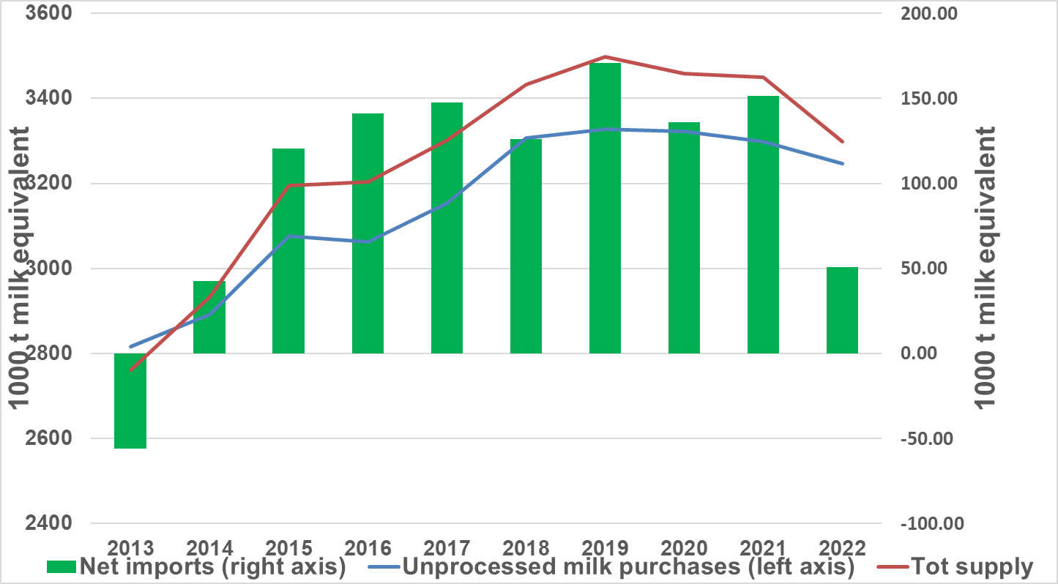
Annual purchases of unprocessed milk plus milk equivalent of net imports = Tot supply: 2013 to 2022
Source: SAMPRO, MILK SA,

Slide 22
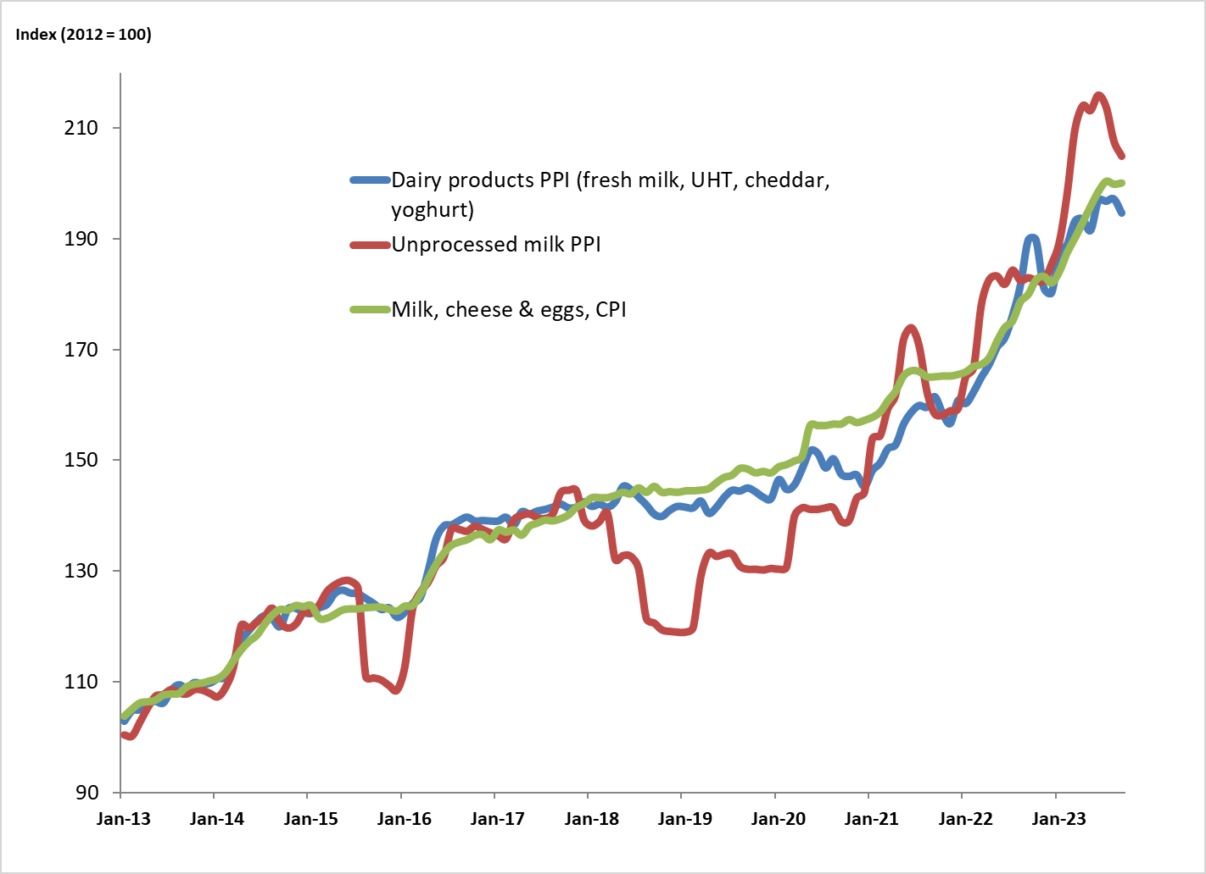
PPI Indices of unprocessed milk and dairy products and the CPI of milk, cheese and eggs: 2013 to Oct 2023
Source: Stats SA

Slide 23
Thank you

