Slide 1
MilkSA Project: Economies and Markets
Presentation for the
Milk SA Annual General Meeting
13 June 2024
Prepared by B van Heerden, assisted by the MSA Industry Information Work Group
June 2024

Slide 2
International economy
International dairy situation
SA economic situation
SA dairy situation

Slide 3
.
Source: IMF, WEO April 2024 (* forecast)

Slide 4
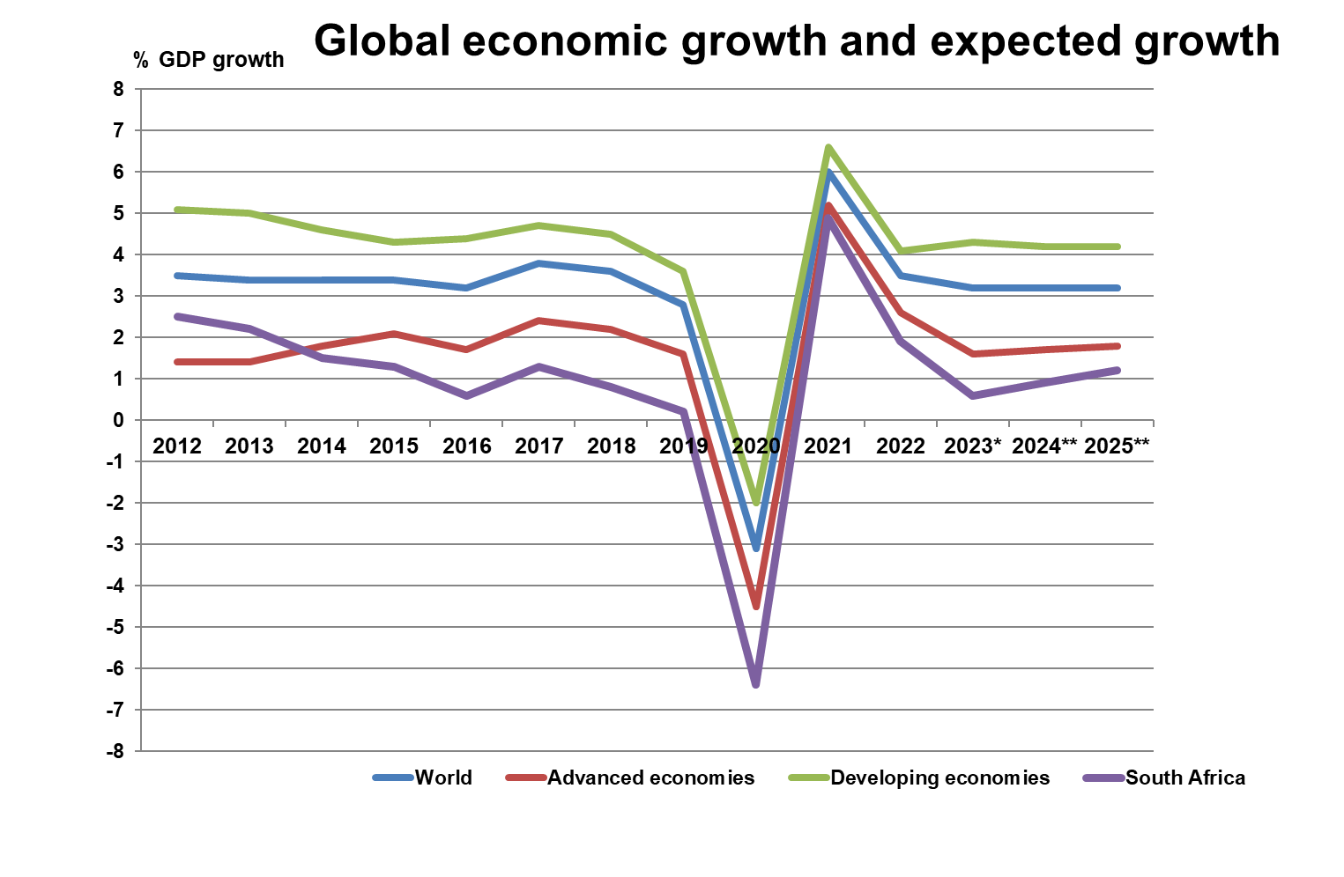
.
Source: World bank (* estimate) (** forecast)

Slide 5
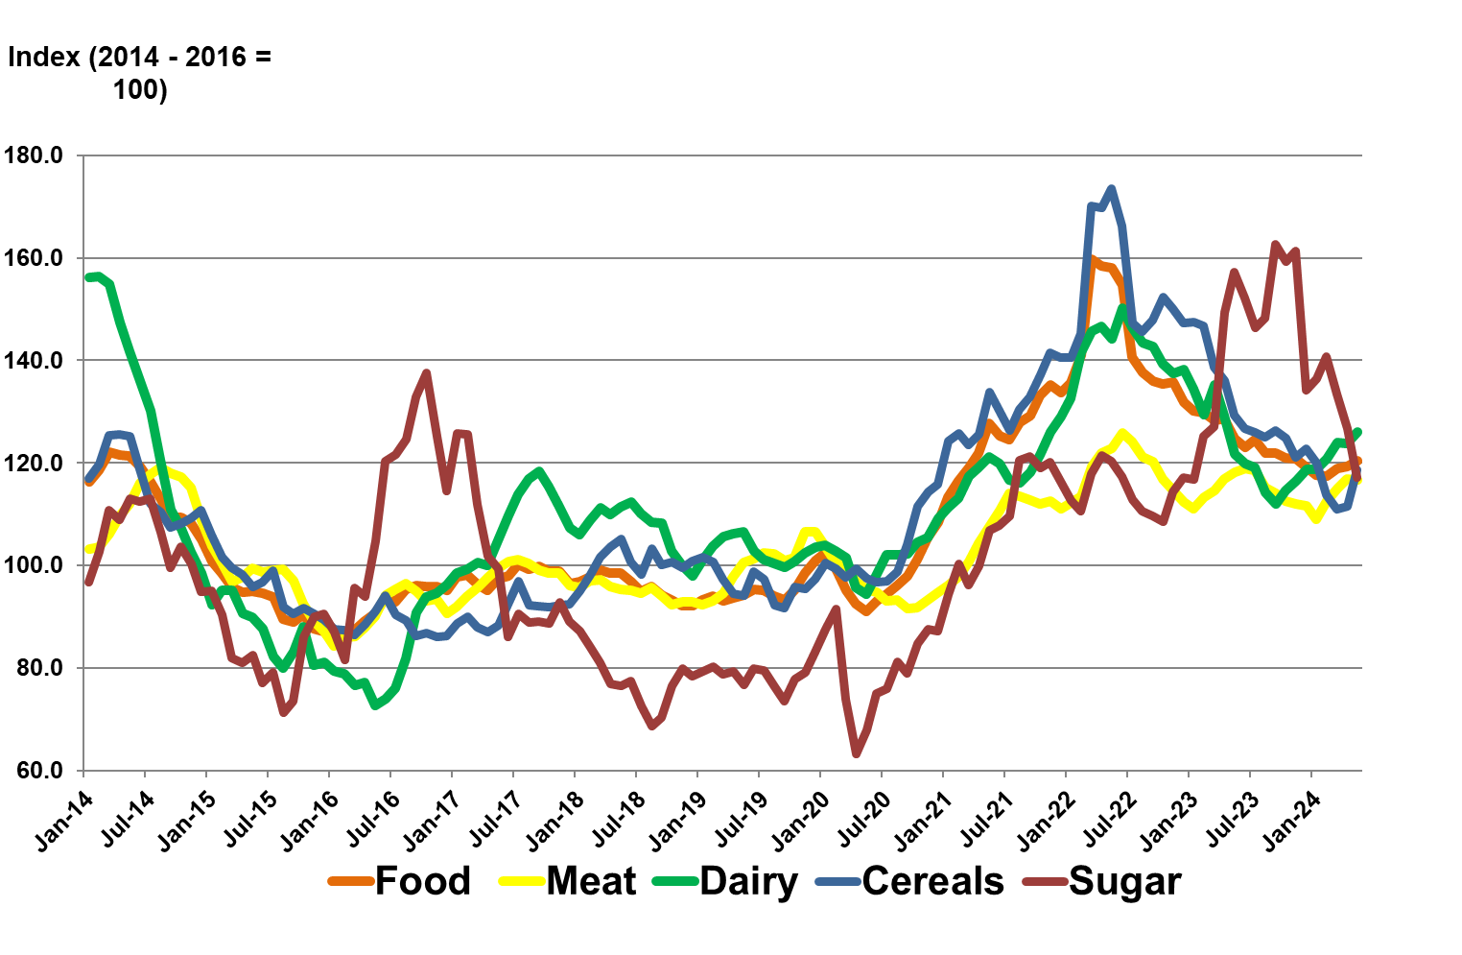
FAO food price indices Jan 2014 – May 2024
Source: FAO, June 2024

Slide 6
World Dynamic: “Recovery is steady but slow and differs by region”

Slide 7
International economy
International dairy situation
SA economic situation
SA dairy situation

Slide 8
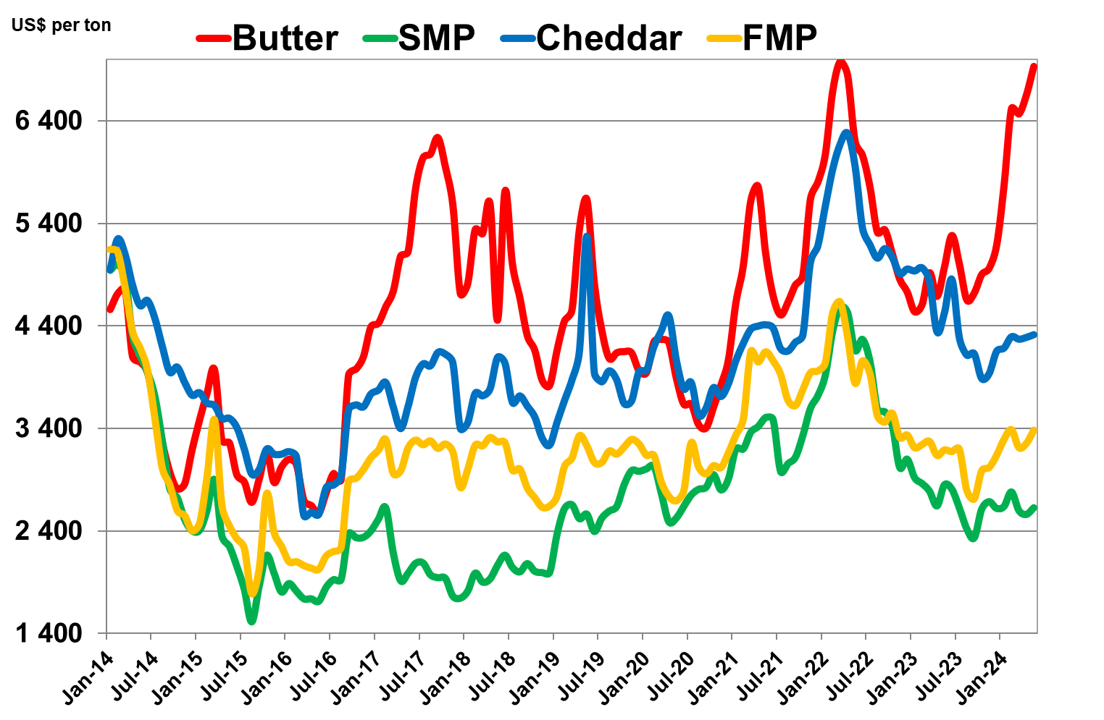
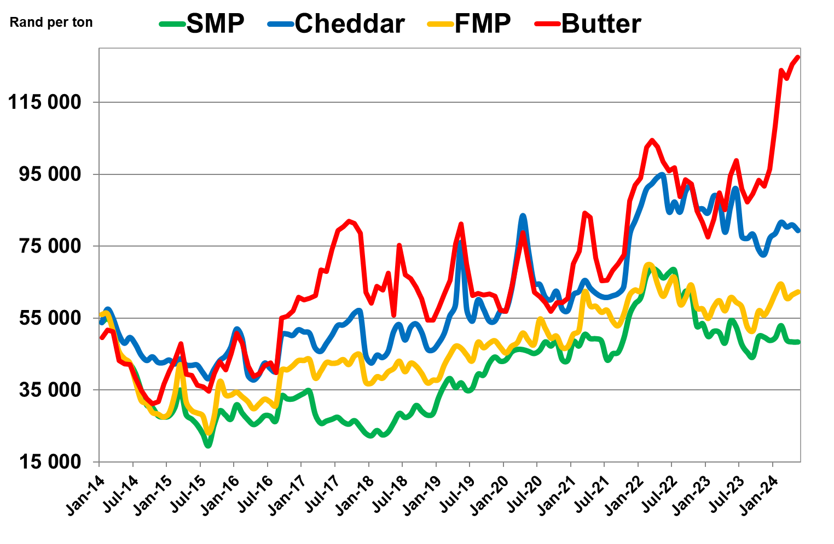
International prices of dairy products Jan 2014 – May 2024
US$/ton
Rand/ton
Source: USDA, South African Reserve Bank for exchange rate

Slide 9
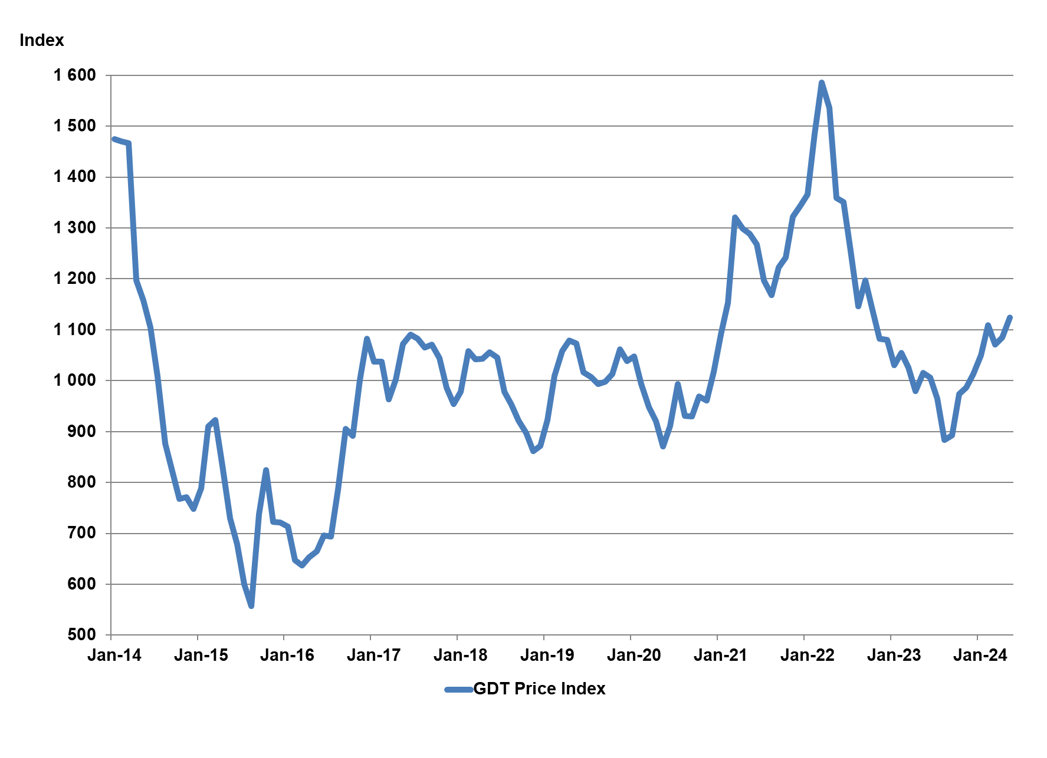
Global Dairy Trade Auction Price Index of Dairy Products (GDT). Jan 2014 – May 2024
Source: GDT Events

Slide 10
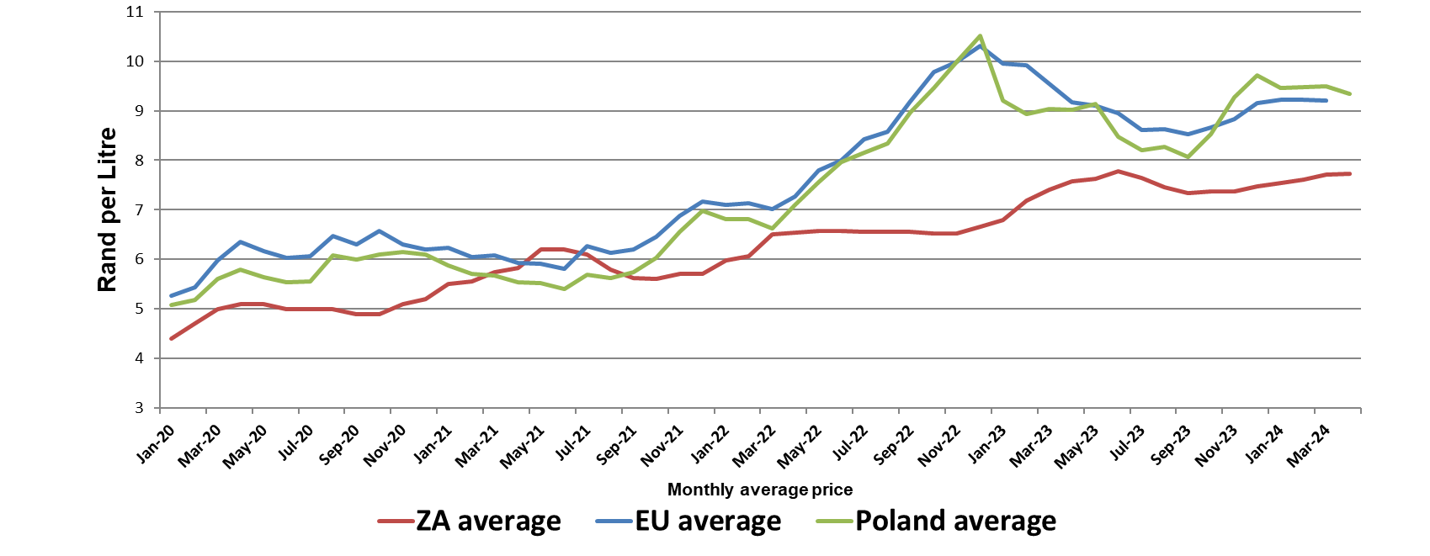
Average European, Poland, and SA producer prices, of unprocessed milk, R/litre, Jan 2020 – April 2024 (latest month preliminary)
Source: European Commission, MPO and SARB

Slide 11
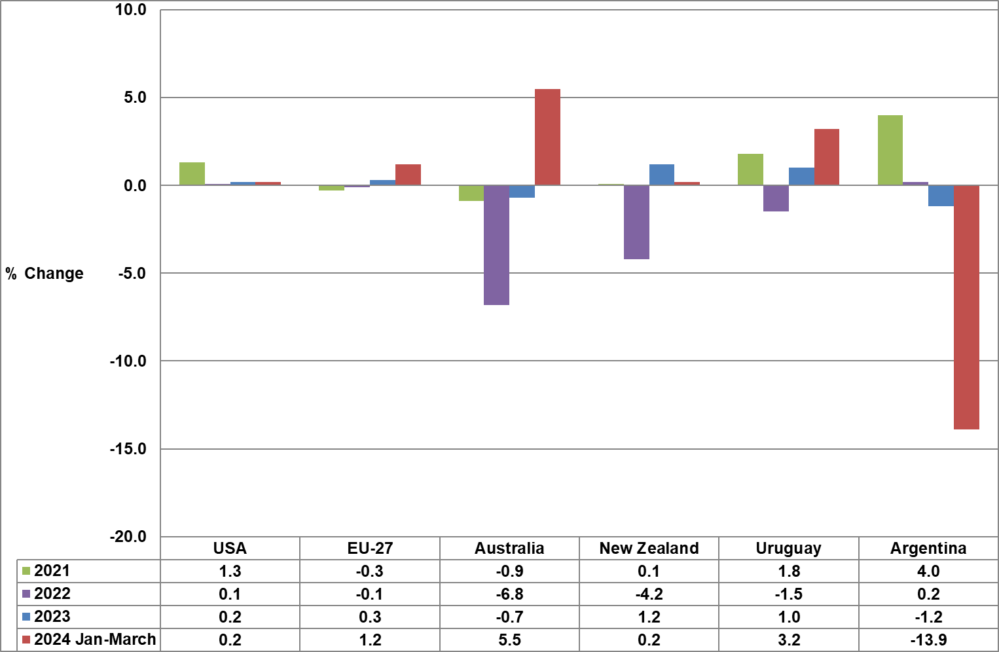
Unprocessed milk production in key exporting countries
Source: CLAL Advisory

Slide 12
International economy
International dairy situation
SA economic situation
SA dairy situation

Slide 13
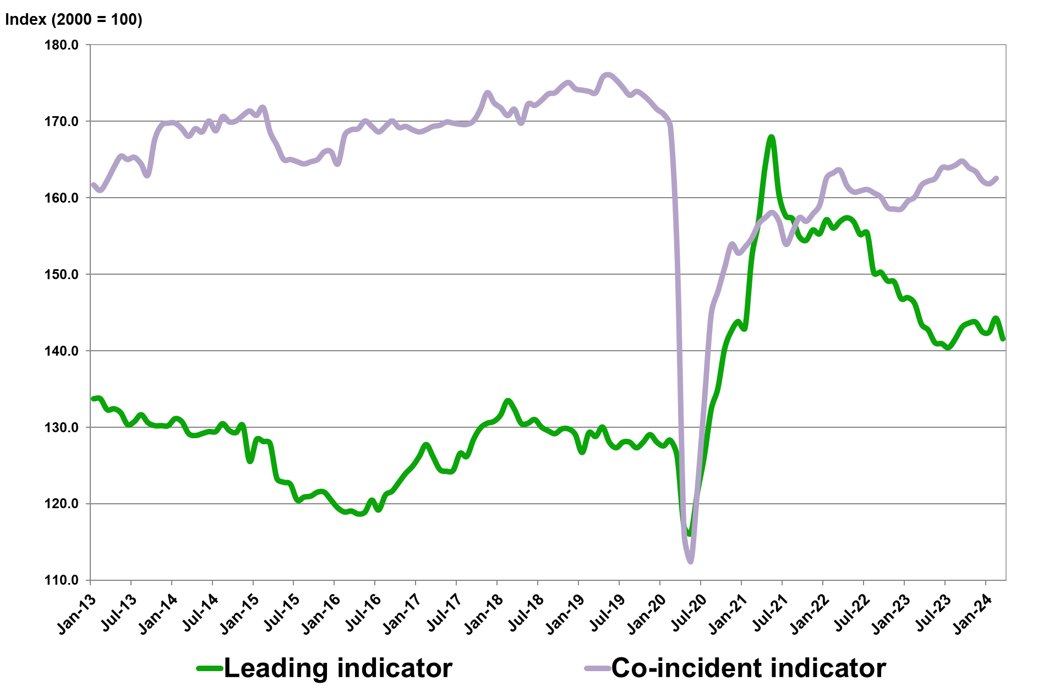
Business cycle indicators: Leading and the Co-incident Indicator Jan 2013 – March 2024
Source: SA Reserve Bank

Slide 14
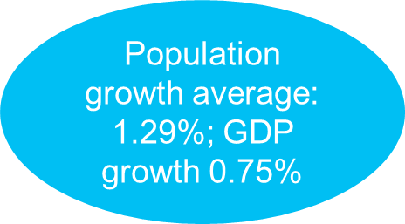
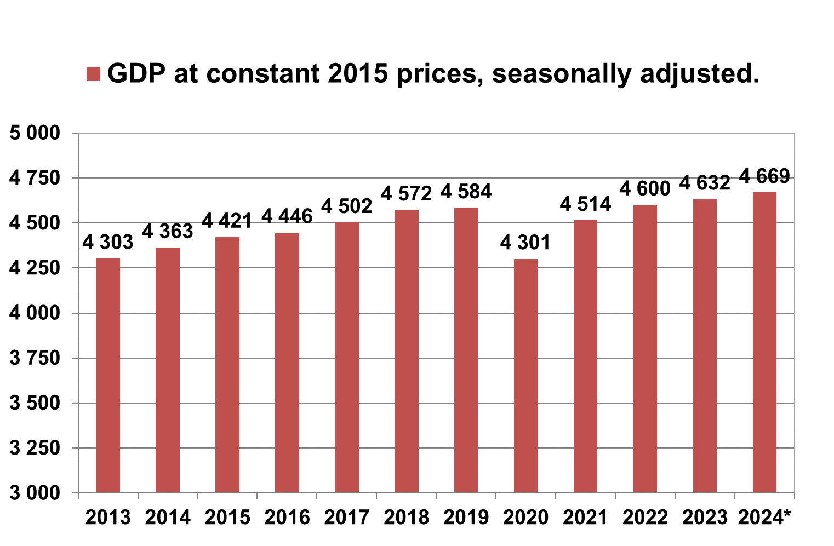
Annual SA GDP at 2015 constant prices 2013 – 2024 (R billion)
Source: Stats SA, * projected by the IMF.

Slide 15
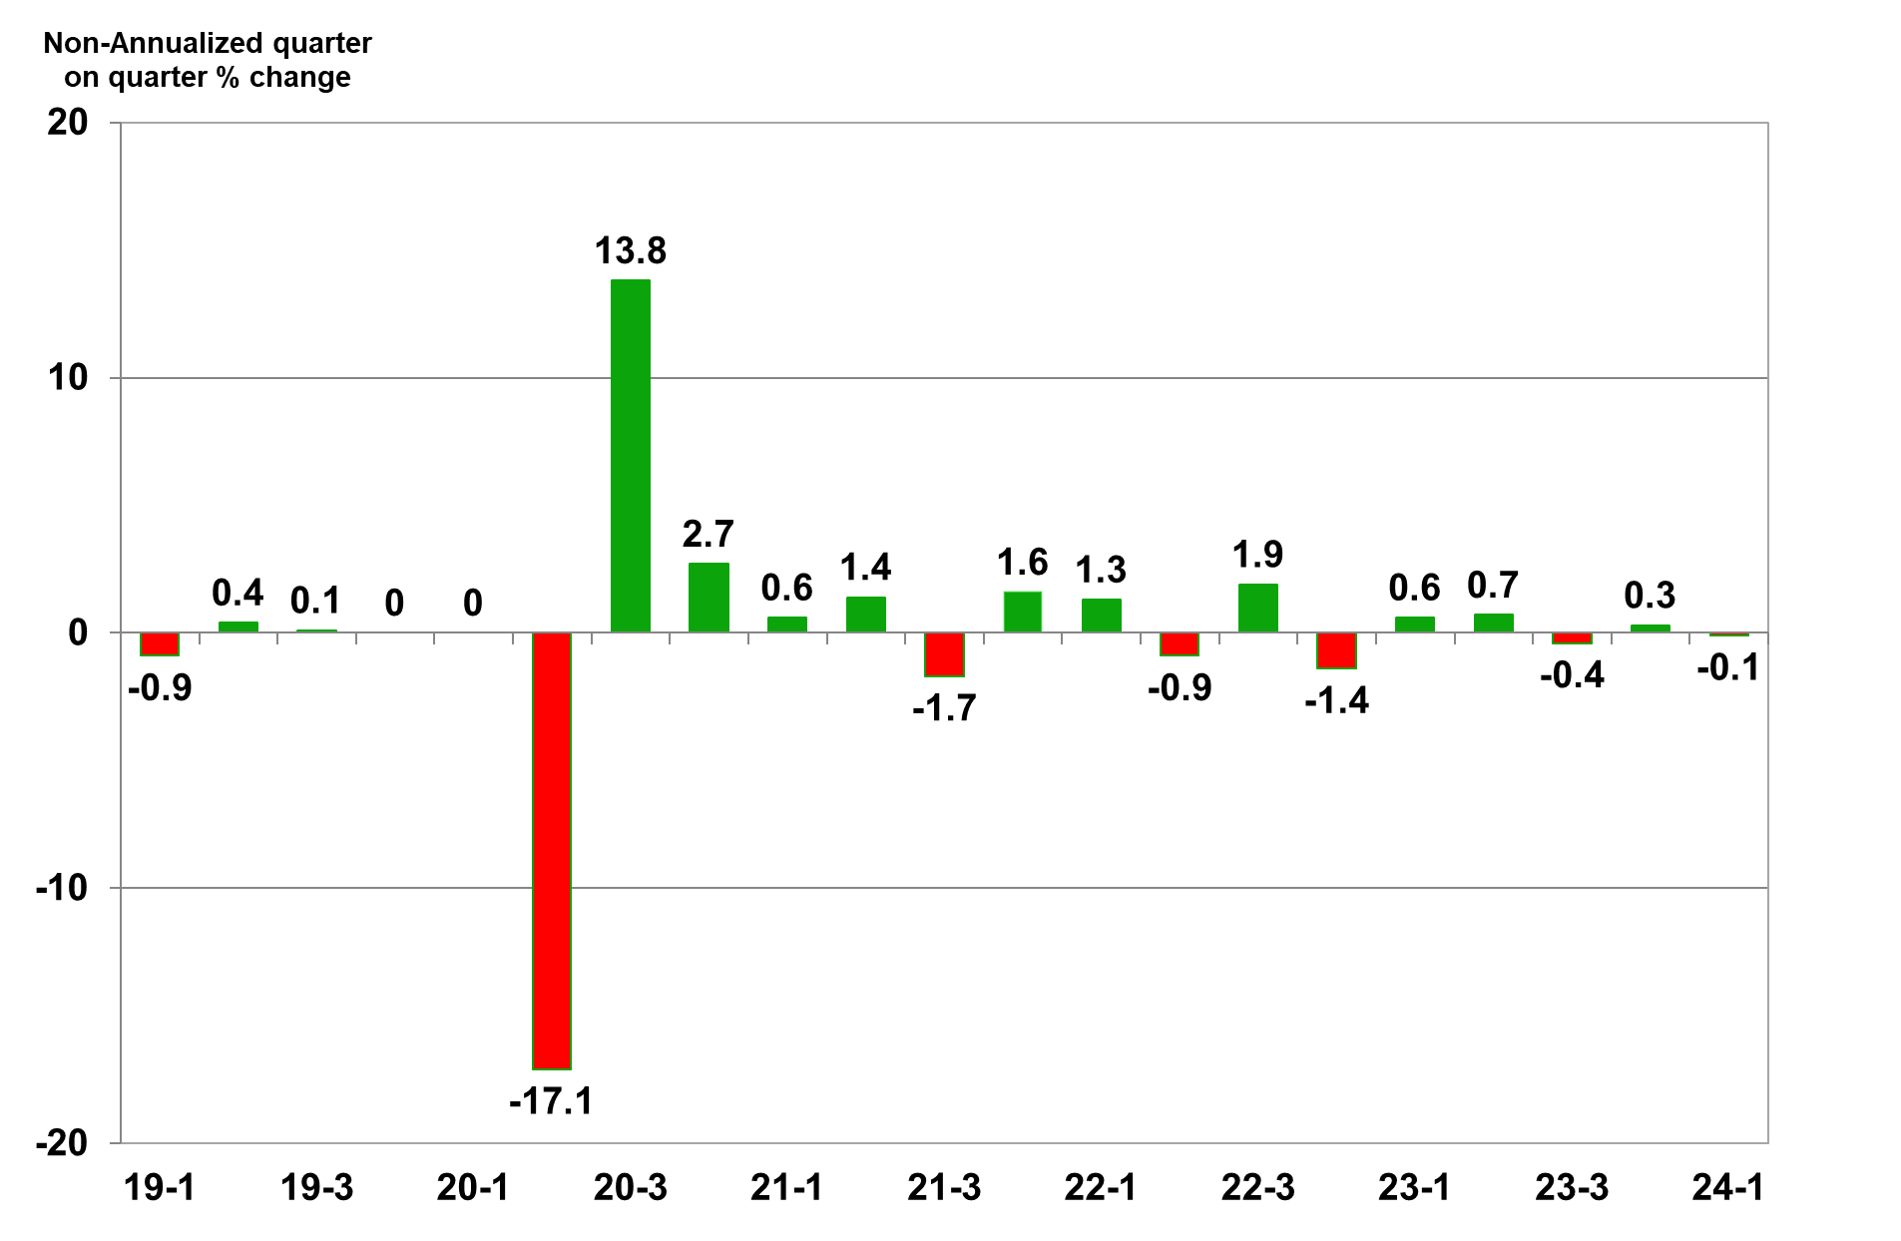
Quarterly economic growth in SA (seasonally adjusted), 2019 – 2024 (base year 2015)
Source: Stats SA

Slide 16
International economy
International dairy situation
SA economic situation
SA dairy situation

Slide 17
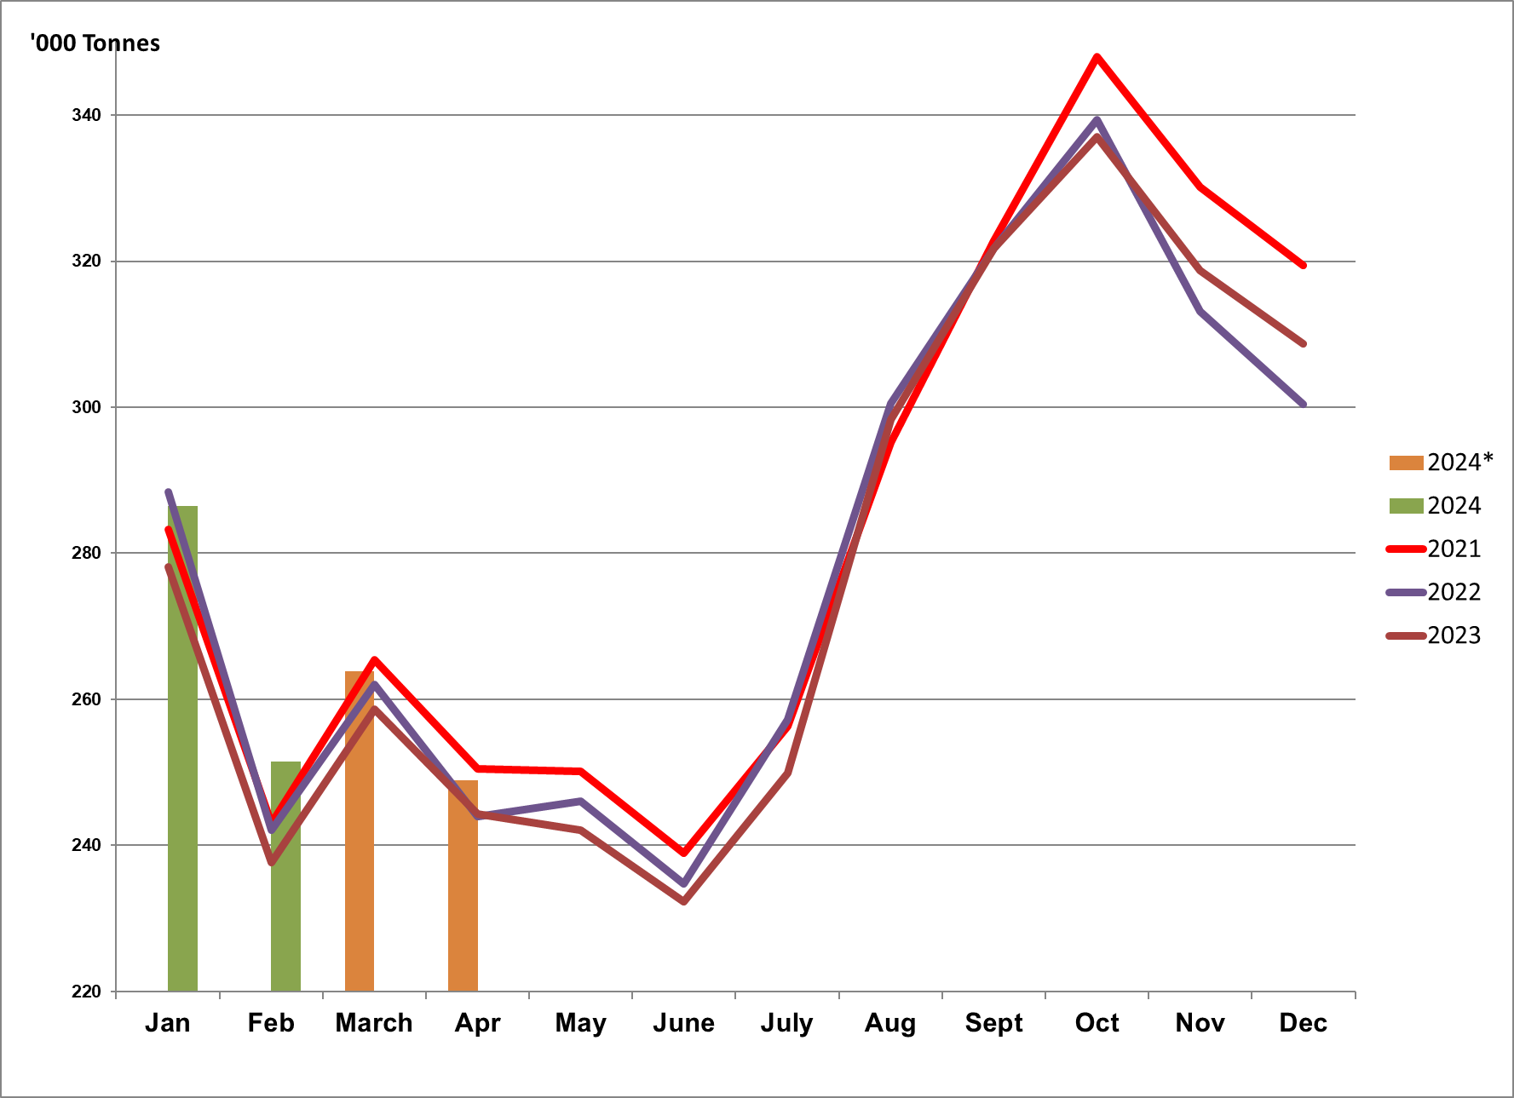
Monthly unprocessed milk purchases: Jan 2020 – April 2024
Source: Milk SA; March and April preliminary

Slide 18
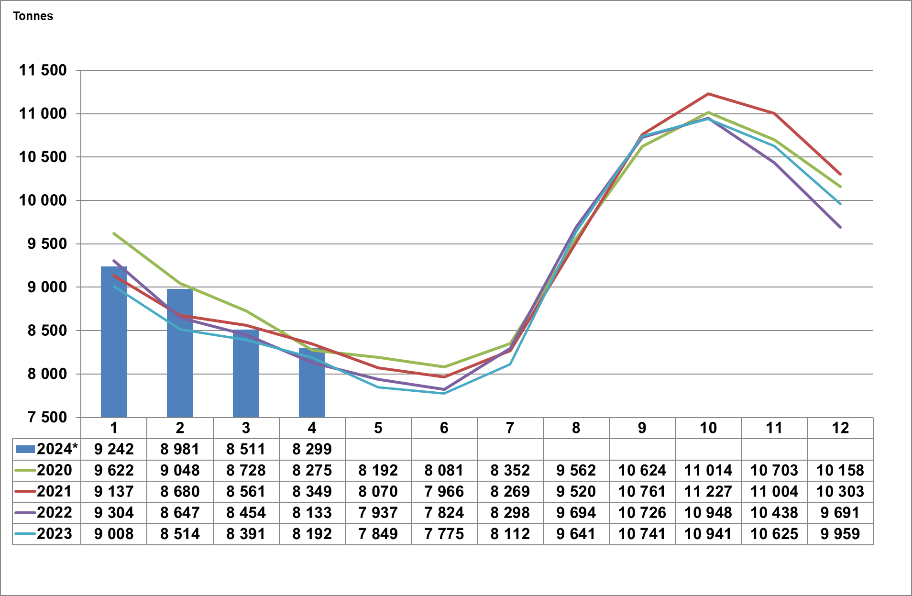
Monthly daily average unprocessed milk purchases: Jan 2020 – April 2024
Source: Milk SA; March and April preliminary

Slide 19
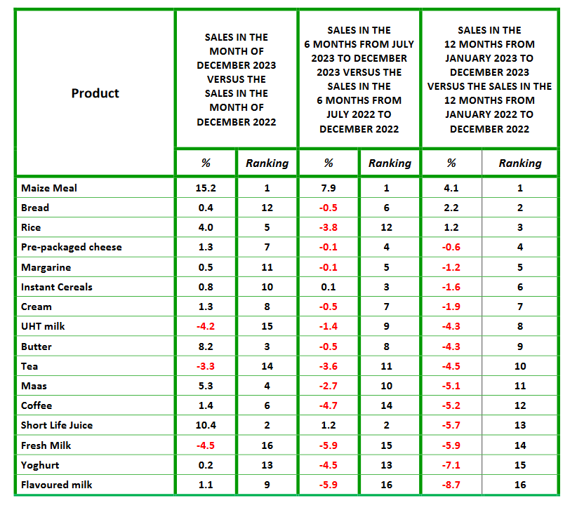
DECEMBER 2022 OF SPECIFIC DAIRY PRODUCTS
Changes in the Quantities of retail sales of specific dairy products and specific other food products
Source: SAMPRO based on NielsenIQ December 2023 report

Slide 20
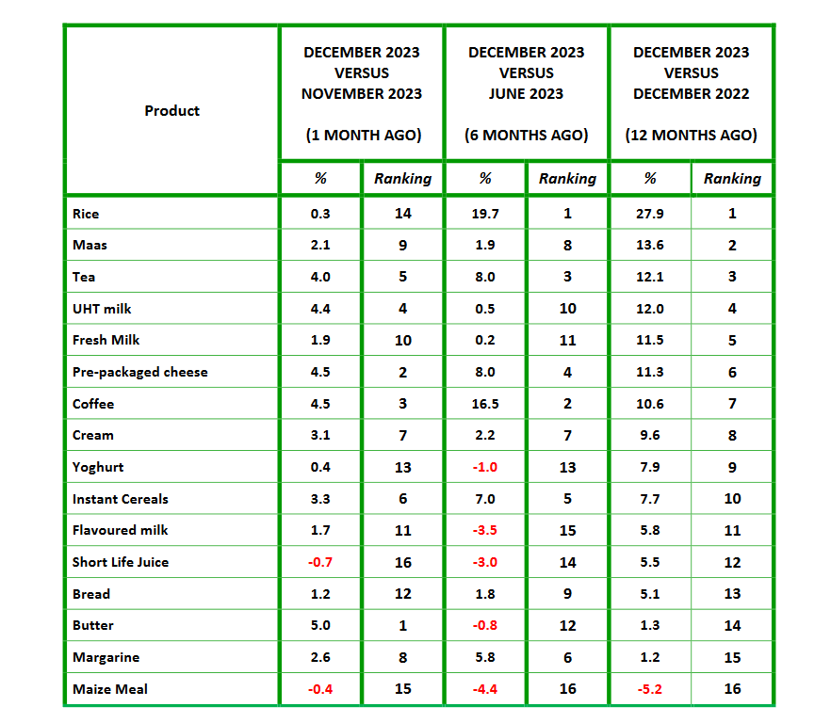
Changes in the average retail prices of specific dairy products and specific other food products
Source: SAMPRO based on NielsenIQ December 2023 report

Slide 21
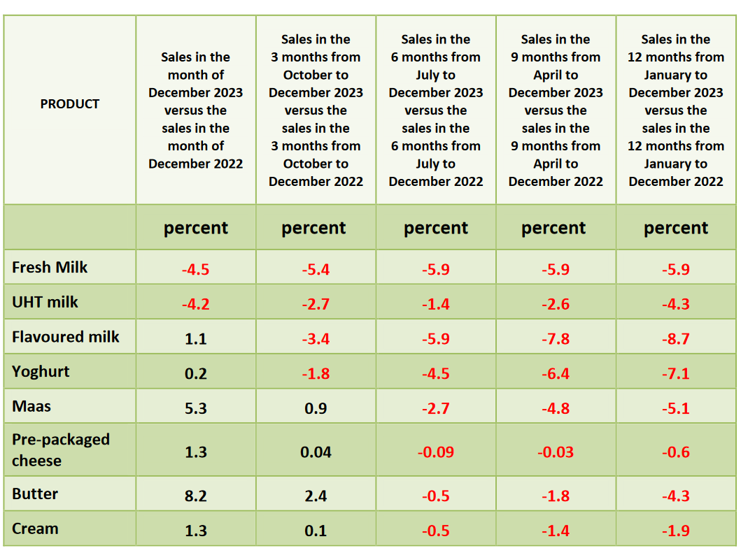
CHANGES IN THE QUANTITIES OF RETAIL SALES OF SPECIFIC DAIRY PRODUCTS
Source: SAMPRO based on NielsenIQ December 2023 report

Slide 22
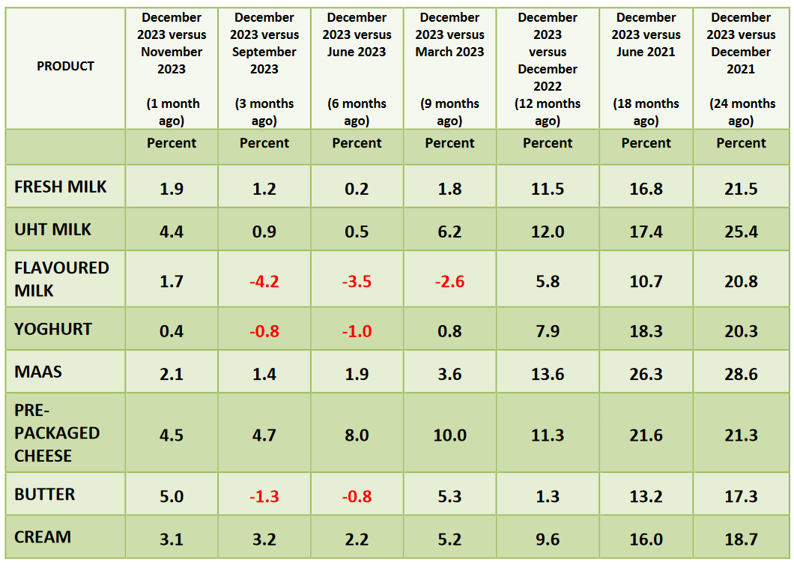
Changes in average retail prices of specific dairy products
Source: SAMPRO based on NielsenIQ December 2023 report

Slide 23
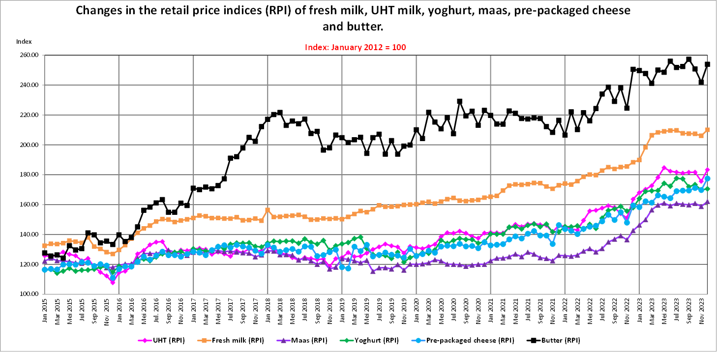
THE RETAIL PRICE INDICES (RPI) OF SPECIFIC DAIRY PRODUCTS, FROM JANUARY 2015 TO DECEMBER 2023
Source: SAMPRO based on NielsenIQ December 2023 report

Slide 24
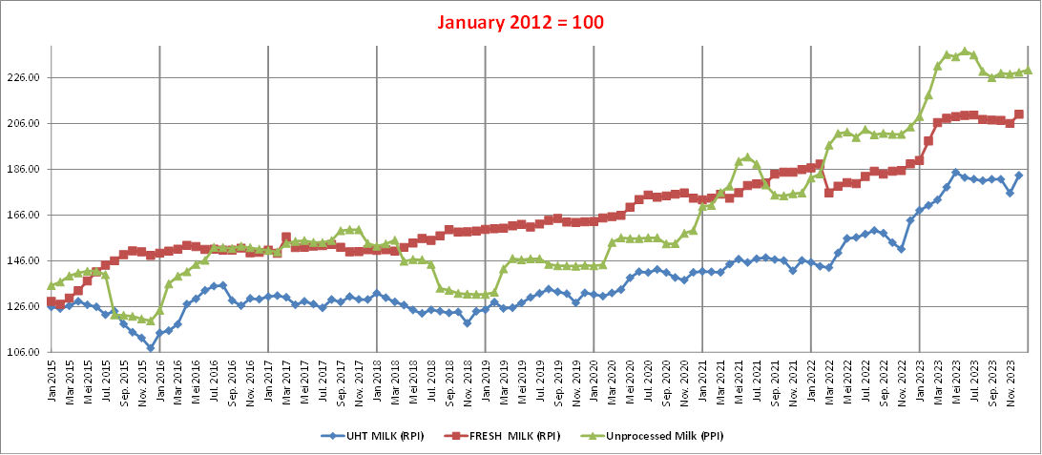
THE PRODUCER PRICE INDEX (PPI) OF UNPROCESSED MILK, FROM JANUARY 2015 TO JANUARY 2024 AND THE RETAIL PRICE INDICES (RPI) OF FRESH MILK AND UHT MILK, FROM JANUARY 2015 TO DECEMBER 2023
Source: SAMPRO based on NielsenIQ December 2023 report

Slide 25
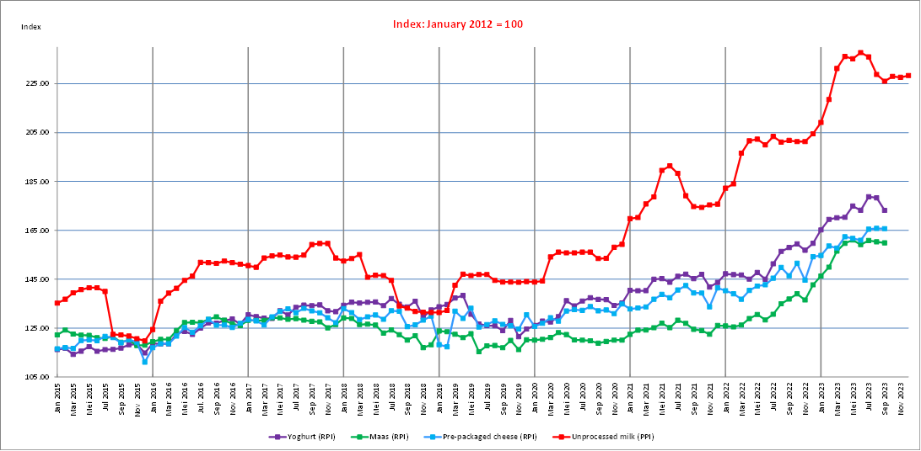
THE PRODUCER PRICE INDEX (PPI) OF UNPROCESSED MILK, FROM JANUARY 2015 TO JANUARY 2024 AND THE RETAIL PRICE INDICES (RPI) OF YOGHURT, MAAS AND PRE-PACKAGED CHEESE, FROM JANUARY 2015 TO DECEMBER 2023
Source: SAMPRO based on NielsenIQ December 2023 report

Slide 26
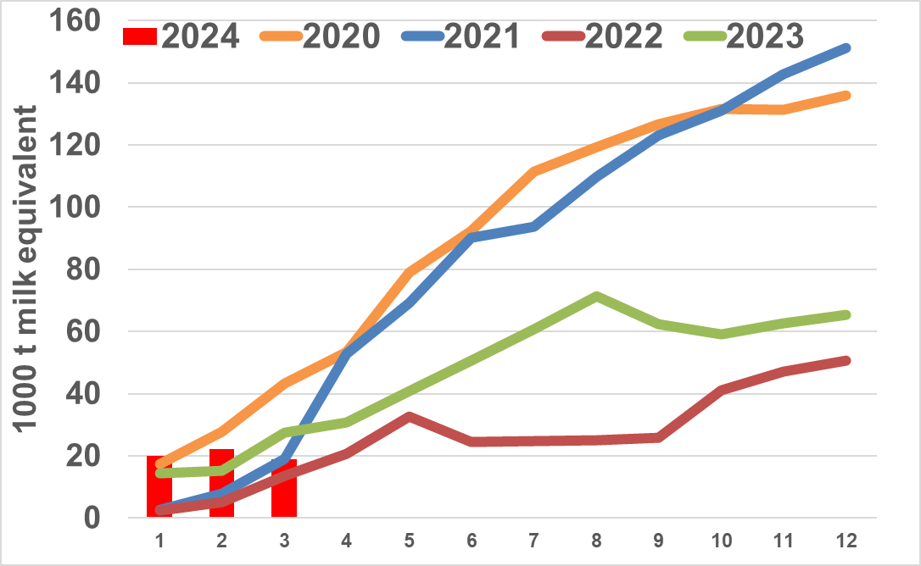
Monthly cumulative net imports, milk equivalent: Jan 2020 to March 2024
Source: SARS as supplied by SAMPRO

Slide 27
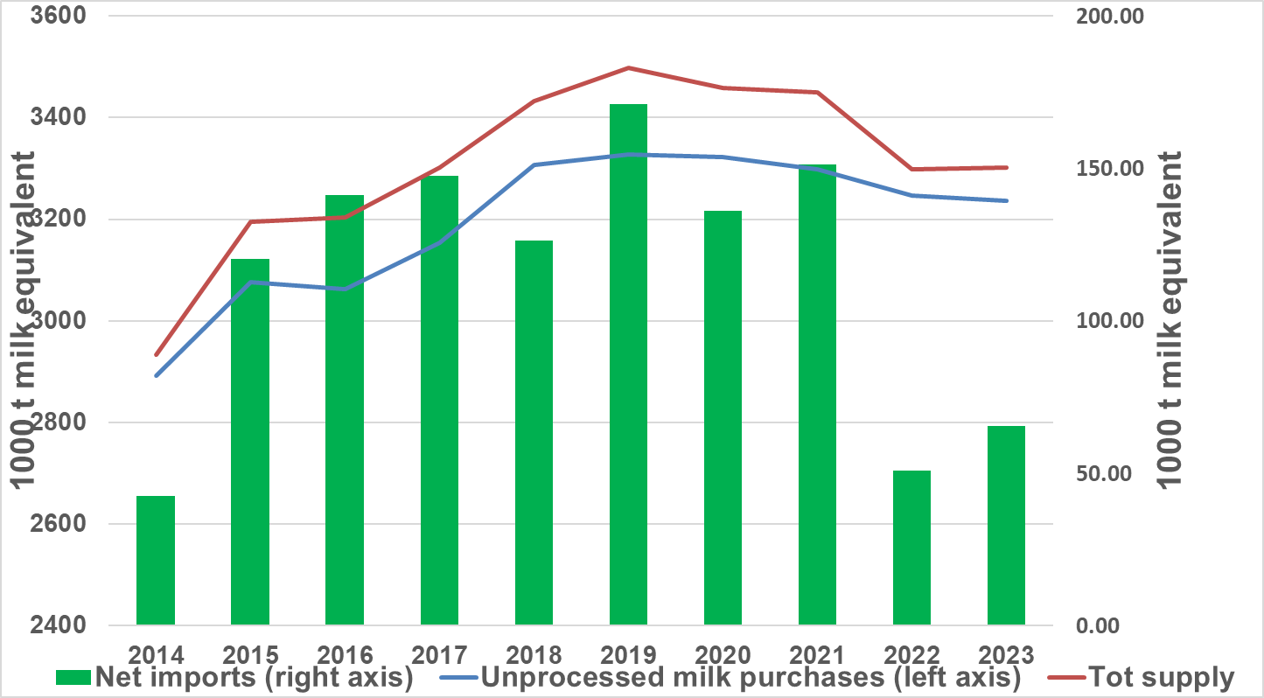
Annual purchases of unprocessed milk plus milk equivalent of net imports = Tot supply: 2014 to 2023
Source: SAMPRO, MPO, MILK SA,

Slide 28
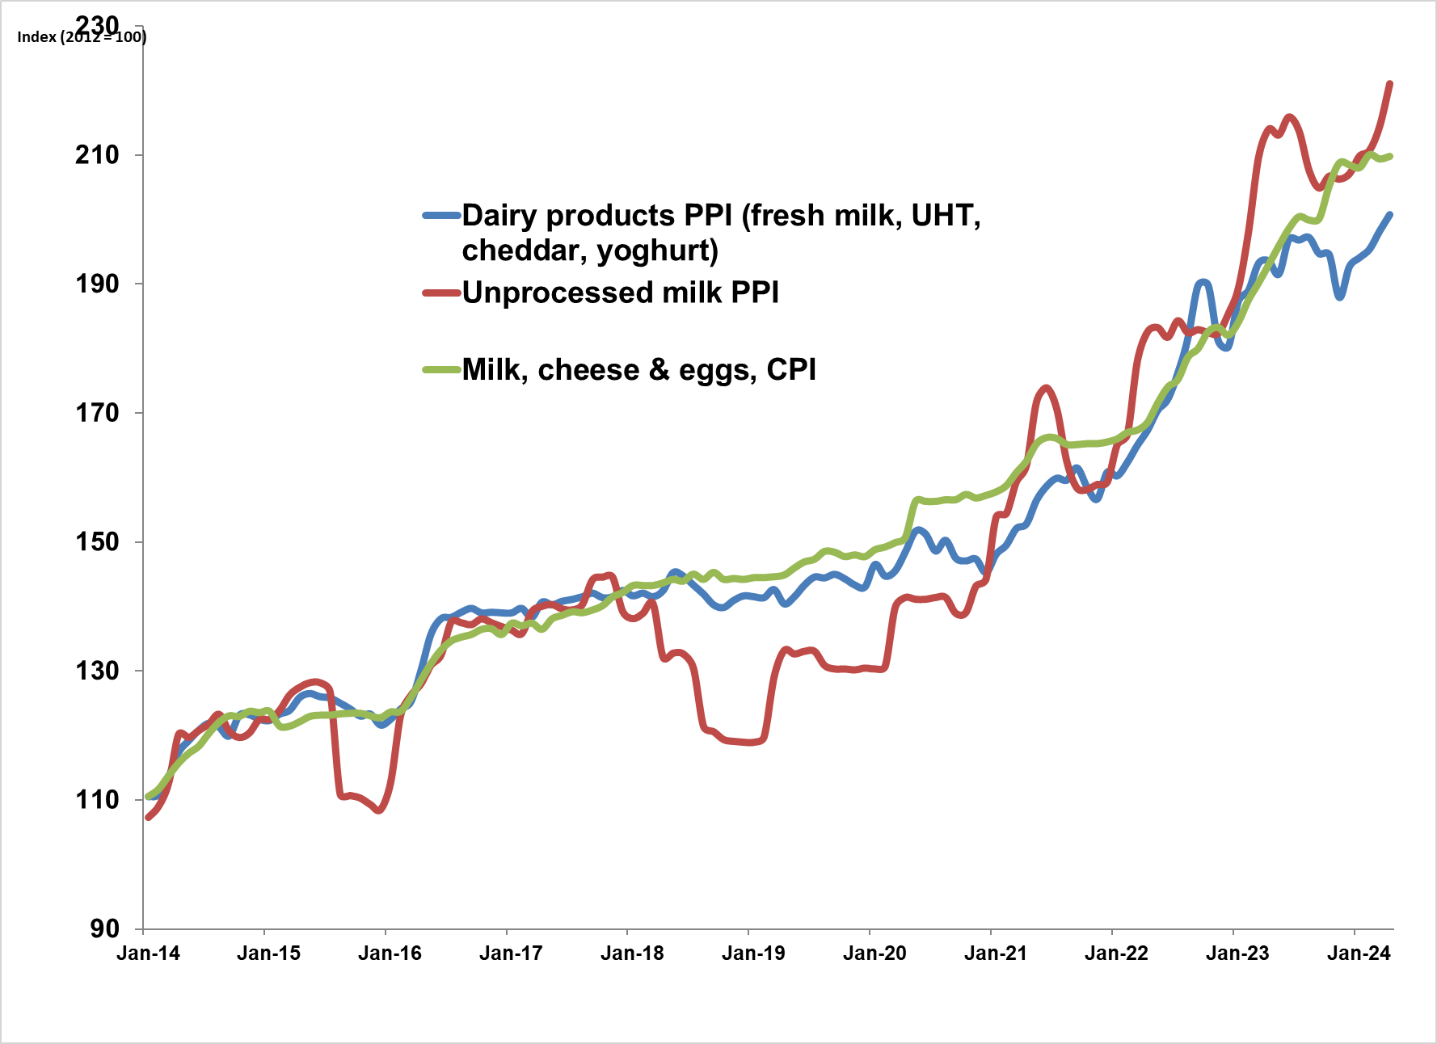
PPI Indices of unprocessed milk and dairy products and the CPI of milk, cheese and eggs: 2014 to April 2024
Source: Stats SA

Slide 29
Thank you

