Slide 1

General Meeting of
Milk South Africa
27 November 2024

Slide 2
Vision and Direction
You are gathered here today as Members of this organisation who still value the same vision, “To promote a healthy SA dairy community”.
You have chartered this flight. Although it has no final destination, it certainly has direction and purpose.
Over 22 years already, this flight has delivered an increasingly number of goods in response to the growing and changing demands over time.

Slide 3
The “goods”
Learning material maintenance
Info: Raw milk to products
TV and Social media
Development of Environmental Health Practitioners
Dairy Gives You Go & Rediscover Dairy
Info: Raw milk to market
Curriculum development: Tertiary institutions
Code of Practice: Milk Producers
Revision of Acts and Regulations
Info: Imports & Exports
Foot-and-Mouth disease protocol
Labelling guidance and evaluation
Code of Practice: Milk Processors
SABS Standards review
Info: Retail quantities and prices
TB and Brucellosis protocols
Empowerment of Clinic staff and Health professionals
Food quality monitoring
Status update: Sustainability in the SA dairy industry
Destiny Tool
Trade protocols and agreements
Research Column
Dairy laboratory
Dairy R&D in South Africa
Sporidesmin Toxicity
DiEET Tool
Empowerment of black dairy entrepreneurs

Slide 4
Some major challenges
Animal health & welfare
  Review of animal health & welfare protocols – MSA + Govt
  Practising of animal health protocols – all role-players
  Deployment of state veterinarians
Biosecurity
  Surveillance and early warning system
  Audits (farm and factory)
Export certification
  Veterinary Procedures Notices
  Chemical Residue Programme
Environment (farm and factory)
  Soil, atmosphere, water, waste
Information transfer
General communication

Slide 5
Income and expenses
Jan 2022 – Oct 2024 (34 months)
 | Budget ‘000 | Actual ‘000 | Deviation %
Income | 186 815 | 184 245 | -1,38
Expenditure | 189 068 | 174 563 | -7,67
Surplus / Deficit | (2 253) | 9 683
Less income due to:
  Decline in demand and milk production during 2022/23; and
  Less imports in 2024.
Surplus mainly due to under-expenditure in:
  Transformation (2022/3) – R6,3 mil
  Consumer education (2024) – R2,8 mil

Slide 6
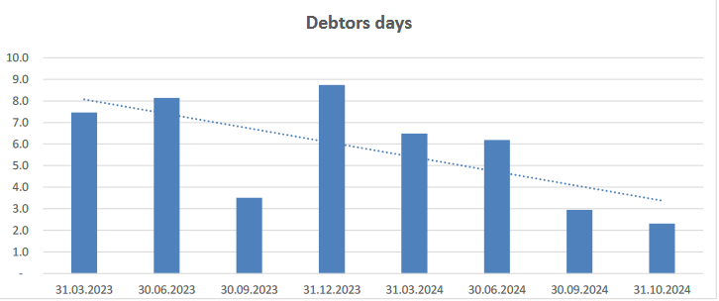
Debt analysis: Debtors days

Slide 7
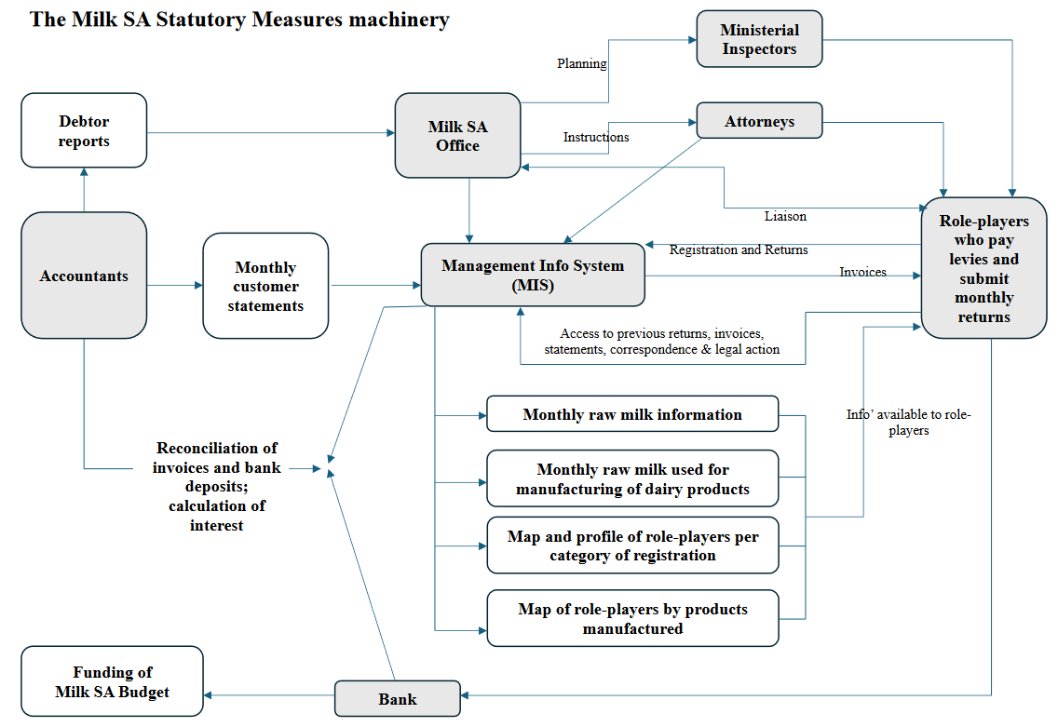
The statutory measures machinery

Slide 8
Milk SA Budget 2025

Slide 9
Take pride …
You all have good reason to take pride in your organization, Milk South Africa
Therefore …
Spread the good news …
As I wish you a Merry Christmas

