Slide 1

Milk SA Project: Economies and Markets
Presentation for the
Milk SA Annual General Meeting
27 November 2024
Prepared by B van Heerden, assisted by the MSA Industry Information Work Group
November 2024

Slide 2
International economy
International dairy situation
SA economic situation
SA dairy situation

Slide 3
.
Global inflation forecast:
2024 = 5,8%
2025 = 4,3%
2026 = 4,2%
Source: IMF, WEO October 2024 (* forecast)
Notes:
Global inflation forecast:
2024 = 5,8%
2025 = 4,3%
2026 = 4,2%
https://www.imf.org/en/Publications/WEO/Issues/2024/10/22/world-economic-outlook-october-2024
Page XIV – IMF October 2024

Slide 4
.
Estimated growth in 2024:
World = 3,2%
Advanced econ = 1,8%
Developing econ = 4,2%
South Africa = 1,1%
Source: IMF, WEO (*estimate) (** forecast)
Notes:
https://www.imf.org/en/Publications/WEO/Issues/2024/07/16/world-economic-outlook-update-july-2024#tools

Slide 5
FAO food price indices January 2014 – September 2024
Source: FAO, September 2024
Notes:
https://www.fao.org/worldfoodsituation/foodpricesindex/en/

Slide 6
World Dynamic: “Policy Pivot, Rising Threats”
Notes:
Policy Pivots, Rising Threats
Pivots" include adjustments in monetary policy (like interest rate changes by central banks) and fiscal policy (government spending and taxation) to manage challenges such as inflation, slowing growth, and financial stability risks.
Increasing number of global risks that could impact economies. These “threats” include rising commodity prices, food insecurity, geopolitical tensions.

Slide 7
International economy
International dairy situation
SA economic situation
SA dairy situation

Slide 8
Global unprocessed milk production: 2013 - 2023
Source:IDF World Dairy Situation 2023
Notes:
https://milksa.co.za/sites/default/files/2024-01/2023%20World%20Dairy%20Situation%20Report.pdf
The main reasons for the lower growth rate were:
High production costs:
The cost of dairy farming inputs increased significantly, which led to smaller margins and reduced production.
Quality of roughage:
In Europe, the quality of roughage was poor, which further reduced milk production and milk contents.
Negative growth in some regions:
Oceania saw a -4.3% decline, South America saw a -3.2% decline, and the EU27 countries saw zero growth.

Slide 9
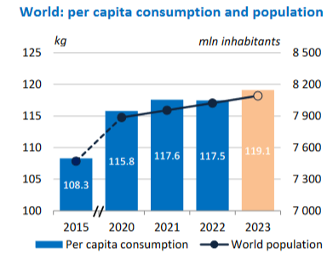
World population and per capita dairy consumption
Source:IDF World Dairy Situation 2024
Notes:
https://milksa.co.za/sites/default/files/2024-01/2023%20World%20Dairy%20Situation%20Report.pdf
https://fil-idf.org/dairys-global-impact/

Slide 10
Global Dairy Trade Auction Price Index of Dairy Products (GDT) January 2014 – October 2024
Source: GDT Events
Notes:
https://www.globaldairytrade.info/en/product-results/

Slide 11
International prices of dairy products Jan 2014 – September 2024
US$/ton
Rand/ton
Source: USDA, South African Reserve Bank for exchange rate
Notes:
Received from dairy digits

Slide 12
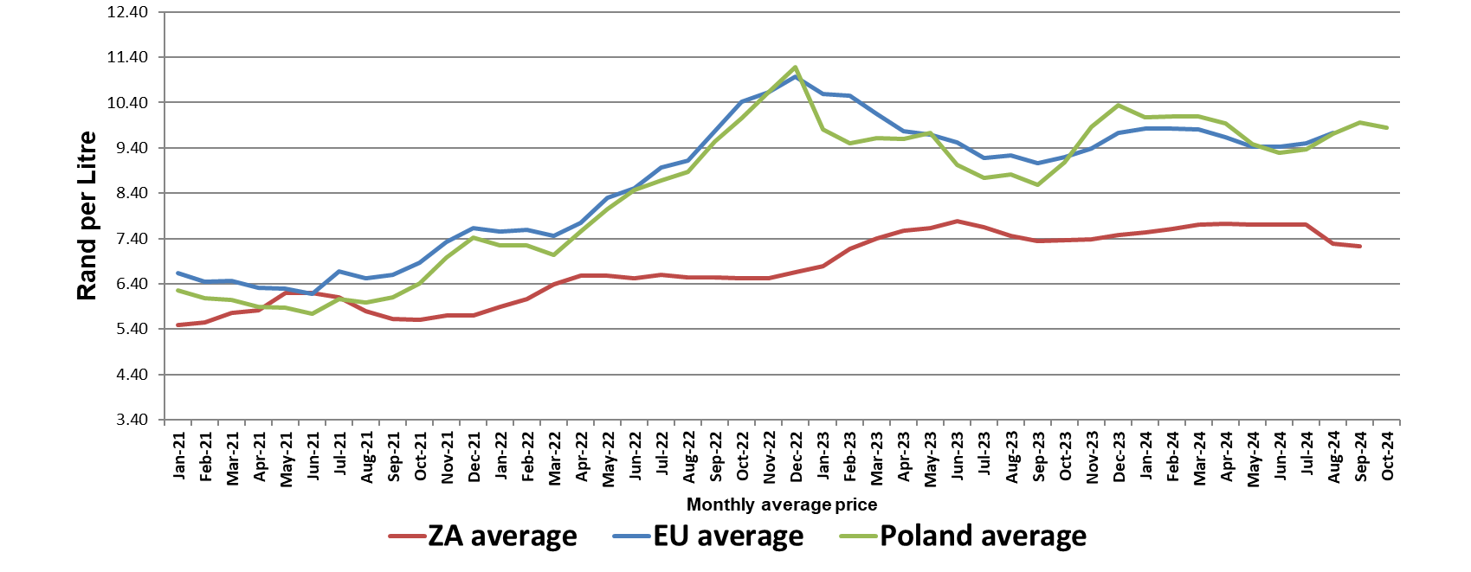
Average European, Poland, and SA producer prices, of unprocessed milk, R/litre, Jan 2021 – Oct 2024 (latest two month preliminary)
Source: European Commission, MPO and SARB

Slide 13
Unprocessed milk production in key exporting countries
Source: CLAL Advisory
Notes:
USA: https://www.clal.it/en/index.php?section=produzioni_usa_latte_bovino
EU-27:
Aus: https://www.clal.it/en/index.php?section=consegne_australia
NZL: https://www.clal.it/en/?section=stat_newzealand
Uru: https://www.clal.it/en/index.php?section=consegne_uruguay
Arg: https://www.clal.it/en/index.php?section=milk_production_argentina

Slide 14
International economy
International dairy situation
SA economic situation
SA dairy situation

Slide 15
Business cycle indicators: Leading and the Co-incident Indicator January 2013 – August 2024
Source: SA Reserve Bank
Notes:
https://www.resbank.co.za/content/dam/sarb/publications/composite-business-cycle-indicators/2024/Composite%20Business%20Cycle%20Indicators%20October%202024.pdf

Slide 16
Quarterly economic growth in SA (seasonally adjusted), 2019 – 2024 (base year 2015)
Source: Stats SA
Notes:
https://www.statssa.gov.za/publications/P0441/P04412ndQuarter2024.pdf

Slide 17
Annual SA GDP at 2015 constant prices 2013 – 2024 (R billion)
Population growth average: 1,29%;GDP growth 1,1%
Source: Stats SA, * projected by the IMF.
Notes:
https://www.statssa.gov.za/?page_id=1854&PPN=P0441&SCH=73778
https://www.imf.org/en/Countries/ZAF#countrydata

Slide 18
Consumer price inflation (CPI) headline and food inflation in SA, January 2022 – September 2024
Source: Stats SA
Notes:
BFAP, as supplied from Stats SA

Slide 19
Consumer price inflation (CPI) headline, food & milk, eggs and cheese inflation in SA, January 2022 – September 2024
Source: Stats SA
Notes:
BFAP, as supplied from Stats SA

Slide 20
Prime interest rates in South Africa, January 2013 – September 2024
Source: Stats SA
Notes:
https://www.resbank.co.za/en/home/what-we-do/statistics/key-statistics

Slide 21
SA households: Real per capita disposable income and debt % of disposable income
Source: Stats SA
Notes:
https://www.resbank.co.za/en/home/what-we-do/statistics/key-statistics
https://www.resbank.co.za/en/home/publications/publication-detail-pages/quarterly-bulletins/quarterly-bulletin-publications/2024/FullQuarterlyBulletinNo313September2024

Slide 22
South African growth in Real Retail Sales: January 2014 – August 2024
Source: Stats SA
Notes:
https://www.statssa.gov.za/?page_id=1866&PPN=P6242.1&SCH=6205&page=1

Slide 23
International economy
International dairy situation
SA economic situation
SA dairy situation

Slide 24
Monthly unprocessed milk purchases: January 2020 – September 2024
Source: Milk SA; August and September preliminary

Slide 25
Monthly daily average unprocessed milk purchases: January 2020 – September 2024
Source: Milk SA; September preliminary

Slide 26
Maize (70%) and Soybean (30%) Price Ratio: January 2019 – September 2024
Source: Grain SA, SAFEX

Slide 27
Changes in the quantities of retail sales of specific dairy products
PRODUCT | Sales in the month of June 2024 versus the sales in the month of June 2023 | Sales in the 3 months from April 2024 to June 2024 versus the sales in the 3 months from April 2023 to June 2023 | Sales in the 6 months from January 2024 to June 2024 versus the sales in the 6 months from January 2023 to June 2023 | Sales in the 9 months from October 2023 to June 2024 versus the sales in the 9 months from October 2022 to June 2023 | Sales in the 12 months from July 2023 to June 2024 versus the sales in the 12 months from July 2022 to June 2023
 | percent | percent | percent | percent | percent
Fresh Milk | -0.6 | -1.3 | -3.3 | -4.1 | -4.8
UHT milk | 10.2 | 8.3 | 5.0 | 2.3 | 1.6
Flavoured milk | 6.7 | 6.9 | 1.2 | -0.6 | -2.9
Yoghurt | 4.1 | 3.5 | 0.9 | -0.4 | -2.3
Maas | 10.6 | 11.0 | 6.2 | 3.9 | 0.9
Pre-packaged cheese | 1.5 | 2.5 | 1.2 | 0.8 | 0.1
Cream cheese | 7.6 | 1.3 | 4.1 | 4.8 | 7.1
Butter | 12.6 | 3.8 | 3.2 | 2.7 | 1.0
Cream | 2.9 | 0.13 | 1.1 | 0.6 | 0.04
Source: SAMPRO based on NielsenIQ June 2024 report

Slide 28
Changes in average retail prices of specific dairy products
PRODUCT | June 2024 versus May 2024 (1 month ago) | June 2024 versus March 2024 (3 months ago) | June 2024 versus December 2023 (6 months ago) | June 2024 versus September 2023 (9 months ago) | June 2024 versus June 2023 (12 months ago) | June 2024 versus December 2022 (18 months ago) | June 2024 versus June 2022 (24 months ago)
 | Percent | Percent | Percent | Percent | Percent | Percent | Percent
FRESH MILK | 0.7 | 0.8 | 0.9 | 2.1 | 0.9 | 12.5 | 17.9
UHT MILK | 0.8 | 1.9 | -1.0 | -0.5 | -0.7 | 10.5 | 15.7
FLAVOURED MILK | 0.5 | -0.08 | 4.4 | -0.2 | 0.2 | 10.2 | 15.5
YOGHURT | -0.5 | 1.5 | 4.3 | 3.9 | 4.2 | 13.6 | 24.6
MAAS | -0.3 | 1.3 | 0.9 | 2.3 | 2.8 | 14.7 | 27.3
PRE-PACKAGED CHEESE | -0.5 | -1.8 | -4.3 | 2.0 | 5.5 | 6.6 | 18.9
CREAM CHEESE | -1.0 | 6.0 | 0.01 | 5.9 | 5.4 | 12.0 | 17.0
BUTTER | -0.11 | 2.8 | 1.4 | 0.06 | 0.7 | 2.8 | 14.6
CREAM | 0.3 | 1.2 | 0.6 | 3.7 | 2.9 | 10.1 | 16.6
Source: SAMPRO based on NielsenIQ June 2024 report

Slide 29
Changes in the Quantities of retail sales of specific dairy products and specific other food products
Product | Sales in the month of JUNE 2024 versus the sales in the month of JUNE 2023 |  | Sales in the 6 months from JANUARY 2024 TO JUNE 2024 versus the sales in the 6 months from JANUARY 2023 TO JUNE 2023 |  | Sales in the 12 months from JULY 2023 to JUNE 2024 versus the sales in the 12 months from JULY 2022 to JUNE 2023
 | % | Ranking | % | Ranking | % | Ranking
Maize Meal | 7.9 | 4 | 10.2 | 1 | 8.9 | 1
Cream cheese | 7.6 | 5 | 4.1 | 4 | 7.1 | 2
Short Life Juice | 1.7 | 12 | 3.2 | 5 | 2.1 | 3
UHT milk | 10.2 | 3 | 5.0 | 3 | 1.6 | 4
Instant Cereals | 2.0 | 10 | 2.0 | 7 | 1.1 | 5
Butter | 12.6 | 1 | 3.2 | 6 | 1.0 | 6
Maas | 10.6 | 2 | 6.2 | 2 | 0.9 | 7
Pre-packaged cheese | 1.5 | 13 | 1.2 | 8 | 0.1 | 8
Cream | 2.9 | 9 | 1.1 | 10 | 0.04 | 9
Margarine | 0.9 | 14 | -0.3 | 12 | -0.2 | 10
Bread | 5.6 | 7 | -1.3 | 13 | -1.1 | 11
Yoghurt | 4.1 | 8 | 0.9 | 11 | -2.3 | 12
Flavoured milk | 6.7 | 6 | 1.2 | 9 | -2.9 | 13
Rice | 2.0 | 11 | -2.4 | 14 | -3.3 | 14
Tea | -1.3 | 16 | -4.4 | 16 | -4.0 | 15
Coffee | -10.3 | 17 | -5.0 | 17 | -4.3 | 16
Fresh Milk | 0.6 | 15 | -3.3 | 15 | -4.8 | 17
Changes in the Quantities of retail sales of specific dairy products and specific other food products
Source: SAMPRO based on NielsenIQ June 2024 report

Slide 30
Product | JUNE 2024 versus MAY 2024 (1 month ago) |  | JUNE 2024 versus DECEMBER 2023 (6 months ago) |  | JUNE 2024 versus JUNE 2023 (12 months ago)
 | % | Ranking | % | Ranking | % | Ranking
Rice | -0.01 | 8 | 7.9 | 2 | 29.4 | 1
Coffee | -4.3 | 17 | 1.6 | 7 | 19.5 | 2
Tea | -2.6 | 16 | 6.7 | 3 | 15.8 | 3
Short Life Juice | 0.7 | 4 | 12.0 | 1 | 6.7 | 4
Pre-packaged cheese | -0.5 | 12 | -4.3 | 17 | 5.5 | 5
Cream cheese | -1.0 | 15 | 0.01 | 12 | 5.4 | 6
Yoghurt | -0.5 | 13 | 4.3 | 6 | 4.2 | 7
Margarine | -0.06 | 9 | -1.4 | 15 | 4.2 | 8
Instant Cereals | -0.5 | 14 | -2.6 | 16 | 3.5 | 9
Cream | 0.3 | 7 | 0.6 | 11 | 2.9 | 10
Maas | -0.3 | 11 | 0.9 | 9 | 2.8 | 11
Maize Meal | 2.6 | 1 | 6.7 | 4 | 2.3 | 12
Bread | 1.1 | 2 | -0.3 | 13 | 1.3 | 13
Fresh Milk | 0.7 | 5 | 0.9 | 10 | 0.9 | 14
Butter | -0.1 | 10 | 1.4 | 8 | 0.7 | 15
Flavoured milk | 0.5 | 6 | 4.4 | 5 | 0.2 | 16
UHT milk | 0.8 | 3 | -1.0 | 14 | -0.7 | 17
Changes in the average retail prices of specific dairy products and specific other food products
Source: SAMPRO based on NielsenIQ June 2024 report

Slide 31
The retail price indices (RPI) of specific dairy products: December 2016 – June 2024
Source: SAMPRO based on NielsenIQ June 2024 report

Slide 32
The producer price index (PPI) of unprocessed milk, from December 2016 to July 2024 and the retail price indices (RPI) of fresh milk and UHT milk, from December 2016 to June 2024
Source: SAMPRO based on NielsenIQ June 2024 report

Slide 33
The producer price index (PPI) of unprocessed milk, from December 2016 to July 2024 and the retail price indices (RPI) of yoghurt, maas and pre-packaged cheese, from December 2016 to June 2024
Source: SAMPRO based on NielsenIQ December 2023 report

Slide 34
Monthly cumulative net imports, milk equivalent: January 2020 to August 2024
Source: SARS as supplied by SAMPRO

Slide 35
Annual purchases of unprocessed milk plus milk equivalent of net imports = Total supply: 2014 - 2023
Source: SAMPRO, MPO, MILK SA,

Slide 36
PPI Indices of unprocessed milk and dairy products and the CPI of milk, cheese and eggs: January 2014 – September 2024
Source: Stats SA

Slide 37

Thank you

