Slide 1

CEO Presentation
To the Members of Milk SA
At their General Meeting
12 June 2025

Slide 2
Numbers
Every cow produces milk for ±107 people in SA.
For every single dairy farmer, there are ±72 730 consumers.
For every dairy factory in SA, there are ±496 100 consumers.
Only 30 from the 130 dairy factories process 90% of the country’s milk into drinking milk and other dairy products.
SA produces 0,4% of the world’s milk, and we are self-sufficient.

Slide 3
Thoughts
A handful and declining number of entrepreneurs provides for an ever increasing population.
The vulnerability of the dairy industry is also quite obvious in many respects, which is aggravated by the State’s incapacity.
Therefore, the industry needs to stand together, do things together and plan ahead, so that we can continue doing what we love and appreciate most.

Slide 4
“Something wrong”
I received a call last week from a farmer in the Southern Cape who argued that there is something wrong in the dairy industry, as many dairy farmers are closing business. He insisted that the Control Boards should be revived but refused to be a member of the MPO and be part of the solution.
The unsettling reality is that certain not-so-subtle noises have been made in Government circles, about market concentration and unfair competition; and this was also the topic at a recent NEDLAC session, where Milk SA had to field arguments such as that the current system was not conducive for small entrepreneurs and new entrants.
Fortunately, the founders of Milk SA had the vision 23 years ago, to realize that the industry needs a unified stance and strategic intent as well as unified actions to fill in where government failed and to lead where there is no foresight.

Slide 5

We’ve grown organically
For me as CEO, it is a great privilege to have been entrusted by the Board of Directors with the responsibility to take care of the statutory regulations and the governance affairs of Milk SA. As Milk SA, we have grown organically over these years, while the projects were shaped by changing variables such as consumer demand and the regulatory environment.
We are particularly exited about the fact that we could expand the statutory information during the past three-and-a-half years to report on nine different product categories.
We are also proud of our meticulous administration and established structures through which we can collect the levies efficiently and to provide reliable industry information for all.
The Office is prepared and looking forward to be serving the industry for another four-year round, which will be the sixth round.

Slide 6
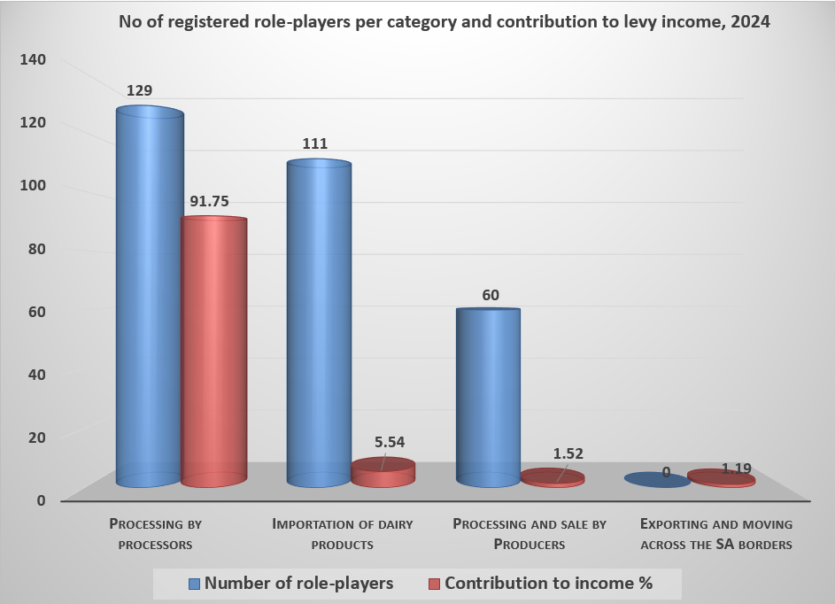
Number of registered role-players per category and their contribution to levy income, 2024

Slide 7
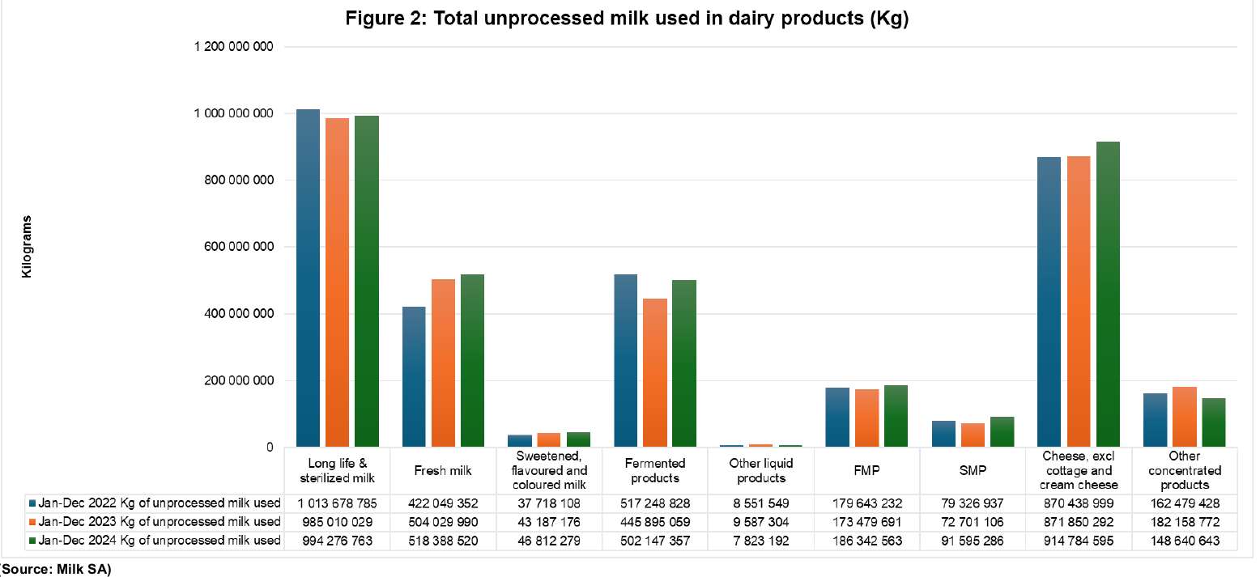

Unprocessed milk used in the manufacturing of milk and other dairy products

Slide 8
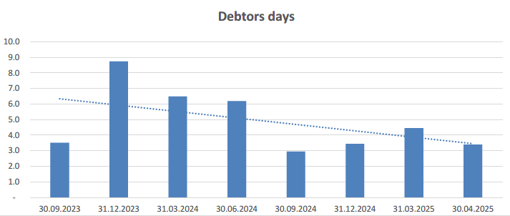
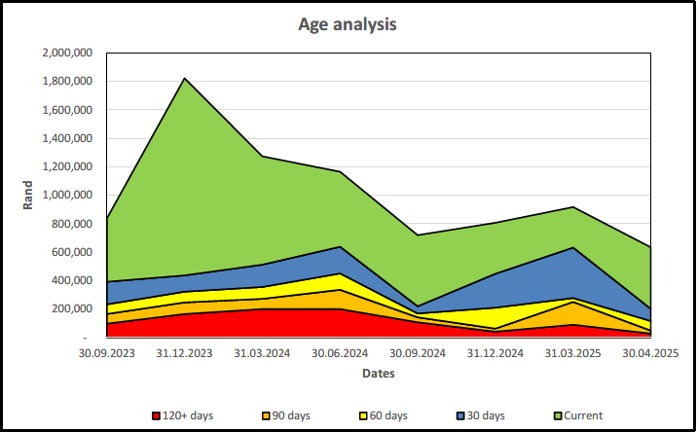
Debt (30 April 2025)
Total debt: R600 000; Provision for bad debt: R300 000

Slide 9
Conclusion
I can proudly say that over more than 20 years, Milk SA has optimally (but not always fully) utilized its resources, time and opportunities towards building this dairy industry.
I tip my hat to some stalwarts with statesmanship, whom we see here today … who might not be here tomorrow anymore … Those with a positive mindset who have brought the industry together and secured the foundation for the future.
I thank everyone who encouraged and supported me and the staff over the last 3 years, as we worked through and around a barrage of additional challenges.

