Slide 1

CEO Presentation
To the Members of Milk SA
At their General Meeting
25 November 2025

Slide 2
If you’ve landed the job,
Don’t just PROVE yourself …

Slide 3
Because the Boss wants you to constantly
IMPROVE

Slide 4
Milk SA has been given a job to do, and we have constantly IMPROVED in our -
Structures
Projects
Communication
Finances
Levy and return administration

Slide 5
New structures in the past few years
Customs duties & Market access project
Animal Health & Welfare programme
Environmental Sustainability programme
Dairy Regulations & Standards Project
The Project Coordination Committee
The Statutory Measures Committee

Slide 6
SIGNIFICANT IMPROVEMENTS IN PROJECTS
Information Products
  Monthly Dairy Digits
  Monthly milk flow
  Quarterly unprocessed (raw) milk conversion into products
  Quarterly review of the performance of the dairy industry
  Quarterly Import and Export report
  Quarterly Retail sales quantities and prices
  Biennial Lacto Data
  Annual International Farm Comparative Report
  Annual World Dairy Situation Report

Slide 7
CUSTOMS DUTIES & MARKET ACCESS
Trade negotiations and market access
Trade protection and tariff dispensation
Import and export monitoring
The effect of animal diseases on international trade
Notes:
Butter: 2010 agreement with EU for 100 tonnes in 20kg chunks.
IIP Botswana
VPN20 (Standards for registration of a vet approved dairy establishment)
Chem Residue Programme

Slide 8
Regulations and Standards Project
The regulatory landscape relating to milk and other dairy products is of multi-dimensional nature, and involves regulations in different domains …
Participation in the formalisation of draft regulations and standards and comments on regulatory matters, as well as communication through Milk SA in the interest of the dairy industry and other stakeholders.
Participation in the African Organisation for Standardisation (ARSO) technical committee
Nejahmogul saga: The project saved PD’s and Processors ±R60 mil p.a.
Notes:
Product composition
Food safety
Animal health and welfare
Animal feed
Milking parlours
Transportation of milk
Processing plants
Storage
Environmental management
Export requirements

Slide 9
Legislation and Standards

Slide 15
5. Codex Standards

Slide 19
Communication initiatives
Monthly You Tube interviews – Plaas Media
Radio talks – RSG Landbou
Dairy Monthly
Technical and Policy articles – Stock Farm / Veeplaas
DSA webinars
Dairy Regulations and Standards webinars
Consumer education webinars
Animal health & welfare webinars

Slide 20
STATUTORY MEASURE ADMINISTRATION
We have all the ingredients for a sound admin system, and the proof is in the pudding –
  Highly competent staff
  Management Information Systems
  Legal action
  Debt management
  Ministerial Inspectors
Debt stood at 2,6 debtors days on 31 October 2025 (The Pudding)

Slide 21
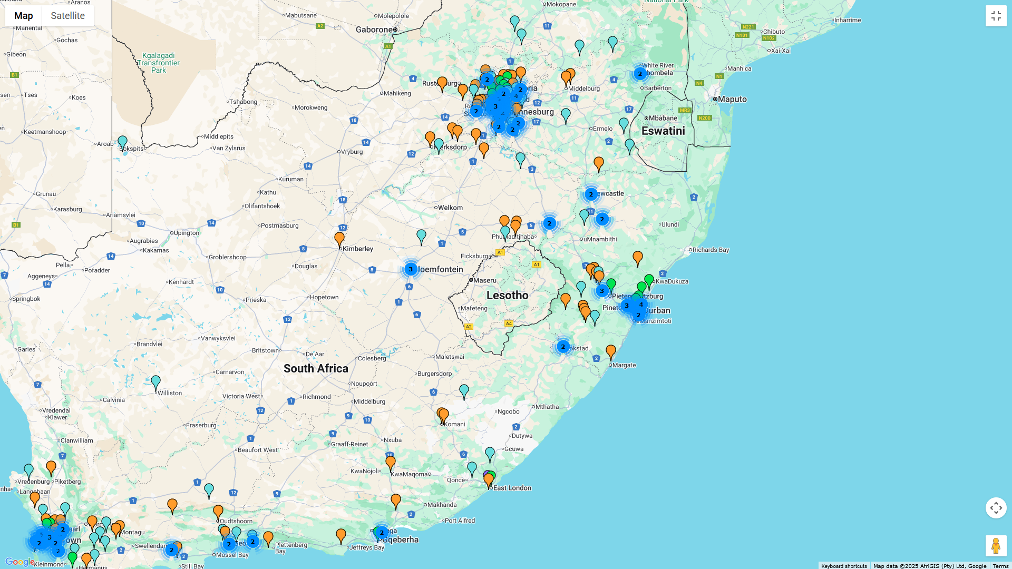

Slide 22
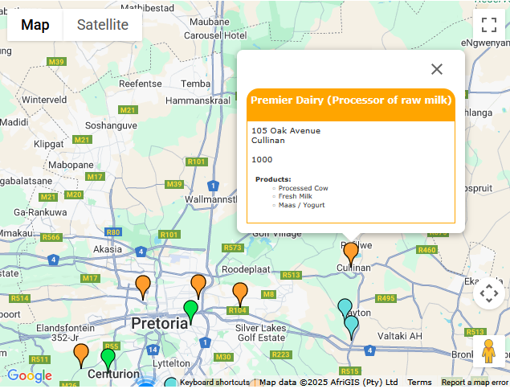

Slide 23
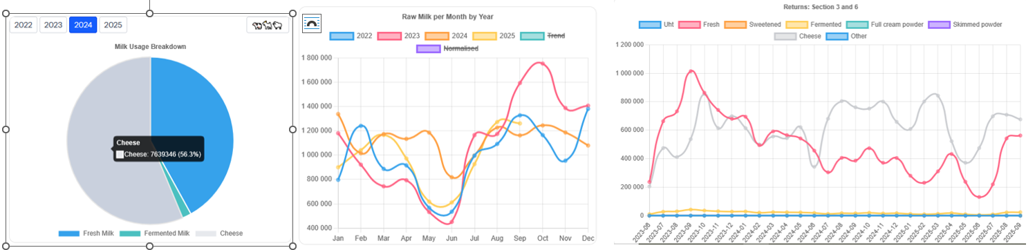
Management Information System: Milk SA

Slide 24
People: Our most valuable asset
Milk SA Staff, Project Managers, Directors …
Common understanding of the purpose of Milk SA is key to our success.
The camaraderie amongst us makes every day a song!
Together, we motivate each other to IMPROVE every day.

