Slide 1

Milk SA Project: Economies and Markets
Presentation for the General MilkSA meeting 26 November 2026
Prepared by B van Heerden

Slide 2
International economy
International dairy situation
SA economic situation
SA dairy situation

Slide 3
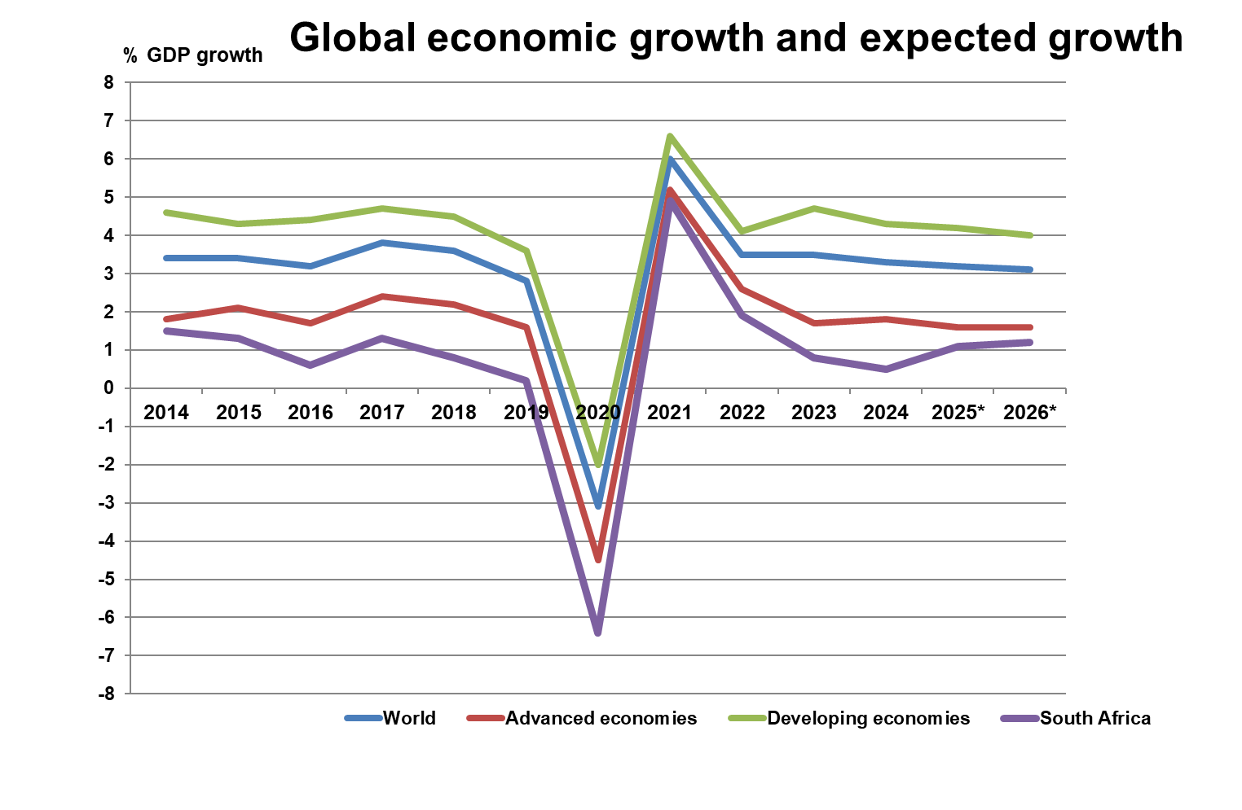
.
Estimated growth in 2025:
World = 3.1%
Developing econ = 4.2%
Advanced econ = 1.6%
South Africa = 1.1%
Global economy in flux, Prospects remain dim
Source: IMF, WEO October 2025 (*estimate) (** forecast)
Notes:
Difference/change from October 2024 WEO for:
World = -0,4%
Advanced = -0,4%
Developing = -0,5%
SA growth = -0,5%
www.imf.org/en/Publications/WEO/Issues/2025/04/22/world-economic-outlook-april-2025

Slide 4
.

Slide 5
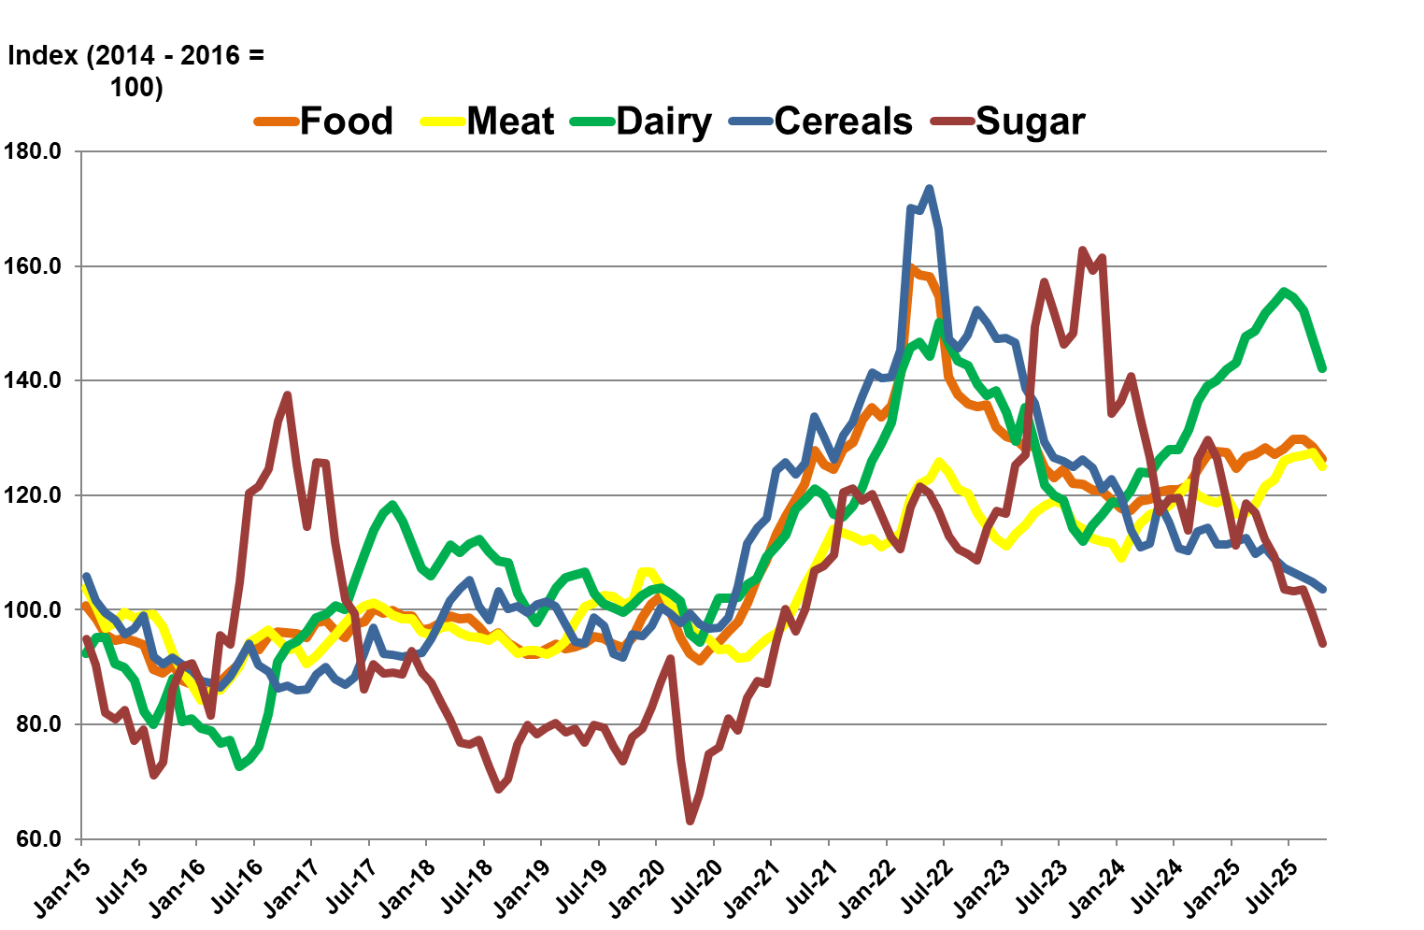
FAO food price indices January 2015 – October 2025
Source: FAO, November 2025
Notes:
The upward trend in the FAO Dairy Price Index reflects a supply-demand imbalance, where limited global supply, particularly in Oceania, and robust international demand have pushed dairy prices upward across all major product categories.
Farmers also face pressures to implementing sustainability goals on their farms, without measurement/outcome shown, the tighter it is to receive subsidies – making it challenging for farmers to produce at maximum production levels.
https://www.fao.org/worldfoodsituation/foodpricesindex/en/

Slide 6
International economy
International dairy situation
SA economic situation
SA dairy situation

Slide 7
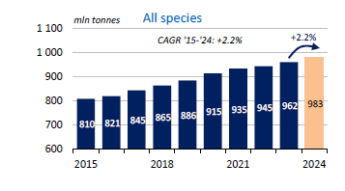
Global Unprocessed Milk Production Growth between 2015 and 2024
Source: IDF Bulletin 537/2025
Notes:
The GDT support level holding at 860 points indicates strong buyer interest and a price floor where the market tends to rebound. The shift in resistance from 1,150 to 1,300 points since October 2024 signals increased price tolerance and stronger demand, suggesting a more optimistic market outlook. This upward shift reflects confidence in global dairy prices, likely driven by factors such as tighter supply, higher production costs, and robust import demand. Overall, it points to a bullish trend in the dairy market.
https://www.globaldairytrade.info/en/product-results/

Slide 8
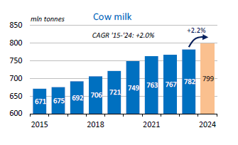
Global Unprocessed Cow Milk Production Growth between 2015 and 2024
Source: IDF Bulletin 537/2025
Notes:
The GDT support level holding at 860 points indicates strong buyer interest and a price floor where the market tends to rebound. The shift in resistance from 1,150 to 1,300 points since October 2024 signals increased price tolerance and stronger demand, suggesting a more optimistic market outlook. This upward shift reflects confidence in global dairy prices, likely driven by factors such as tighter supply, higher production costs, and robust import demand. Overall, it points to a bullish trend in the dairy market.
https://www.globaldairytrade.info/en/product-results/

Slide 9
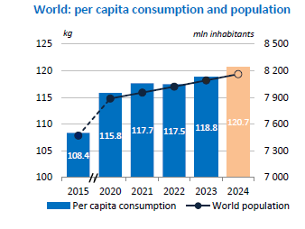
World population and per capita dairy consumption
SA 2024: 48.8
Source:IDF World Dairy Situation 2025
Notes:
From 2015 to 2023, average per capita milk consumption increased by 11 kg to more than 119 kg, representing a 10% growth over this period. The 2024 per capita dairy consumption is not yet released.
https://milksa.co.za/sites/default/files/2024-12/2024%20World%20Dairy%20Situation%20Report.pdf

Slide 10
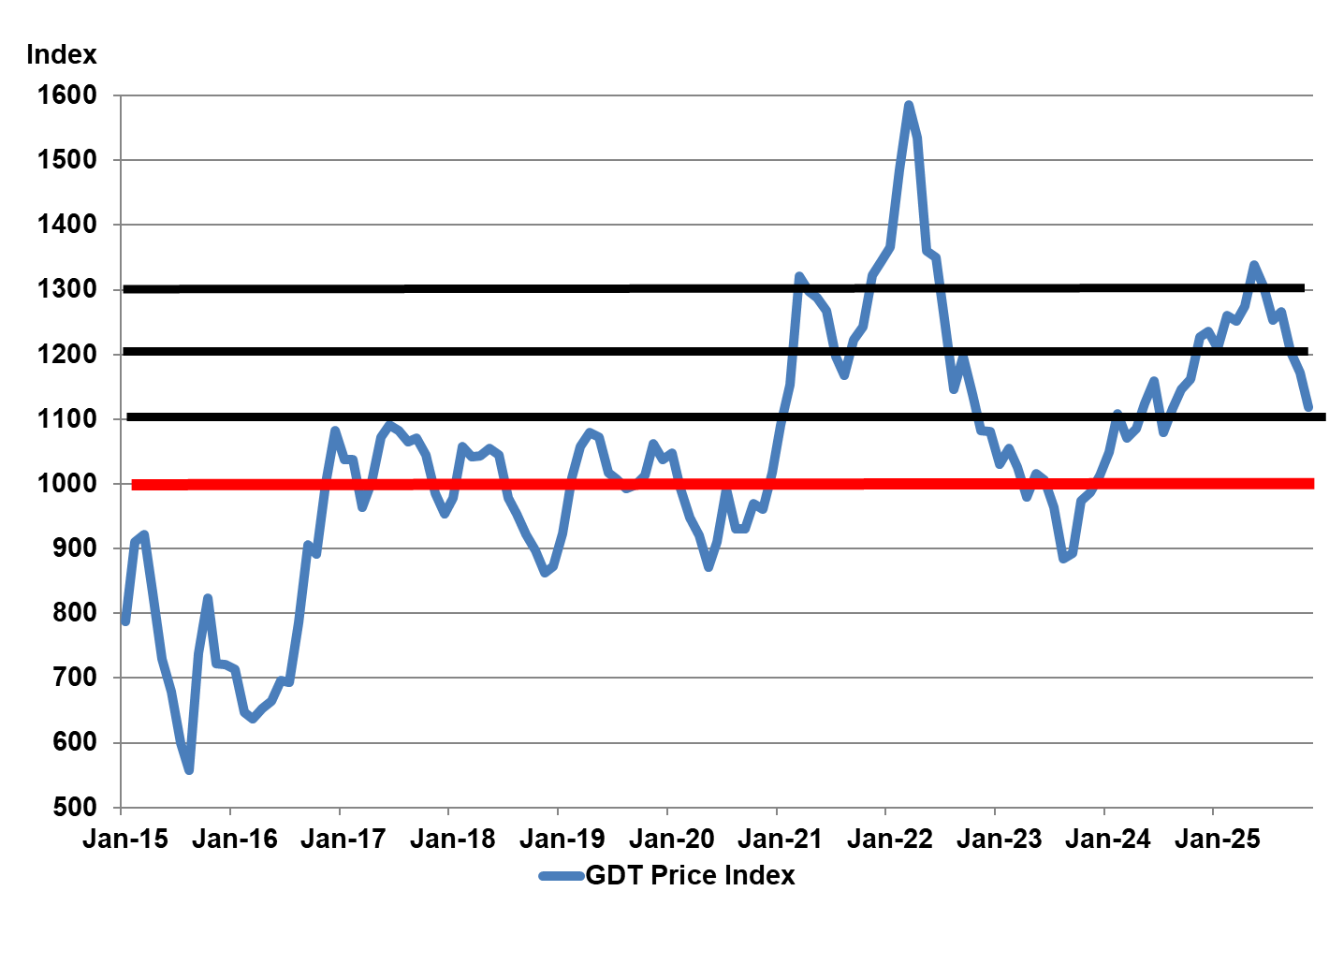
Global Dairy Trade Auction Price Index of Dairy Products (GDT) January 2015 – November 2025
Source: GDT Events
Notes:
The GDT support level holding at 860 points indicates strong buyer interest and a price floor where the market tends to rebound. The shift in resistance from 1,150 to 1,300 points since October 2024 signals increased price tolerance and stronger demand, suggesting a more optimistic market outlook. This upward shift reflects confidence in global dairy prices, likely driven by factors such as tighter supply, higher production costs, and robust import demand. Overall, it points to a bullish trend in the dairy market.
https://www.globaldairytrade.info/en/product-results/

Slide 11
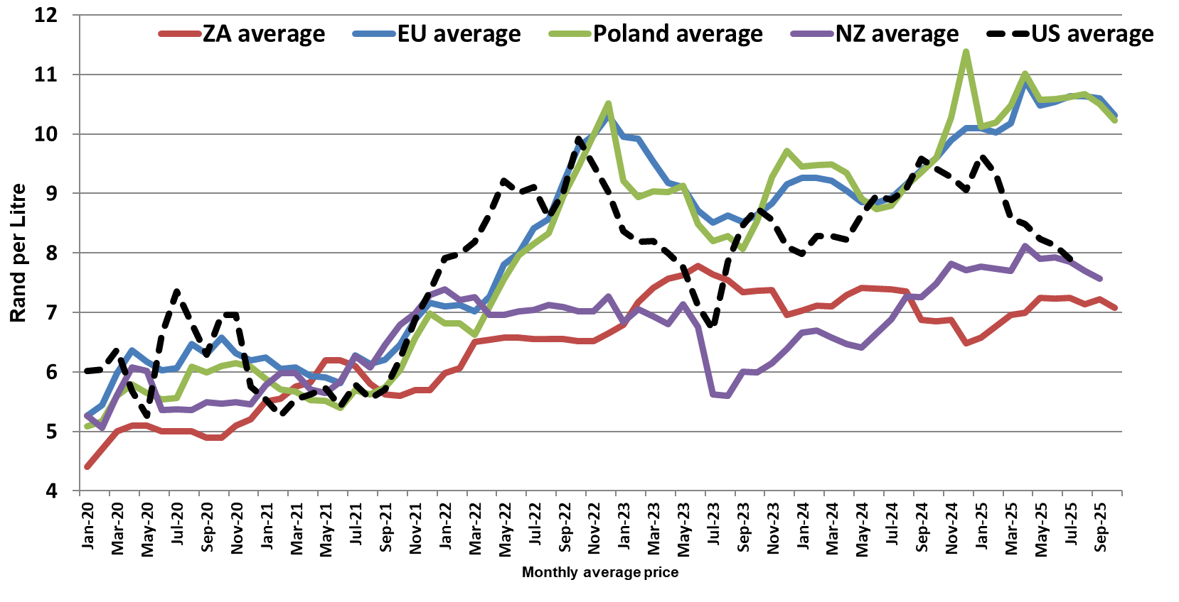
Average European, Poland, NZ, USA and SA producer prices, of unprocessed milk, R/litre, Jan 2020 – Oct 2025 (latest two month preliminary)
Source: European Commission, CLAL, MPO and SARB

Slide 12
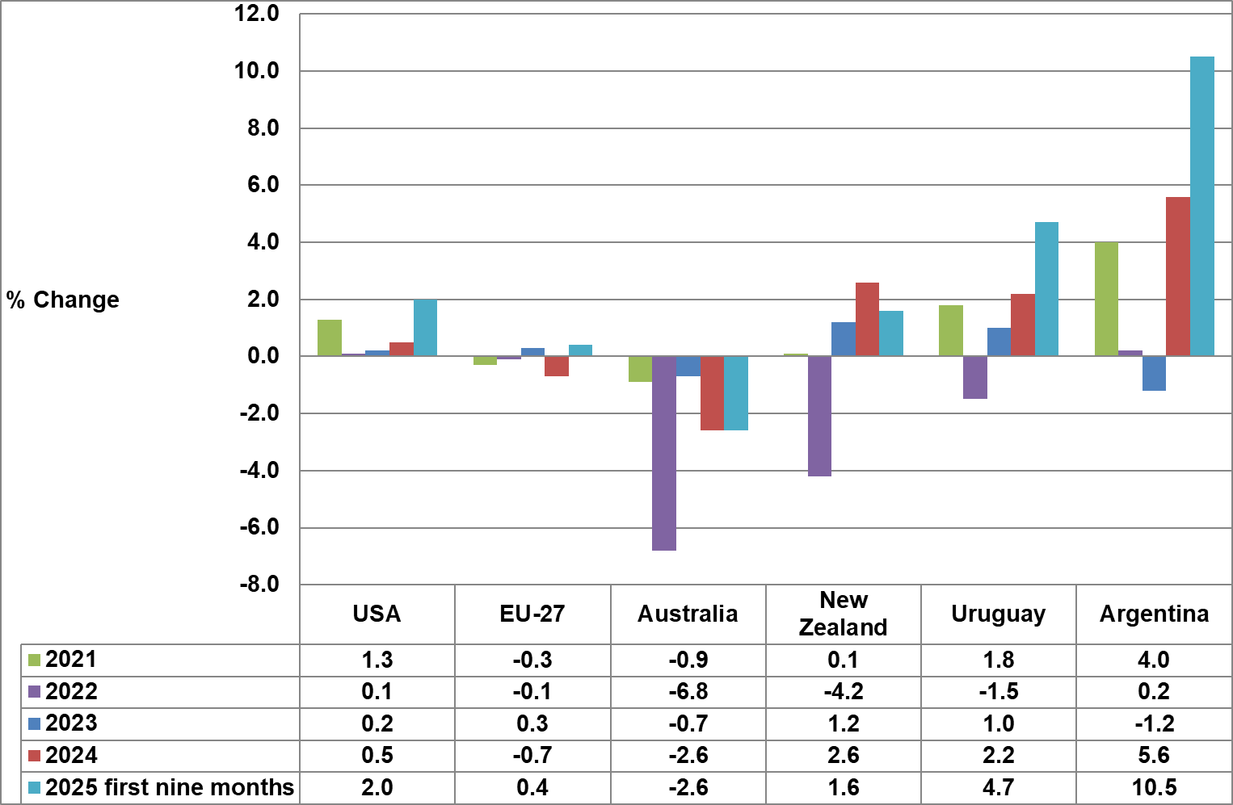
Unprocessed milk production growth in key exporting countries
Source: CLAL Advisory
Notes:
USA: https://www.clal.it/en/index.php?section=produzioni_usa_latte_bovino
EU-27: www.clal.it/en/index.php?section=consegne_eu&p=D1110D__THS_T
Aus: https://www.clal.it/en/index.php?section=consegne_australia
NZL: https://www.clal.it/en/?section=stat_newzealand
Uru: https://www.clal.it/en/index.php?section=consegne_uruguay
Arg: https://www.clal.it/en/index.php?section=milk_production_argentina

Slide 13
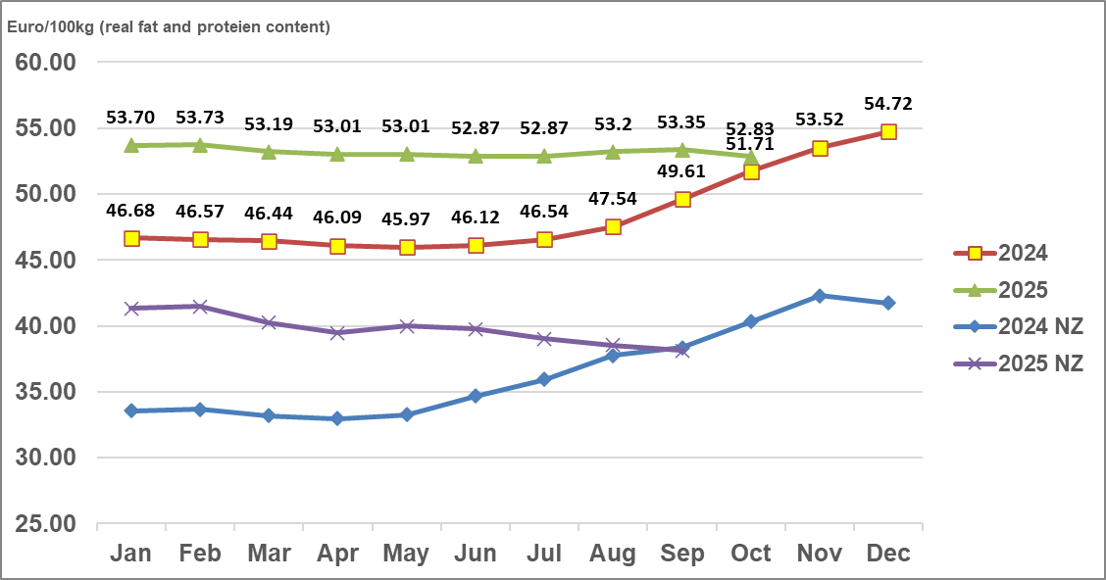
Average European, and NZ, producer prices, of unprocessed milk, Euro/100kg, Jan 2024 – Oct 2025 (latest two month preliminary)
Source: European Commission, CLAL
Notes:
https://agridata.ec.europa.eu/extensions/DashboardRawMilk/RawMilkPrices.html

Slide 14
International economy
International dairy situation
SA economic situation
SA dairy situation

Slide 15
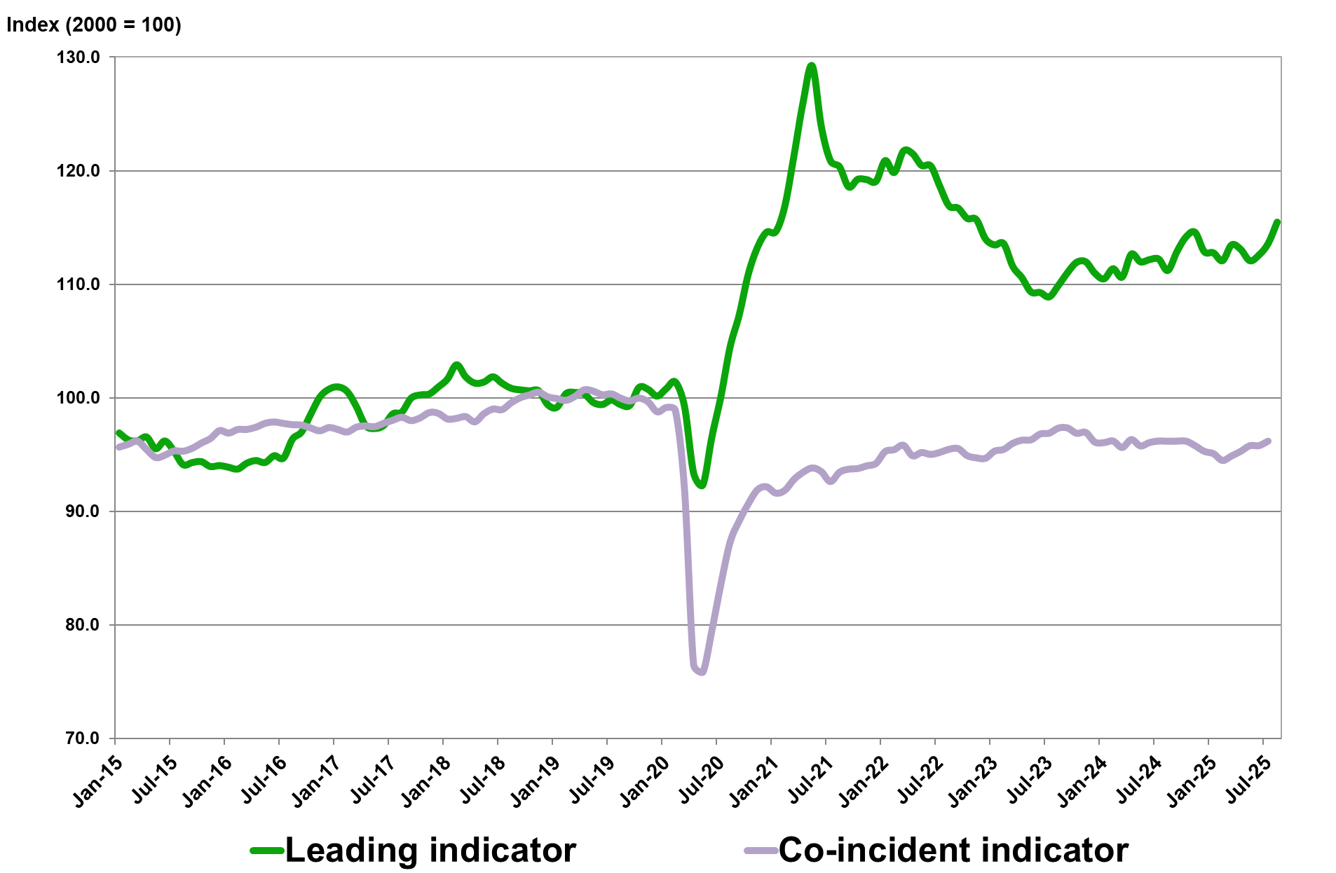
Business cycle indicators: Leading and the Co-incident Indicator
January 2015 – August 2025
Source: SA Reserve Bank

Slide 16
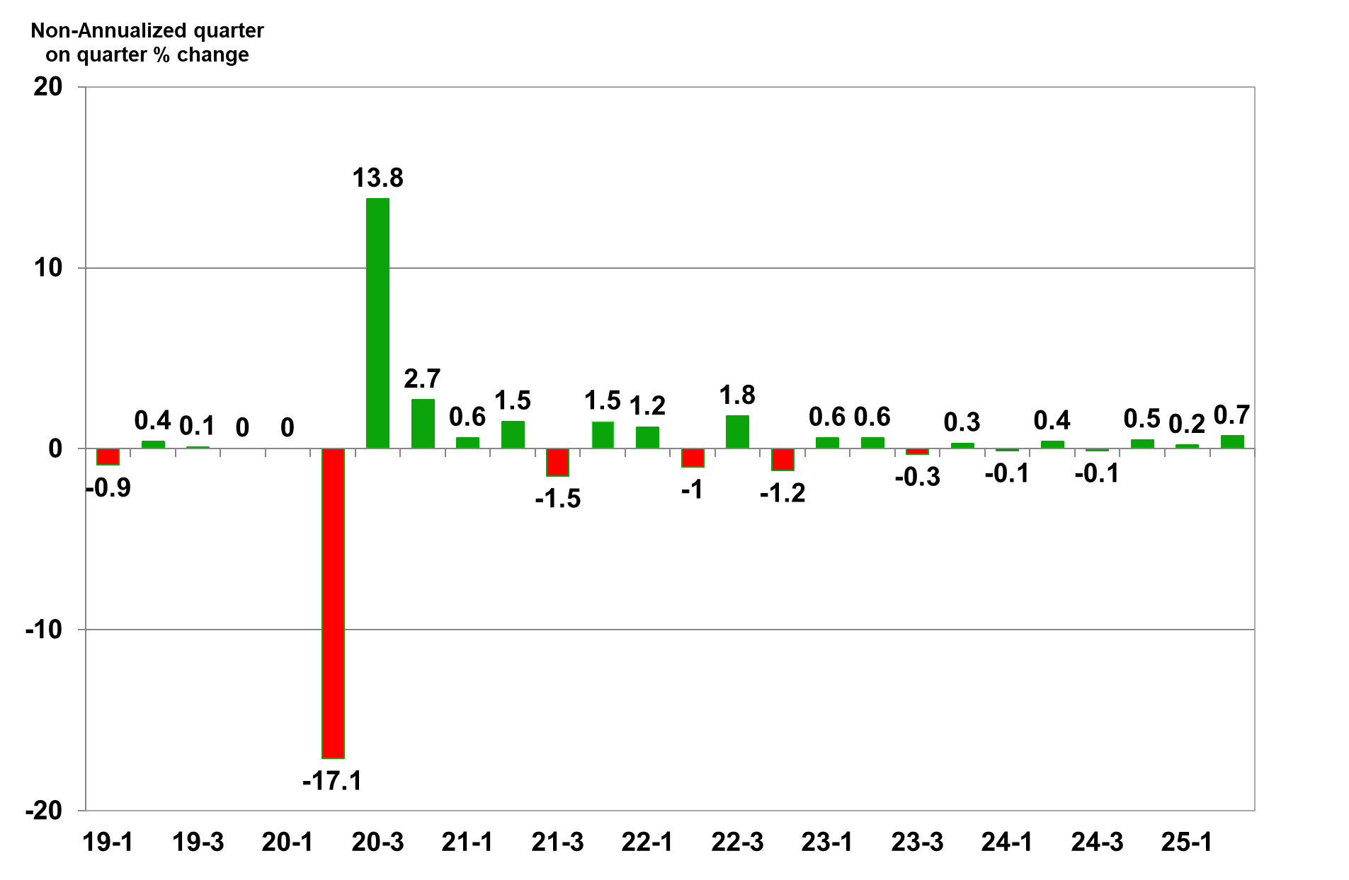
Quarterly economic growth in SA (seasonally adjusted), 2020 – 2025 (base year 2015)
Source: Stats SA

Slide 17
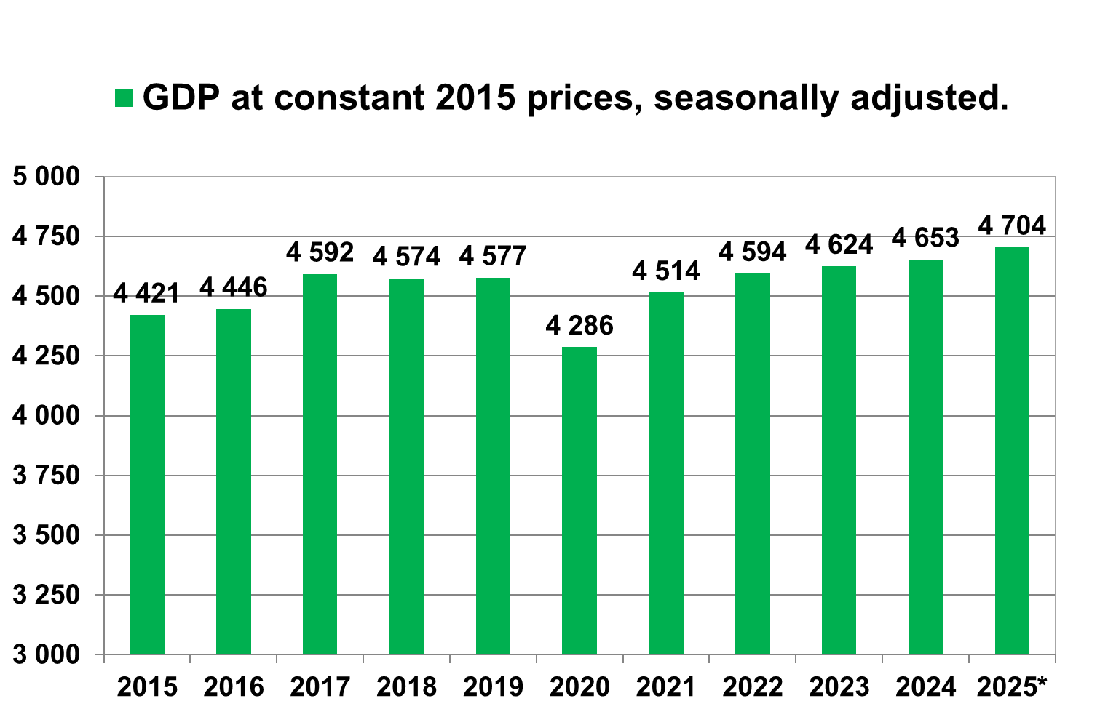
Annual SA GDP at 2015 constant prices
2015 – 2025 (R billion)
Population average growth: 1.33%; GDP growth 1.1%
Source: Stats SA, * projected by the October IMF WEO.

Slide 18
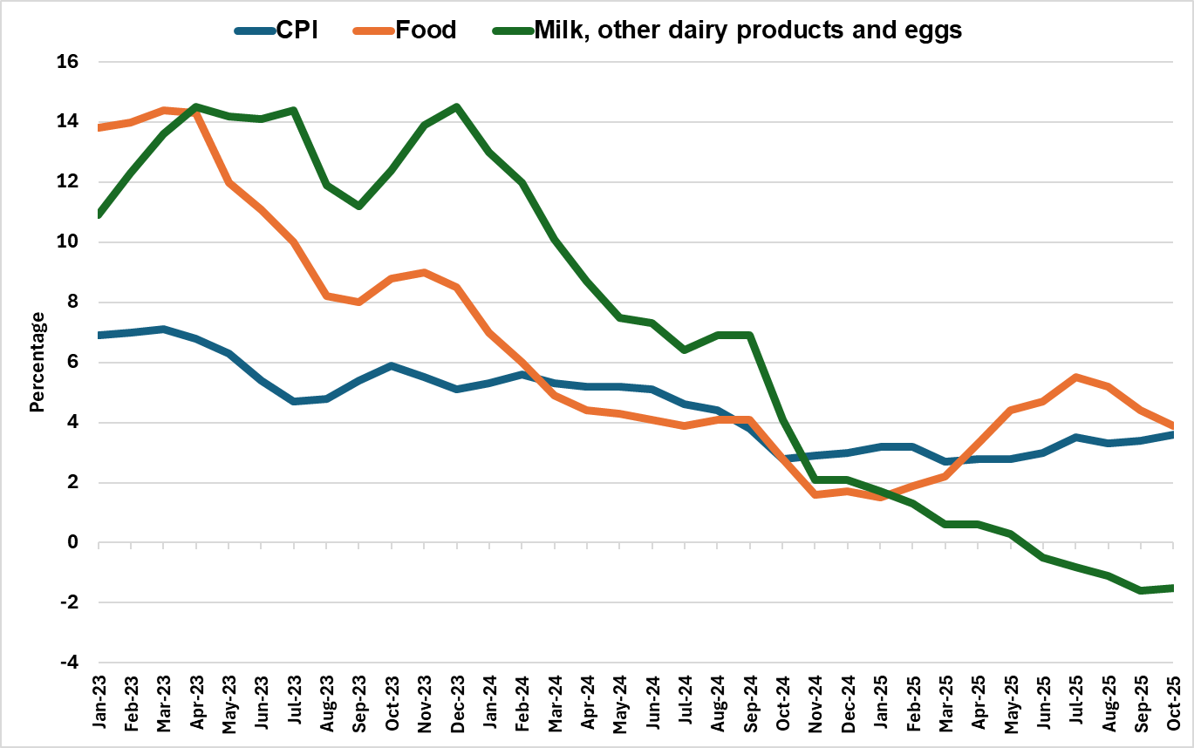
Consumer price inflation (CPI) headline, food & milk, other dairy products and eggs inflation in SA, January 2023 – October 2025
Source: Stats SA
Notes:
The Consumer Price Index (CPI) for milk, other dairy products, and eggs has indeed been lower than both the overall CPI and the food CPI. This trend indicates that the prices have become more stable or even decreased, offering some relief to consumers, we have observed lower prices for some dairy products. However, it's important to note that this can also reflect a decrease in their weighting within the CPI basket, suggesting reduced consumption, particularly among lower-income households.

Slide 19
International economy
International dairy situation
SA economic situation
SA dairy situation

Slide 20
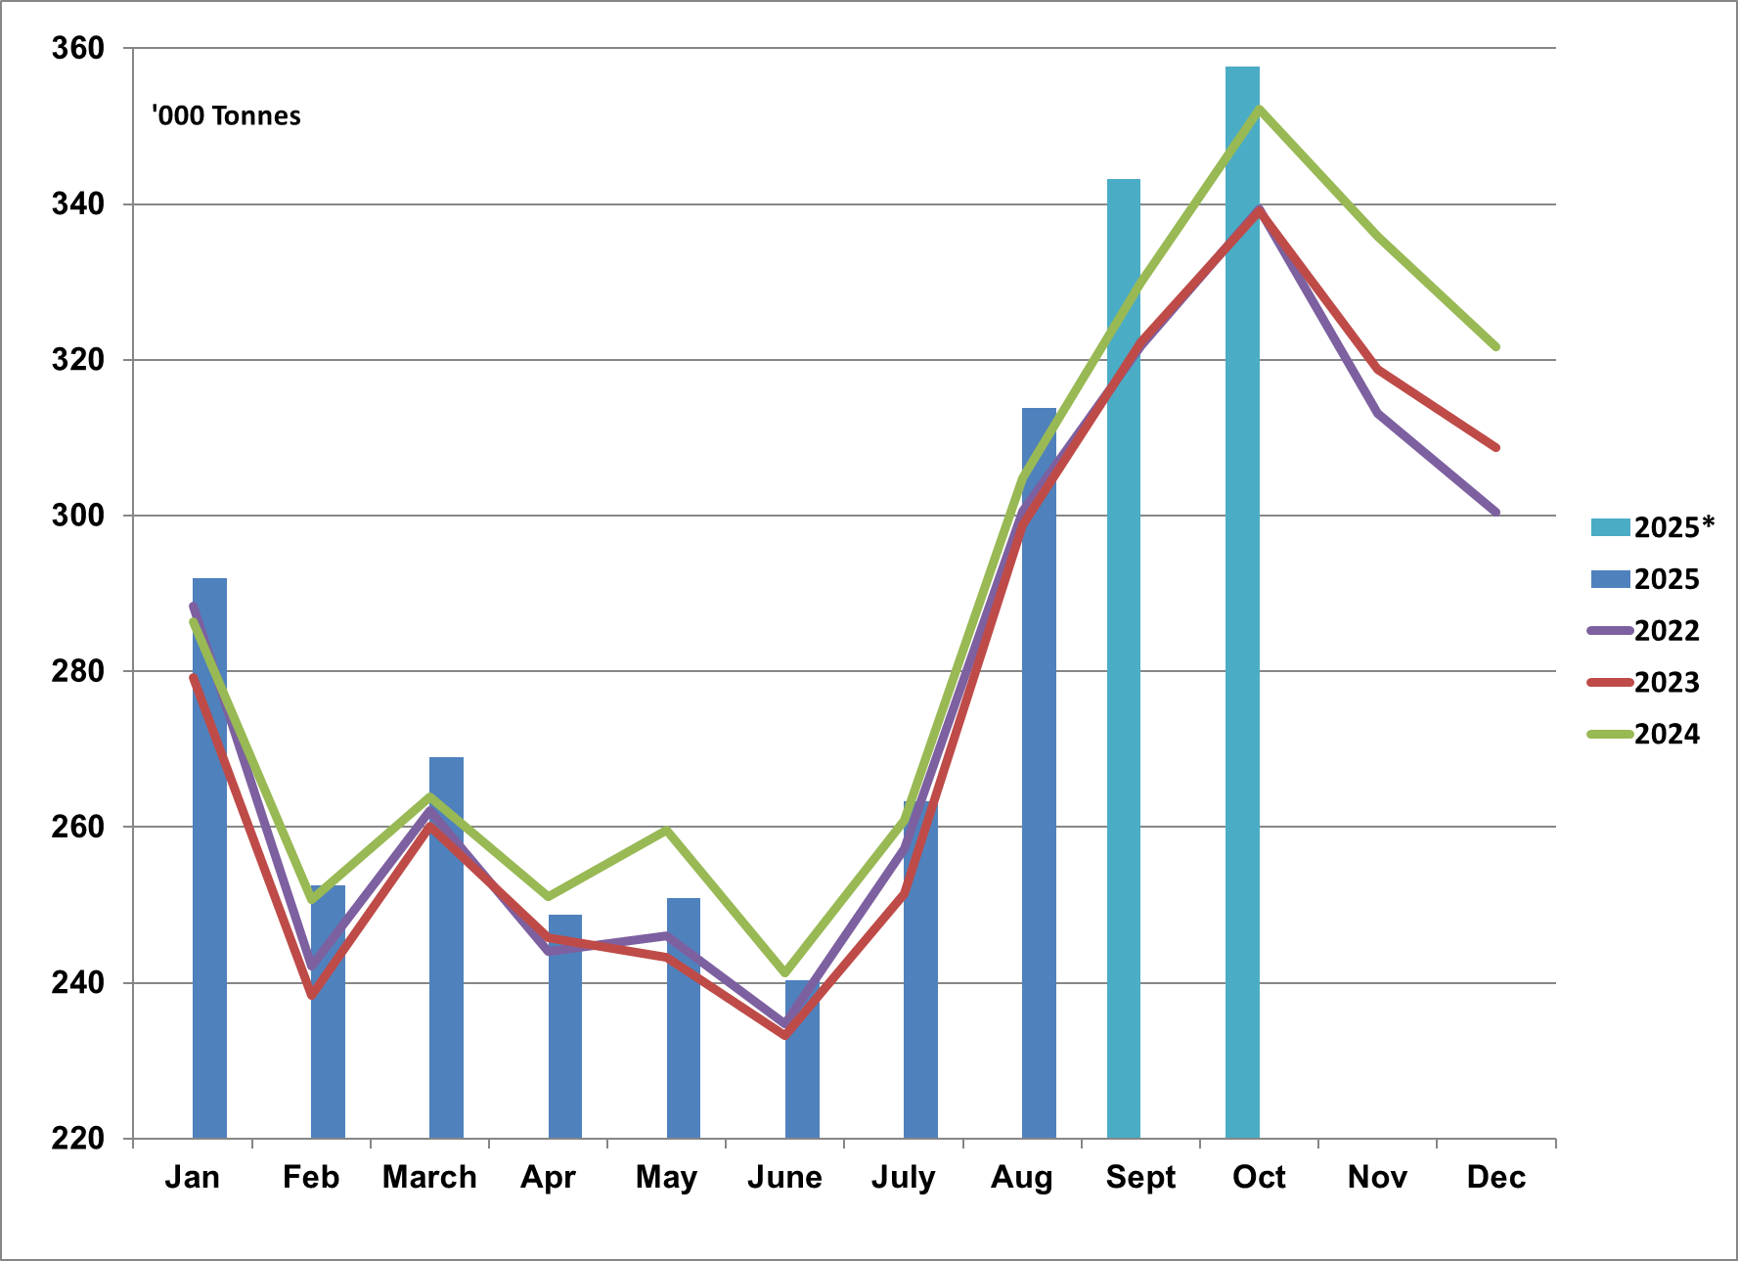
Monthly unprocessed milk purchases: January 2022 – October 2025
Source: Milk SA; *September and October preliminary

Slide 21
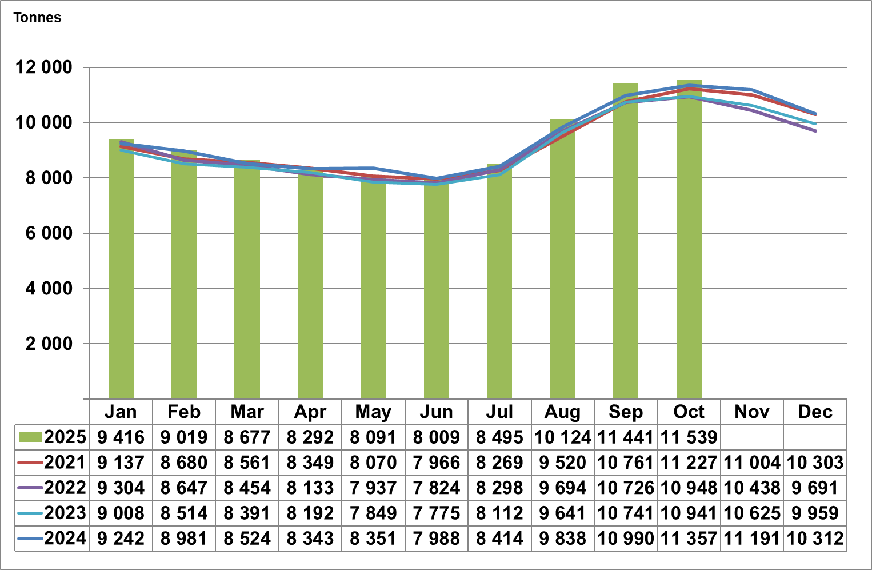
Monthly daily average unprocessed milk purchases:
January 2021 – October 2025
Source: Milk SA; September and October 2025 preliminary

Slide 22
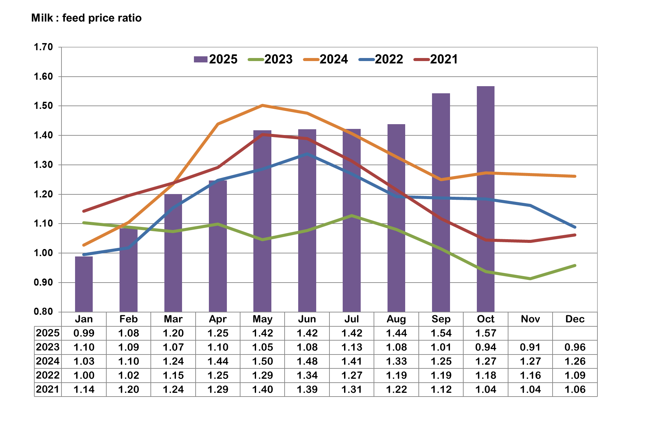
Maize (70%) and Soybean (30%) Price Ratio:
January 2021 – October 2025
Source: SAFEX and MPO

Slide 23
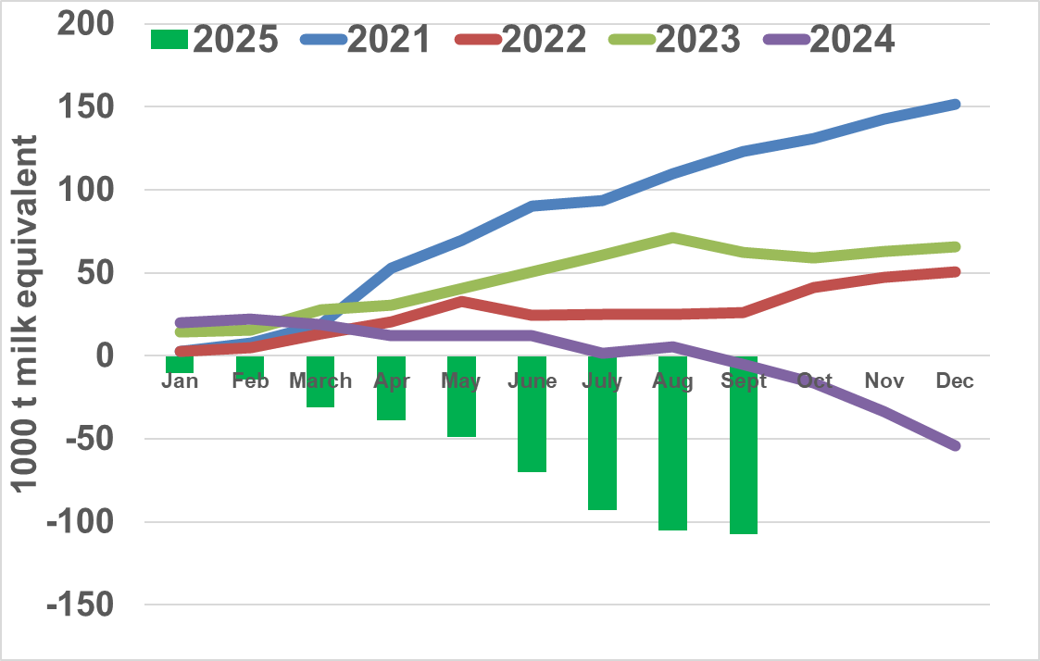
Monthly cumulative net imports, milk equivalent:
January 2021 to September 2025
Source: SARS as supplied by SAMPRO

Slide 24
Annual purchases of unprocessed milk plus milk equivalent of net imports = Total supply: 2013 - 2024
Source: SAMPRO, MPO, MILK SA,

Slide 25
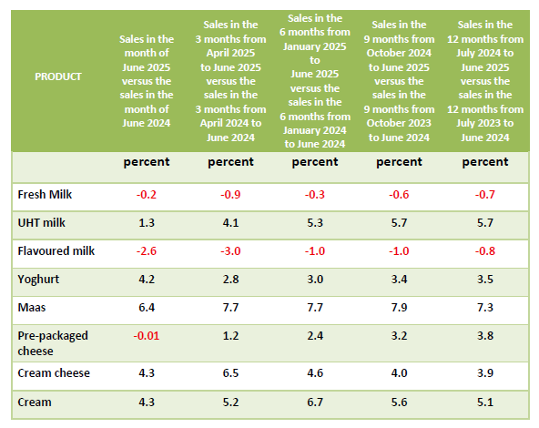
Changes in the quantities of retail sales of specific dairy products
Source: SAMPRO based on NielsenIQ June 2025 report

Slide 26
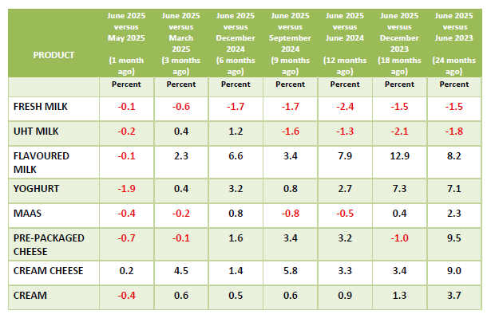
Changes in average retail prices of specific dairy products
Source: SAMPRO based on NielsenIQ March 2025 report

Slide 27
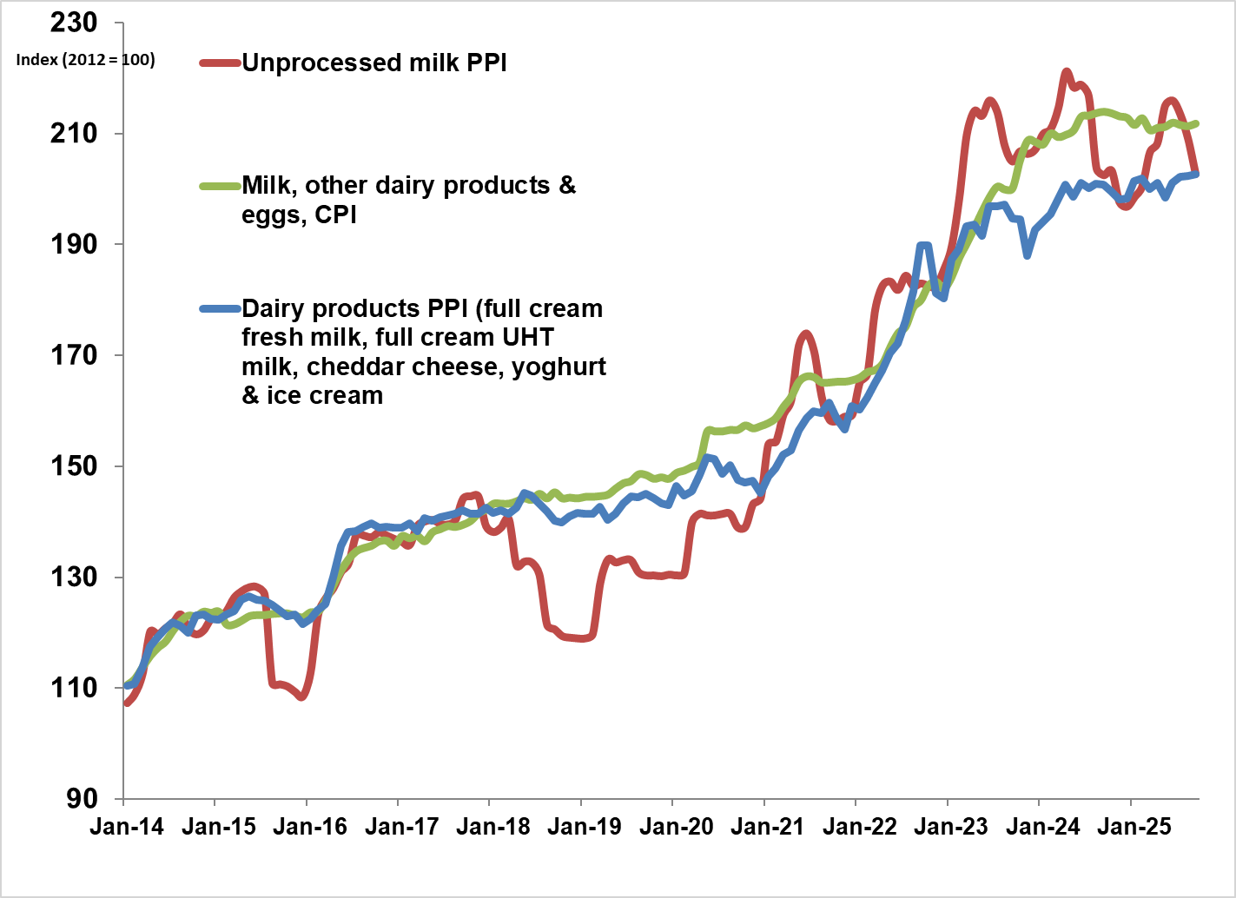
PPI Indices of unprocessed milk and dairy products and the CPI of milk, cheese and eggs: January 2014 – September 2025
Source: Stats SA

Slide 28

Thank you

Slide 29
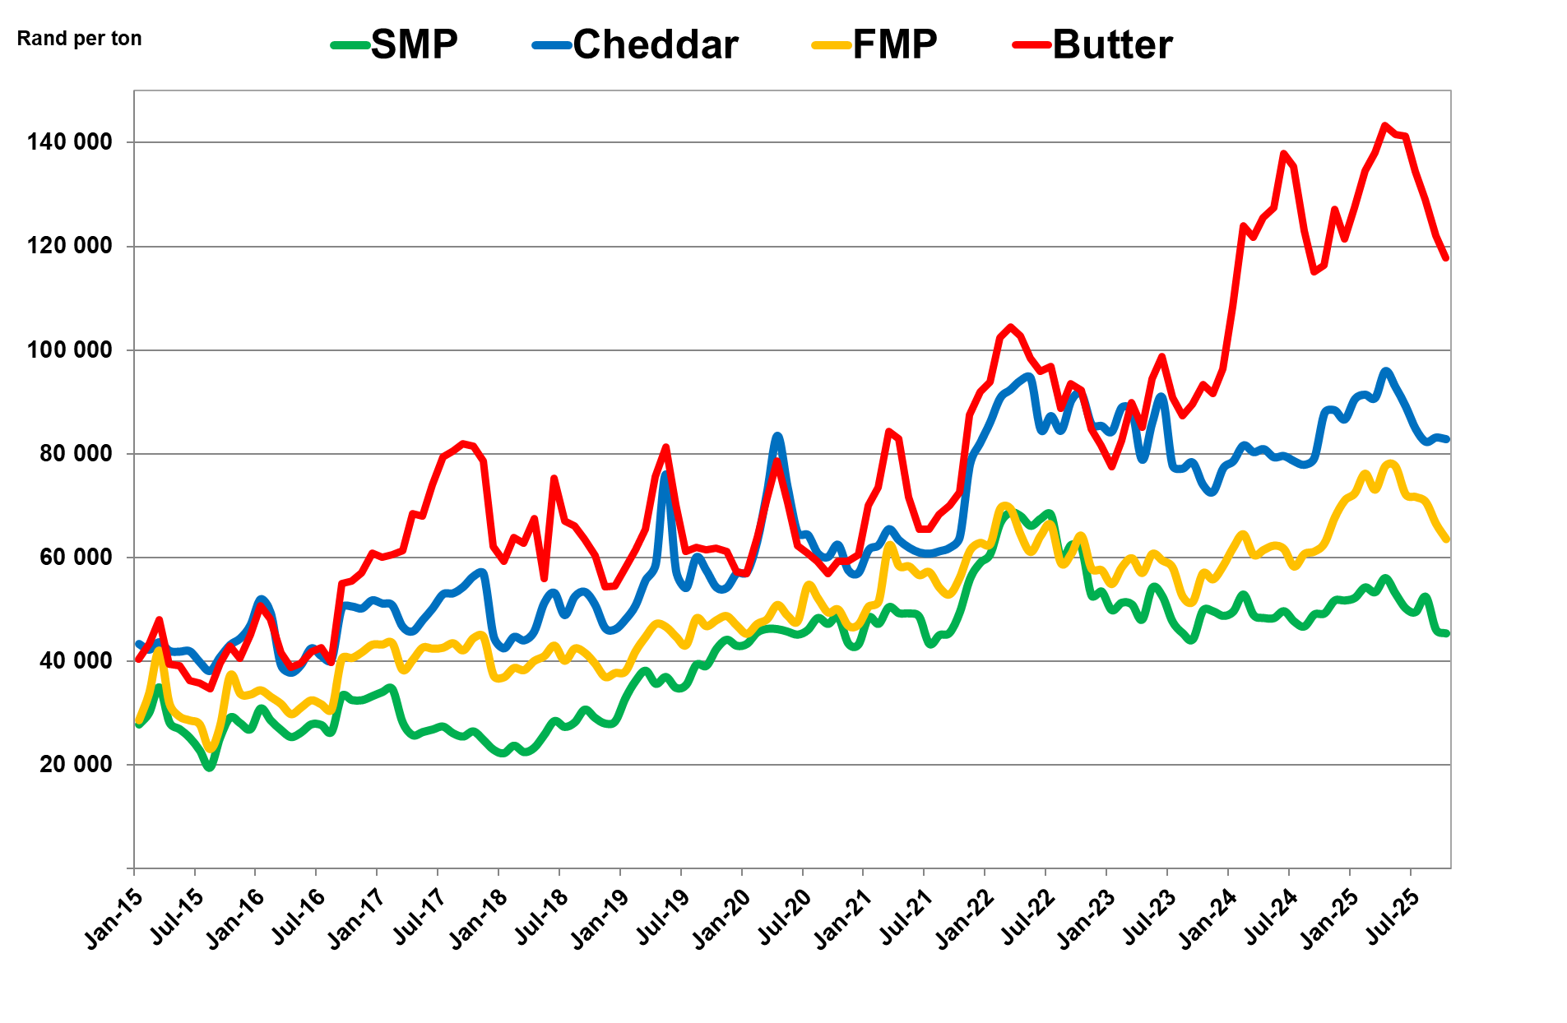
International prices of dairy products January 2015 – Oct 2025
Source: USDA, South African Reserve Bank for exchange rate
Notes:
The international dairy product prices have experienced varied movements. The price dynamics reflect a complex interplay of factors, including supply constraints due to weather challenges, shifting demand patterns, and geopolitical influences.
Butter prices stayed high into 2025 due to ongoing supply shortages caused by droughts and higher production costs, combined with strong global demand—especially in Asia and the Middle East. Producers also shifted more milk to higher-profit products like cheese, limiting butter availability. This tight supply and robust demand kept prices elevated throughout the year.

Slide 30
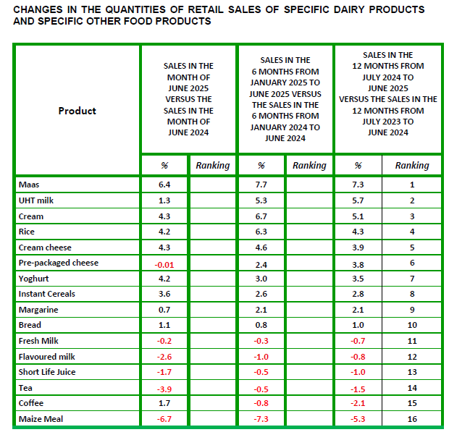
Changes in average retail prices of specific dairy products
Source: SAMPRO based on NielsenIQ March 2025 report

Slide 31
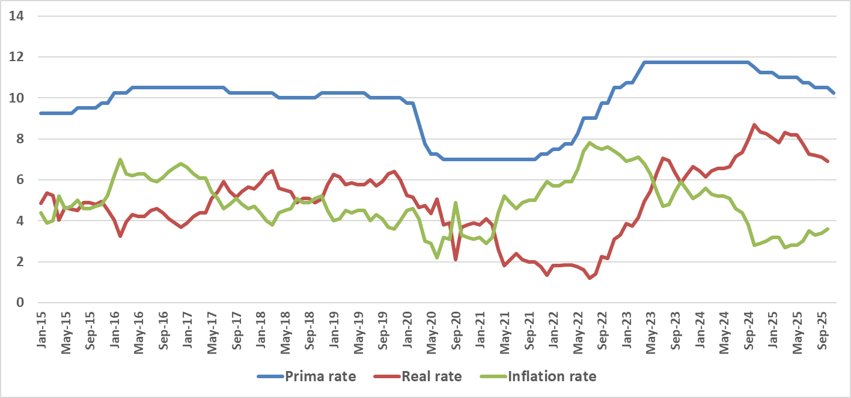
Prime interest rates in South Africa, January 2015 – November 2025
Source: Stats SA, SARB
Notes:
https://www.resbank.co.za/en/home/what-we-do/statistics/key-statistics

